Slide 1
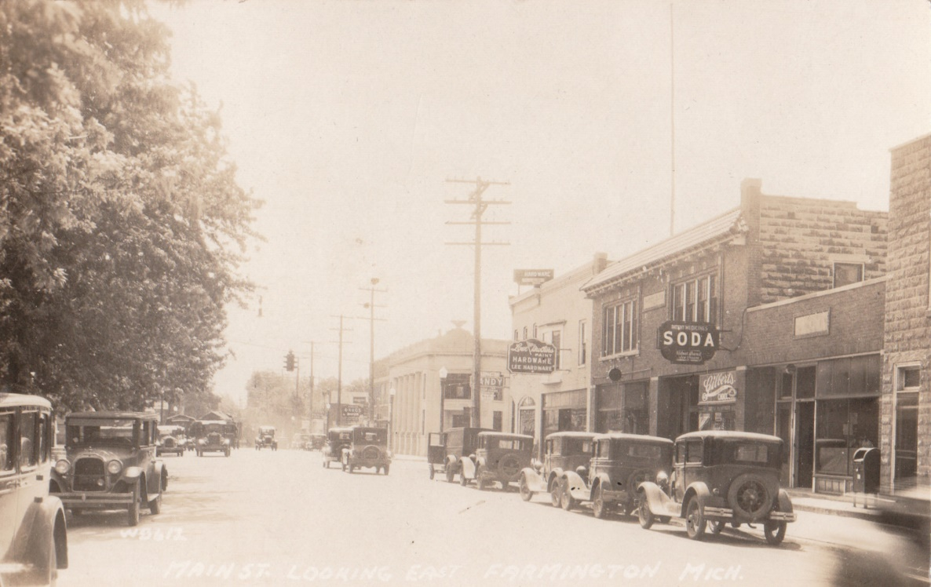
Architectural Styles of Farmington and the Hills
Brought to you by Preservation Farmington

Slide 2
How Styles Change
Architectural styles are influenced by many factors, creating a continuing momentum of change. We’ll look at some of the factors now.
War and Politics
The American Revolution and our newly formed democracy created a fervor around all things Greek. The Federal style took over from the Georgian style, and it emphasized Greek classicism. It featured columns, palladian windows and pedimented porticos among others. Non-residential buildings utilized the Classical Orders to a greater extent.
Soldiers returning from the Second World War created a need for a lot of housing built quickly with a scarcity of materials. Technologies which had been created earlier in the

Slide 3
How Styles Change
century, but weren’t widely used, became the norm. The proliferation of the Minimal Traditional style is an example of the result.
Technology
From hand-forged nails to steel I-beams, construction technology plays a huge part in how styles change. Earlier styles have multi-paned windows, not because it was a design choice but because only small panes of glass could be blown. With advancements in glass manufacturing, larger panes could me and styles changed incorporating design choices.

Slide 4
How Styles Change
Reactions
Reactions to prior styles created changes in aesthetics. The formal classicism of the Georgian and Federal styles brought about the free interpretation of that classicism in Greek Revival and Italianate structures.
Economics
The cost of building influenced many designs as much as other factors. The Craftsman Bungalow was considered an affordable, small but attractive housing option. The Minimal Traditional style was also driven by economics, as low-cost homes were in demand for the Baby Boomer generation.

Slide 5
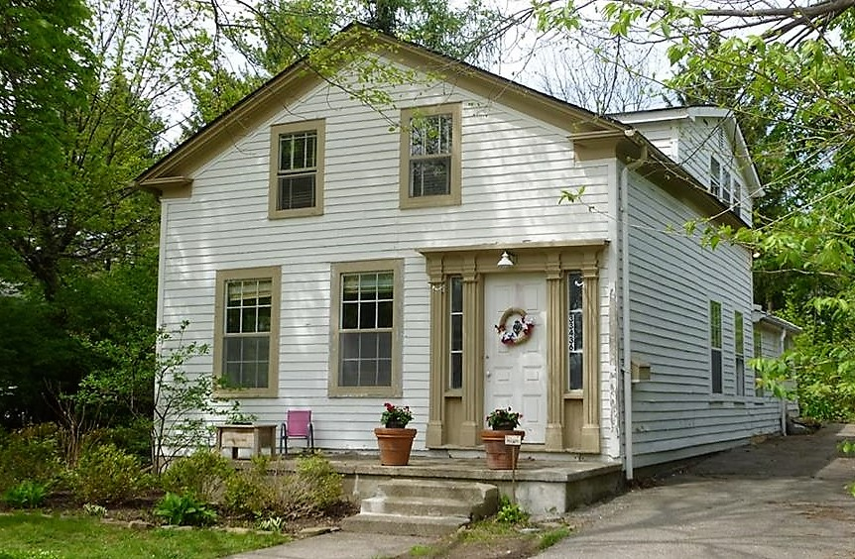
Greek Revival ca. 1825-1860
The Greek Revival style is easily recognizable and is the style most frequently found in our community’s earliest architecture. As with the Italianate style, this less formal style was a reaction to the formal Roman classicism of the end of the prior century .
Greek Revival homes are most often wood clad, though rare masonry examples like our Harger House can be found.

Slide 6
Greek Revival Characteristics
Eave returns
Doors can be single or paired
Doors are usually one, two or four paneled
Door surrounds often have sidelights and/or transoms
Pedimented or simple entablatures over doors
Columns and pilasters are found in door surrounds
Windows are usually six-over-six light
Partial porches on gable front and wing
Wood cladding is most common

Slide 7
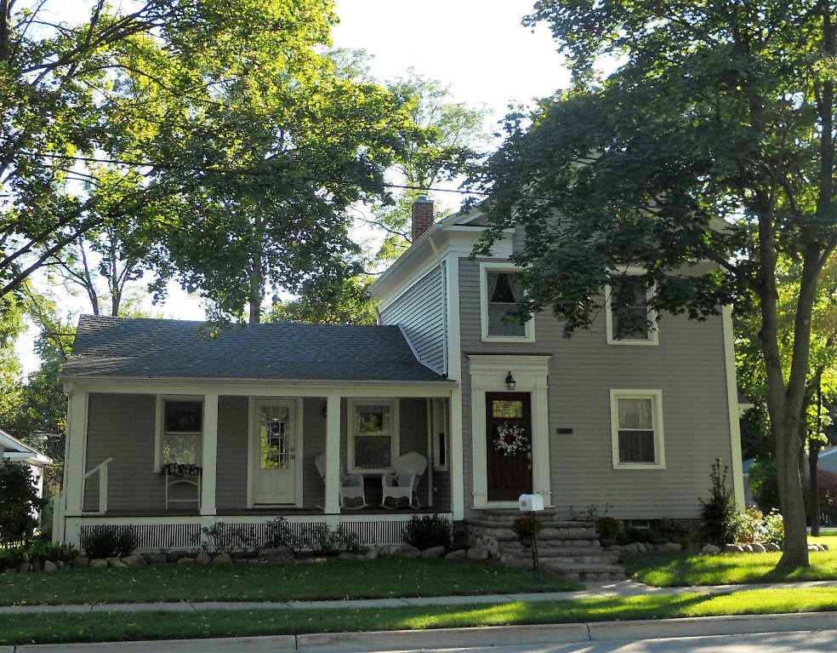
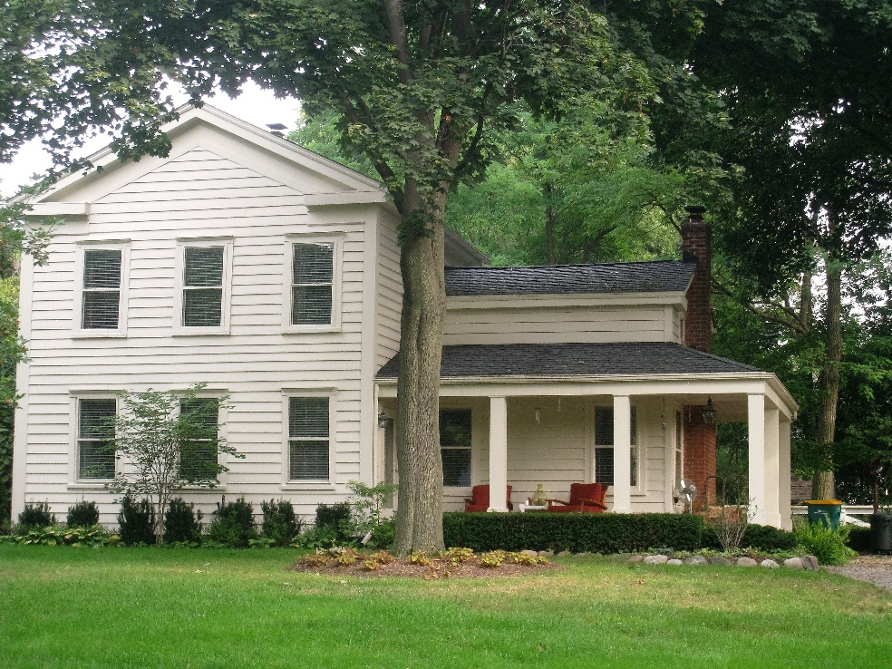
The classic farmhouse style:
Gable Front and Wing Greek Revival

Slide 8
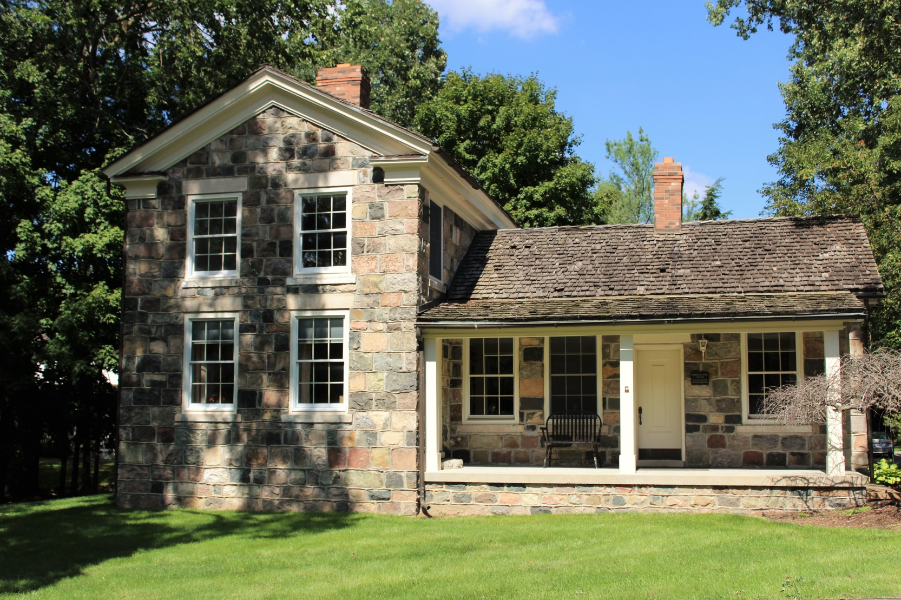
Greek Revival – Stone Gable Front and Wing
John Dallas Harger House, ca. 1837
Twelve Mile Road Farmington Hills
Eave Returns
Simple stone sills and lintels
Six-over-Six Light Windows
Partial Width Porch

Slide 9
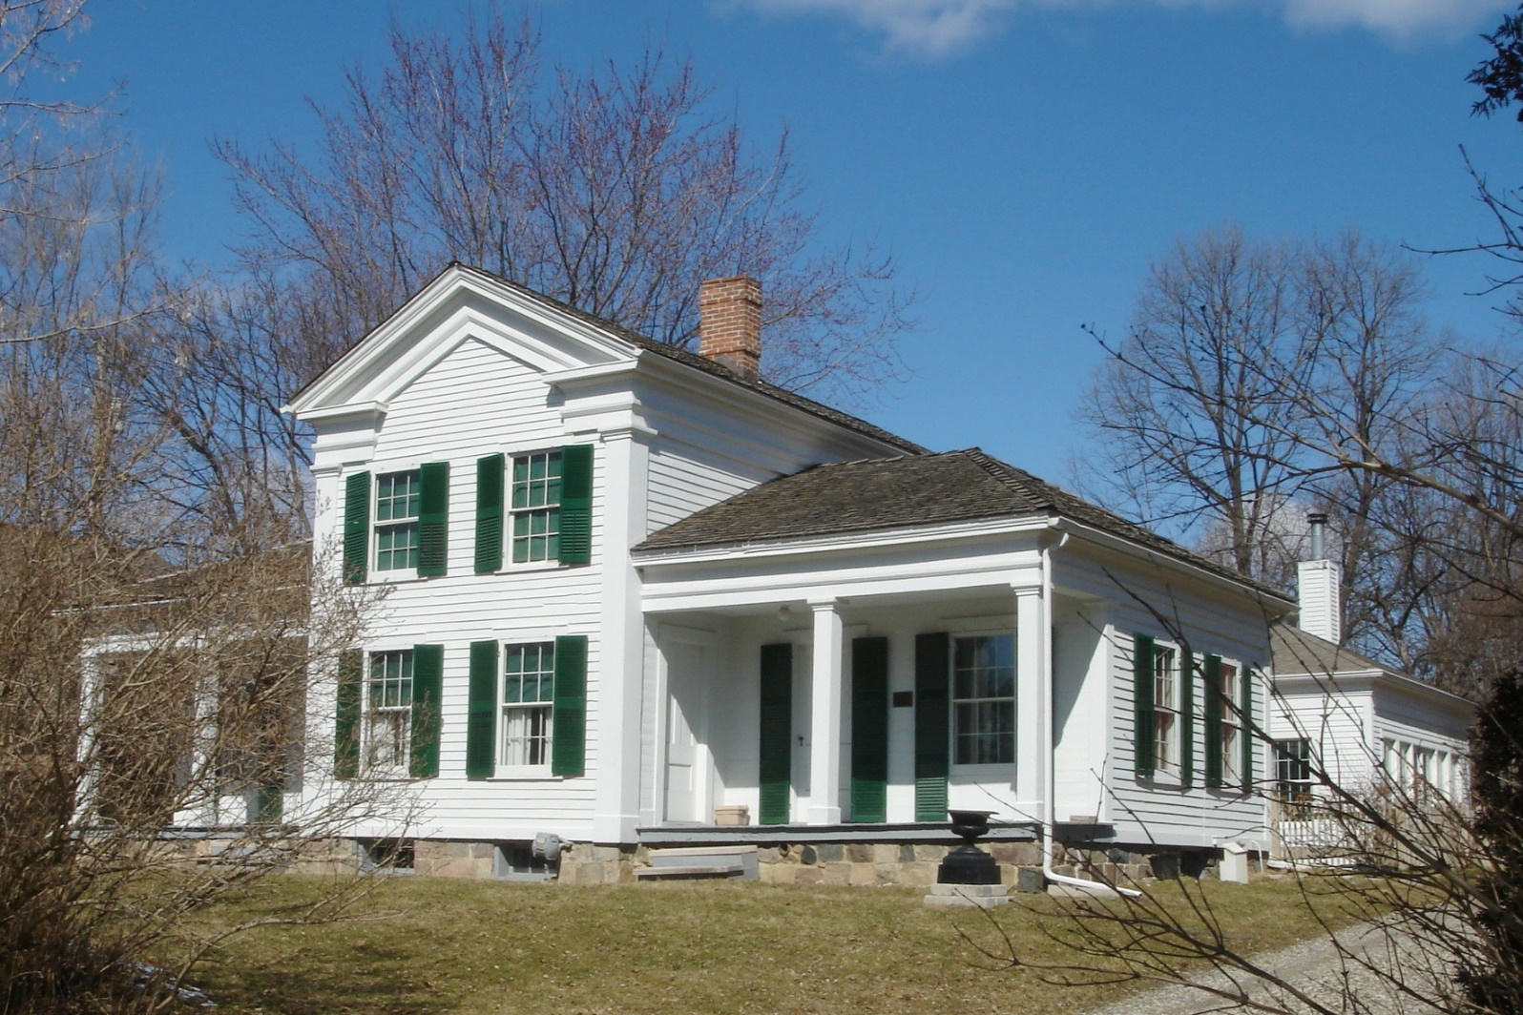
Greek Revival- Gable Front and Double Wing
Royal Aldrich House, ca. 1842
Eleven Mile Road Farmington Hills
Eave Returns
Classical Entablature
Six-over-Six Windows
Corner Pilasters
Square Porch Columns

Slide 10
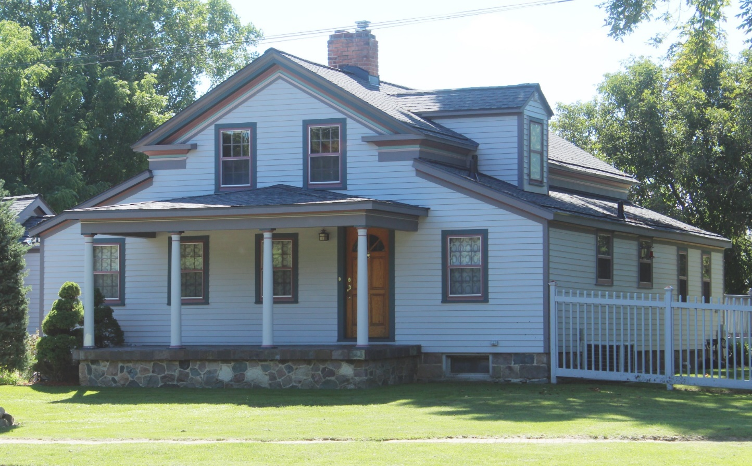
Greek Revival- Hen and Chicks
Silas Green House, ca.
1840
Ten Mile Road
Farmington Hills
Hen
Chicks
Chicks

Slide 11
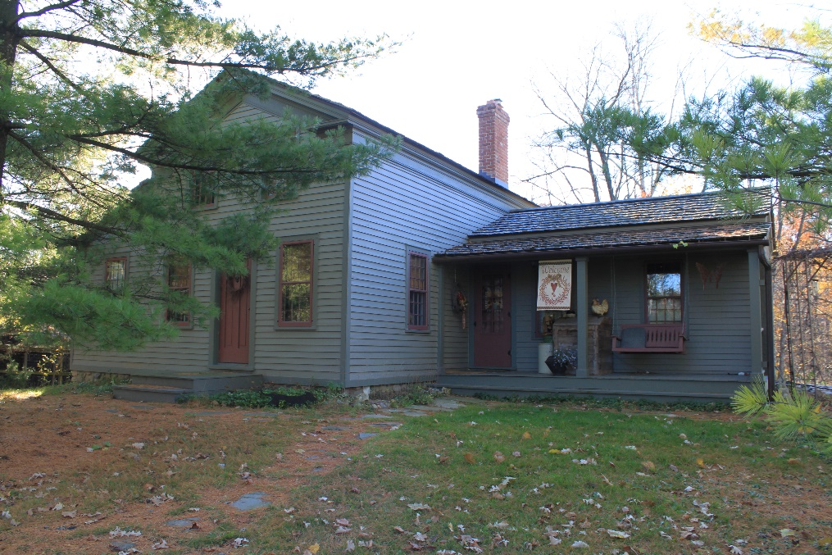
Greek Revival- Hen and Chicks Variants
Eber Durham House, ca. 1845
Thirteen Mile Road
Farmington Hills
Hen
Chick
Wing

Slide 12
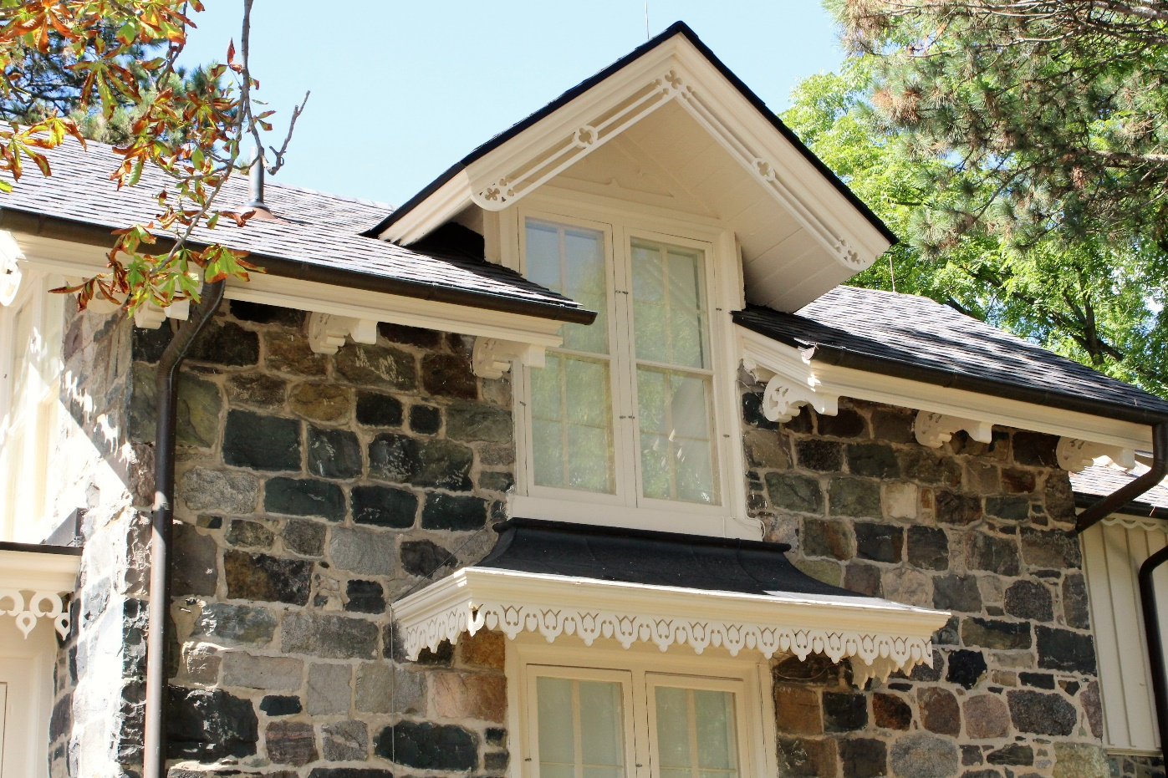
Gothic Revival ca. 1840- 1880
Though not as popular as its contemporaries, Greek Revival and Italianate architecture, the Gothic Revival style can be found in homes, churches and less frequently, governmental buildings. Homes are usually wood clad known as Carpenter Gothic.
Characterized by drip moldings, decorative bargeboards, bay windows and steeply pitched gable roofs, it is easily identified by the centered gable roof with the lacy trim commonly used. Unusually, the most visible example of Gothic Revival architecture in our community is clad in stone.

Slide 13
Gothic Revival Characteristics
A centered gable or paired gables
Pointed arch windows and/or clusters of pointed arch windows
Bay windows, cantilevered bay windows and oriel windows
Drip molding is the most common window and door trim
2-over-2 or 4-over-4 light window sashes
Decorative crowns on windows
Elaborate decorative bargeboard trim
Decorative trim at roofline
One story porches
Open cornices

Slide 14
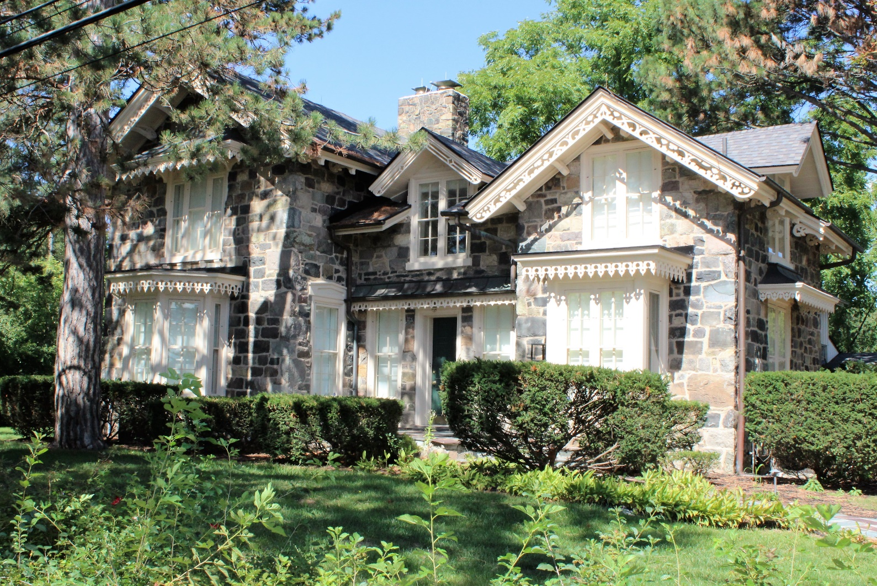
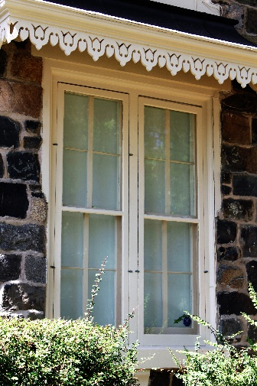
Gothic Revival
Lawrence Simmons House, ca. 1861
Twelve Mile Road
Farmington Hills
Bargeboard
Open Cornice with Roof Brackets
Roof Trim
Bay Window
Bay Window
Drip Molding

Slide 15
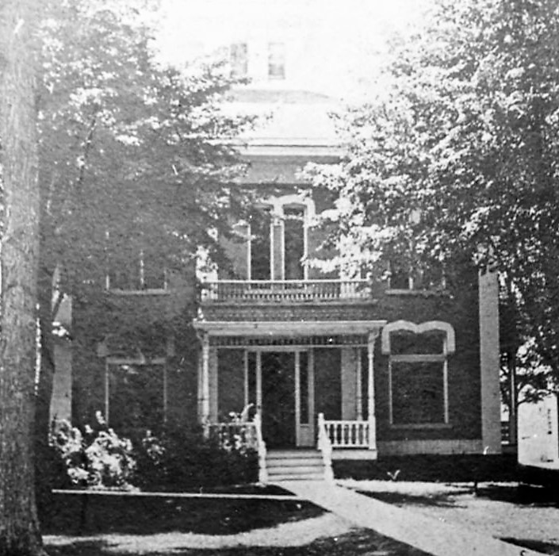
Italianate ca. 1840-1885
Similar to the Greek Revival style, the Italianate style was developed England as a reaction to the more formal classical styles that were its predecessors. The informal Italianate style was made popular in the United States, however, by the pattern books of A.J. Downing beginning in the 1840s.
This historic photo of the Warner Mansion, built in 1867, shows clearly the understated Italianate style prior to the extensive changes of the early twentieth century.

Slide 16
Italianate Characteristics
Hipped roof
Cupola
Bay windows
Window trim that is different on each story, with the most elaborate trim on the first floor (as in classic Roman architecture)
Window trim is often hooded
Arched windows – varying from a full arch to a flattened arch
Window groupings
Two-over-two light sashes

Slide 17
Italianate Characteristics
Quoins
Porches- entry, partial and full-width
Bracketed cornices
Dentilated cornices
Symmetry and asymmetry are both common

Slide 18
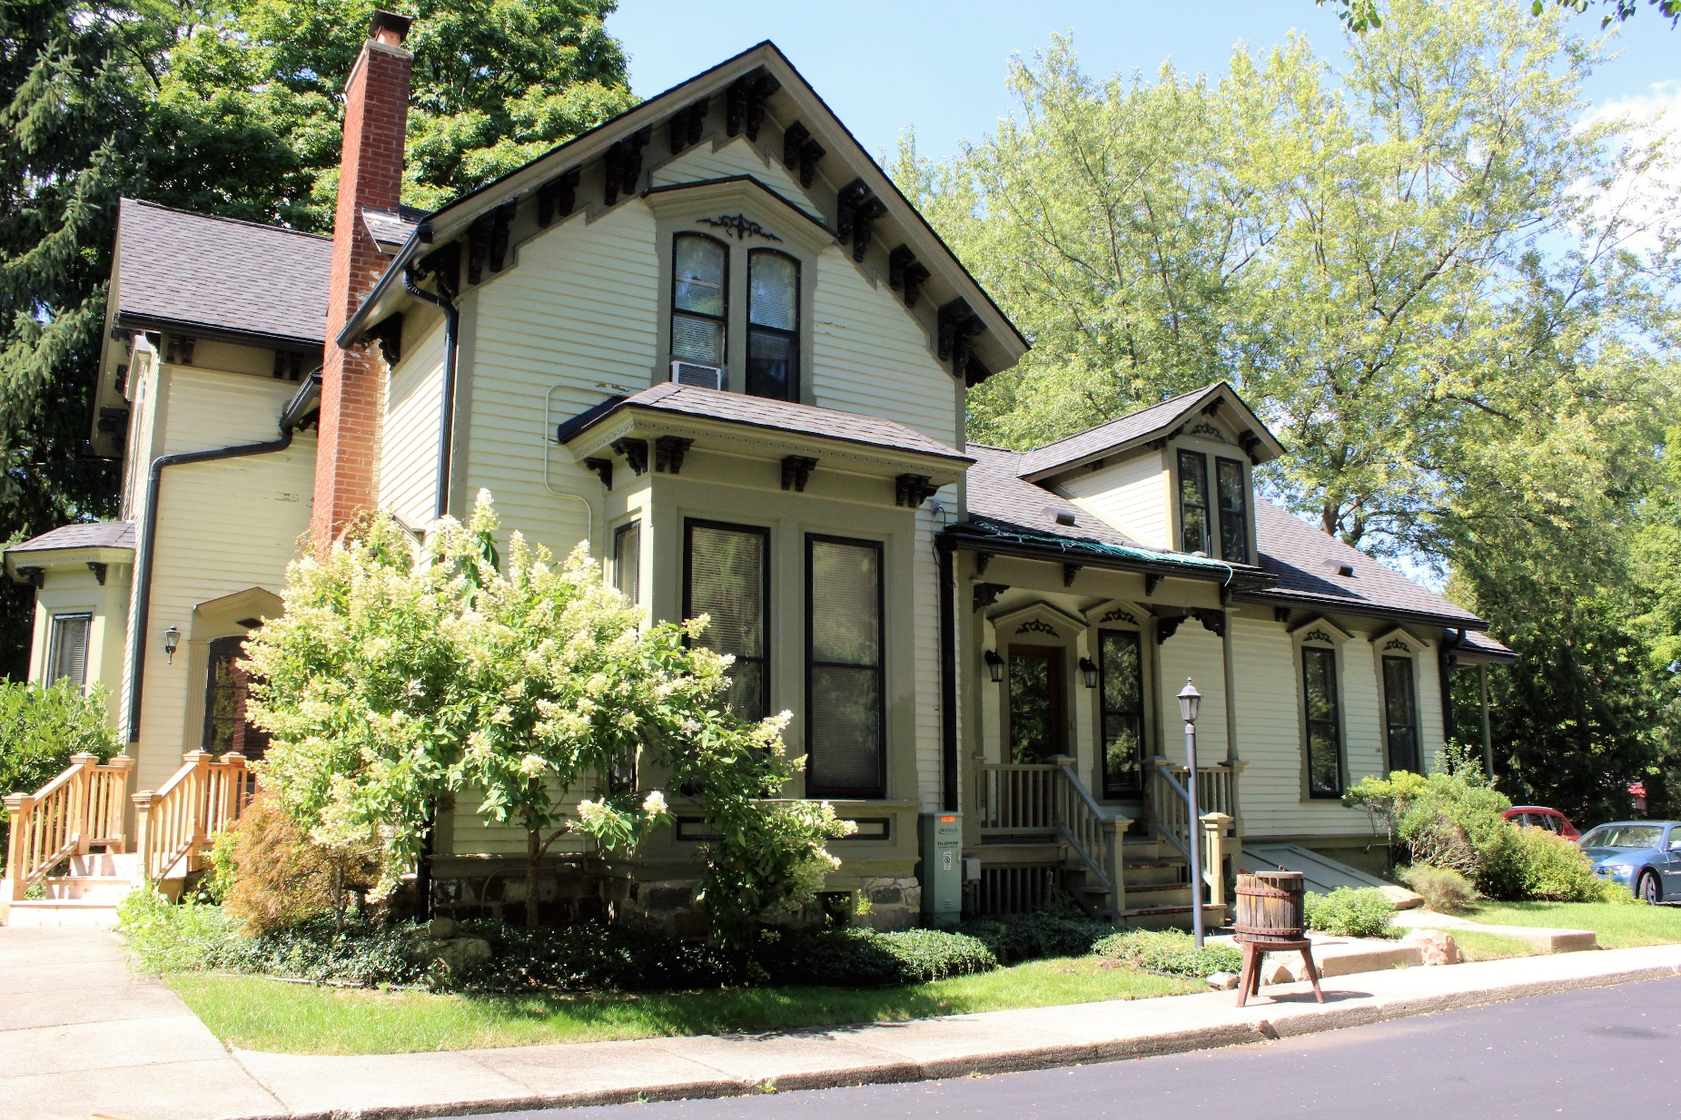
Italianate
John Pettibone House, ca. 1861
Twelve Mile Rd
Farmington Hills
Roof Brackets
Paired Windows and Window Hoods
Bay Window

Slide 19
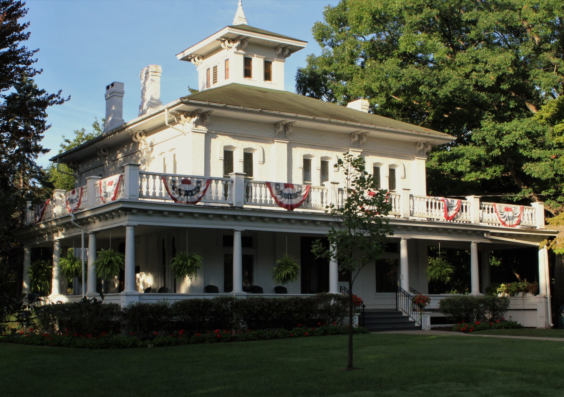
Italianate
1867
Governor Warner Mansion
Grand River Avenue Farmington
Belvedere
Hipped Roof
Paired Roof Brackets
Paired Windows, Window Hoods
Pilasters

Slide 20
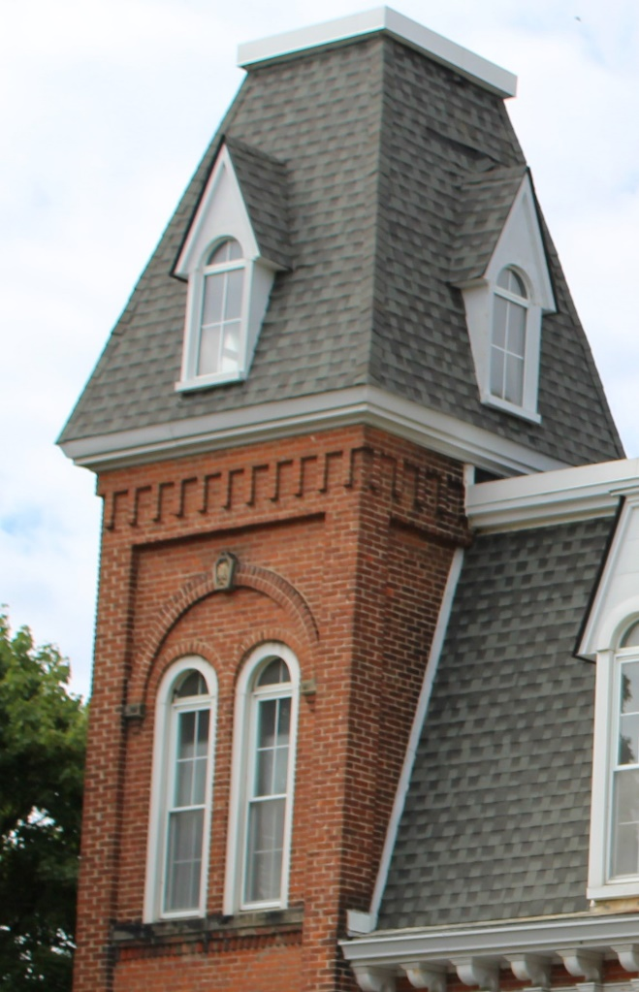
Second Empire ca. 1855-1885
Named for the reign of Napoleon III (1852-1870), the Second Empire style is rare in our community. The distinctive mansard roof was named after Francois Mansard, a 17th century French architect.
Second Empire was considered a modern building style, emulating current French architectural aesthetics.

Slide 21
Second Empire Characteristics
Mansard roof
Segmental dormers
Roof brackets
Paired windows
Towers or cupolas
Entry or partial porch

Slide 22
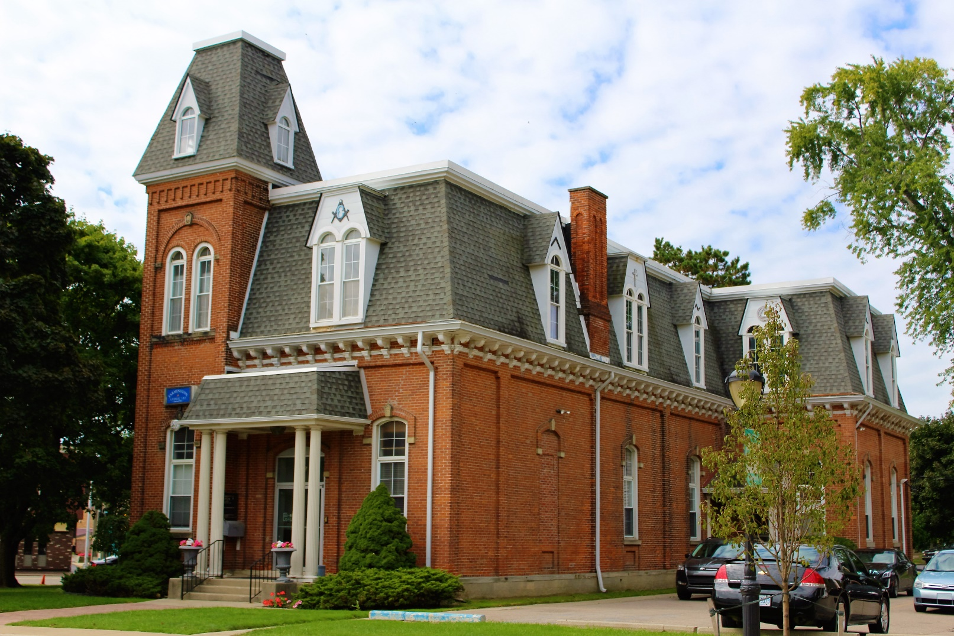
Second Empire
1875
Farmington Masonic Lodge
Grand River Avenue
Farmington
Tower
Mansard Roof
Paired Windows
Arched Windows
Entry Porch
Roof Brackets

Slide 23
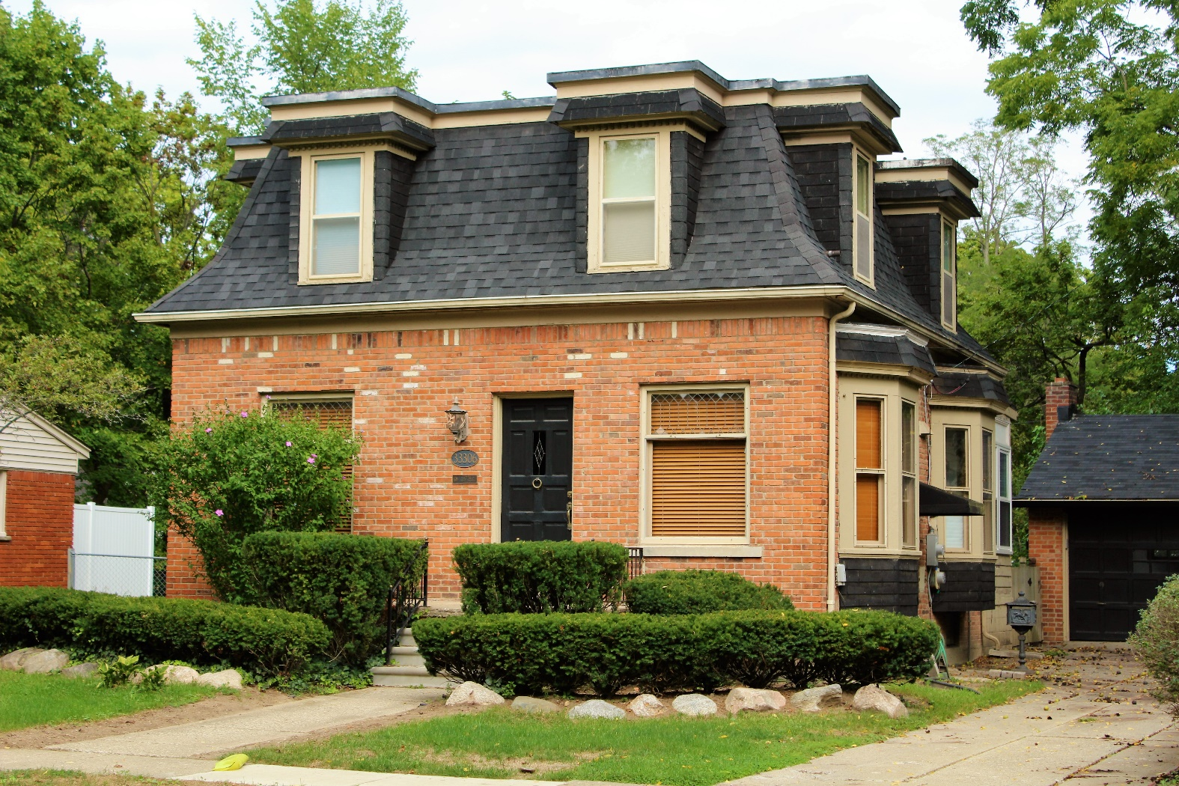
Second Empire
1890
Oakland Avenue
Farmington
Mansard Roof
Dormers
Bay Windows

Slide 24
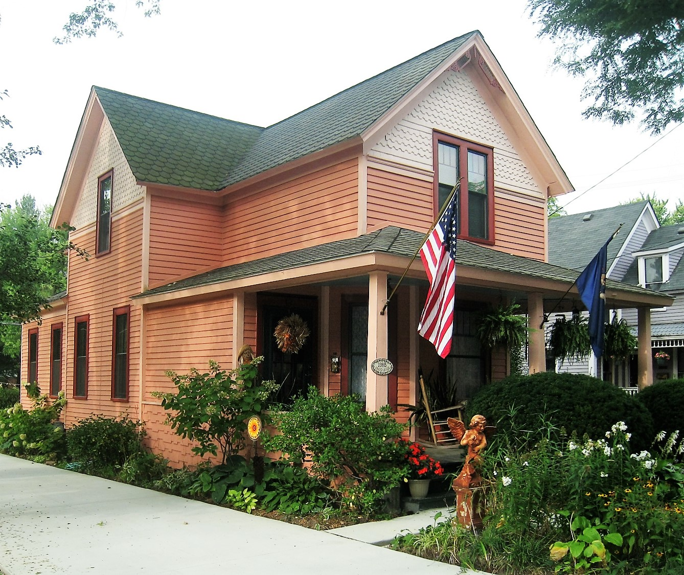
Queen Anne ca. 1880-1910
The name Queen Anne is a misnomer for this style, as it greatly differs from the Renaissance architecture of Queen Anne’s reign. Examples found in our community are Americanized interpretations of the masonry and half-timbered English style.
A drive along Grand River in downtown Farmington will provide any visitor with numerous examples of this style.

Slide 25
Queen Anne Characteristics
A variety of roof styles:
  Hipped roof with cross gables
  Gable roof with cross gables
  Gable front roof
  Gable front with tower or turret
Decorative shingles in gable
Bargeboard
Full-width and wrap-around porches
Spindle work on porches

Slide 26
Queen Anne Characteristics Continued
Bay windows and cantilevered bay windows
Windows composed of a large pane of glass framed by smaller panes
Bright and varied color schemes
Excess of ornamentation

Slide 27
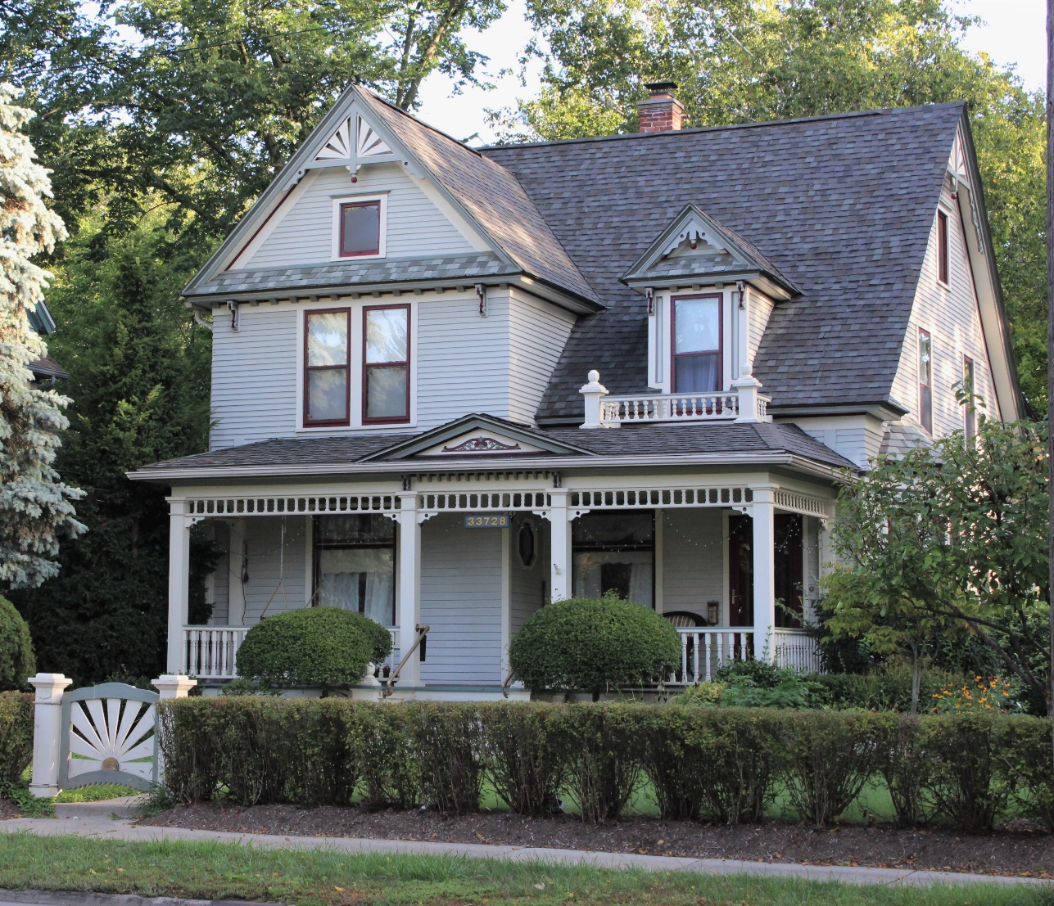
Queen Anne
1900
Grand River Avenue
Farmington
Sunburst Bargeboard with Pendant
Gable Roof with Cross-Gable
Spindlework
Full-Width Porch

Slide 28
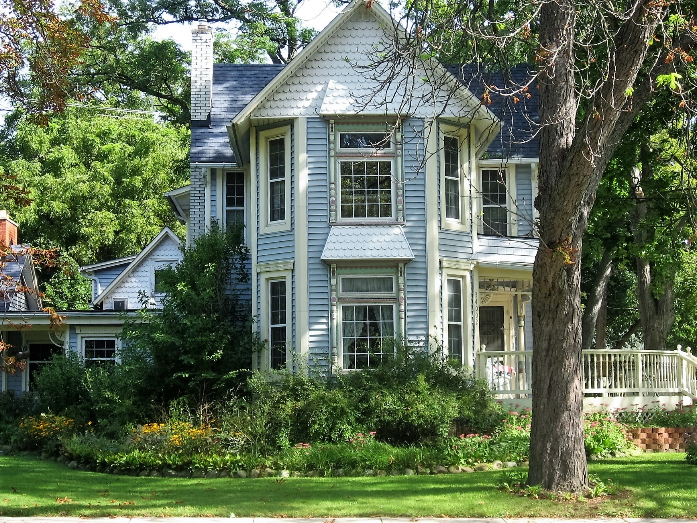
Queen Anne
1900
Grand River Avenue
Farmington
Fish Scale Shingles
Gable Roof with Cross Gables
Side Porch
Spindlework
Projecting Center Bay

Slide 29
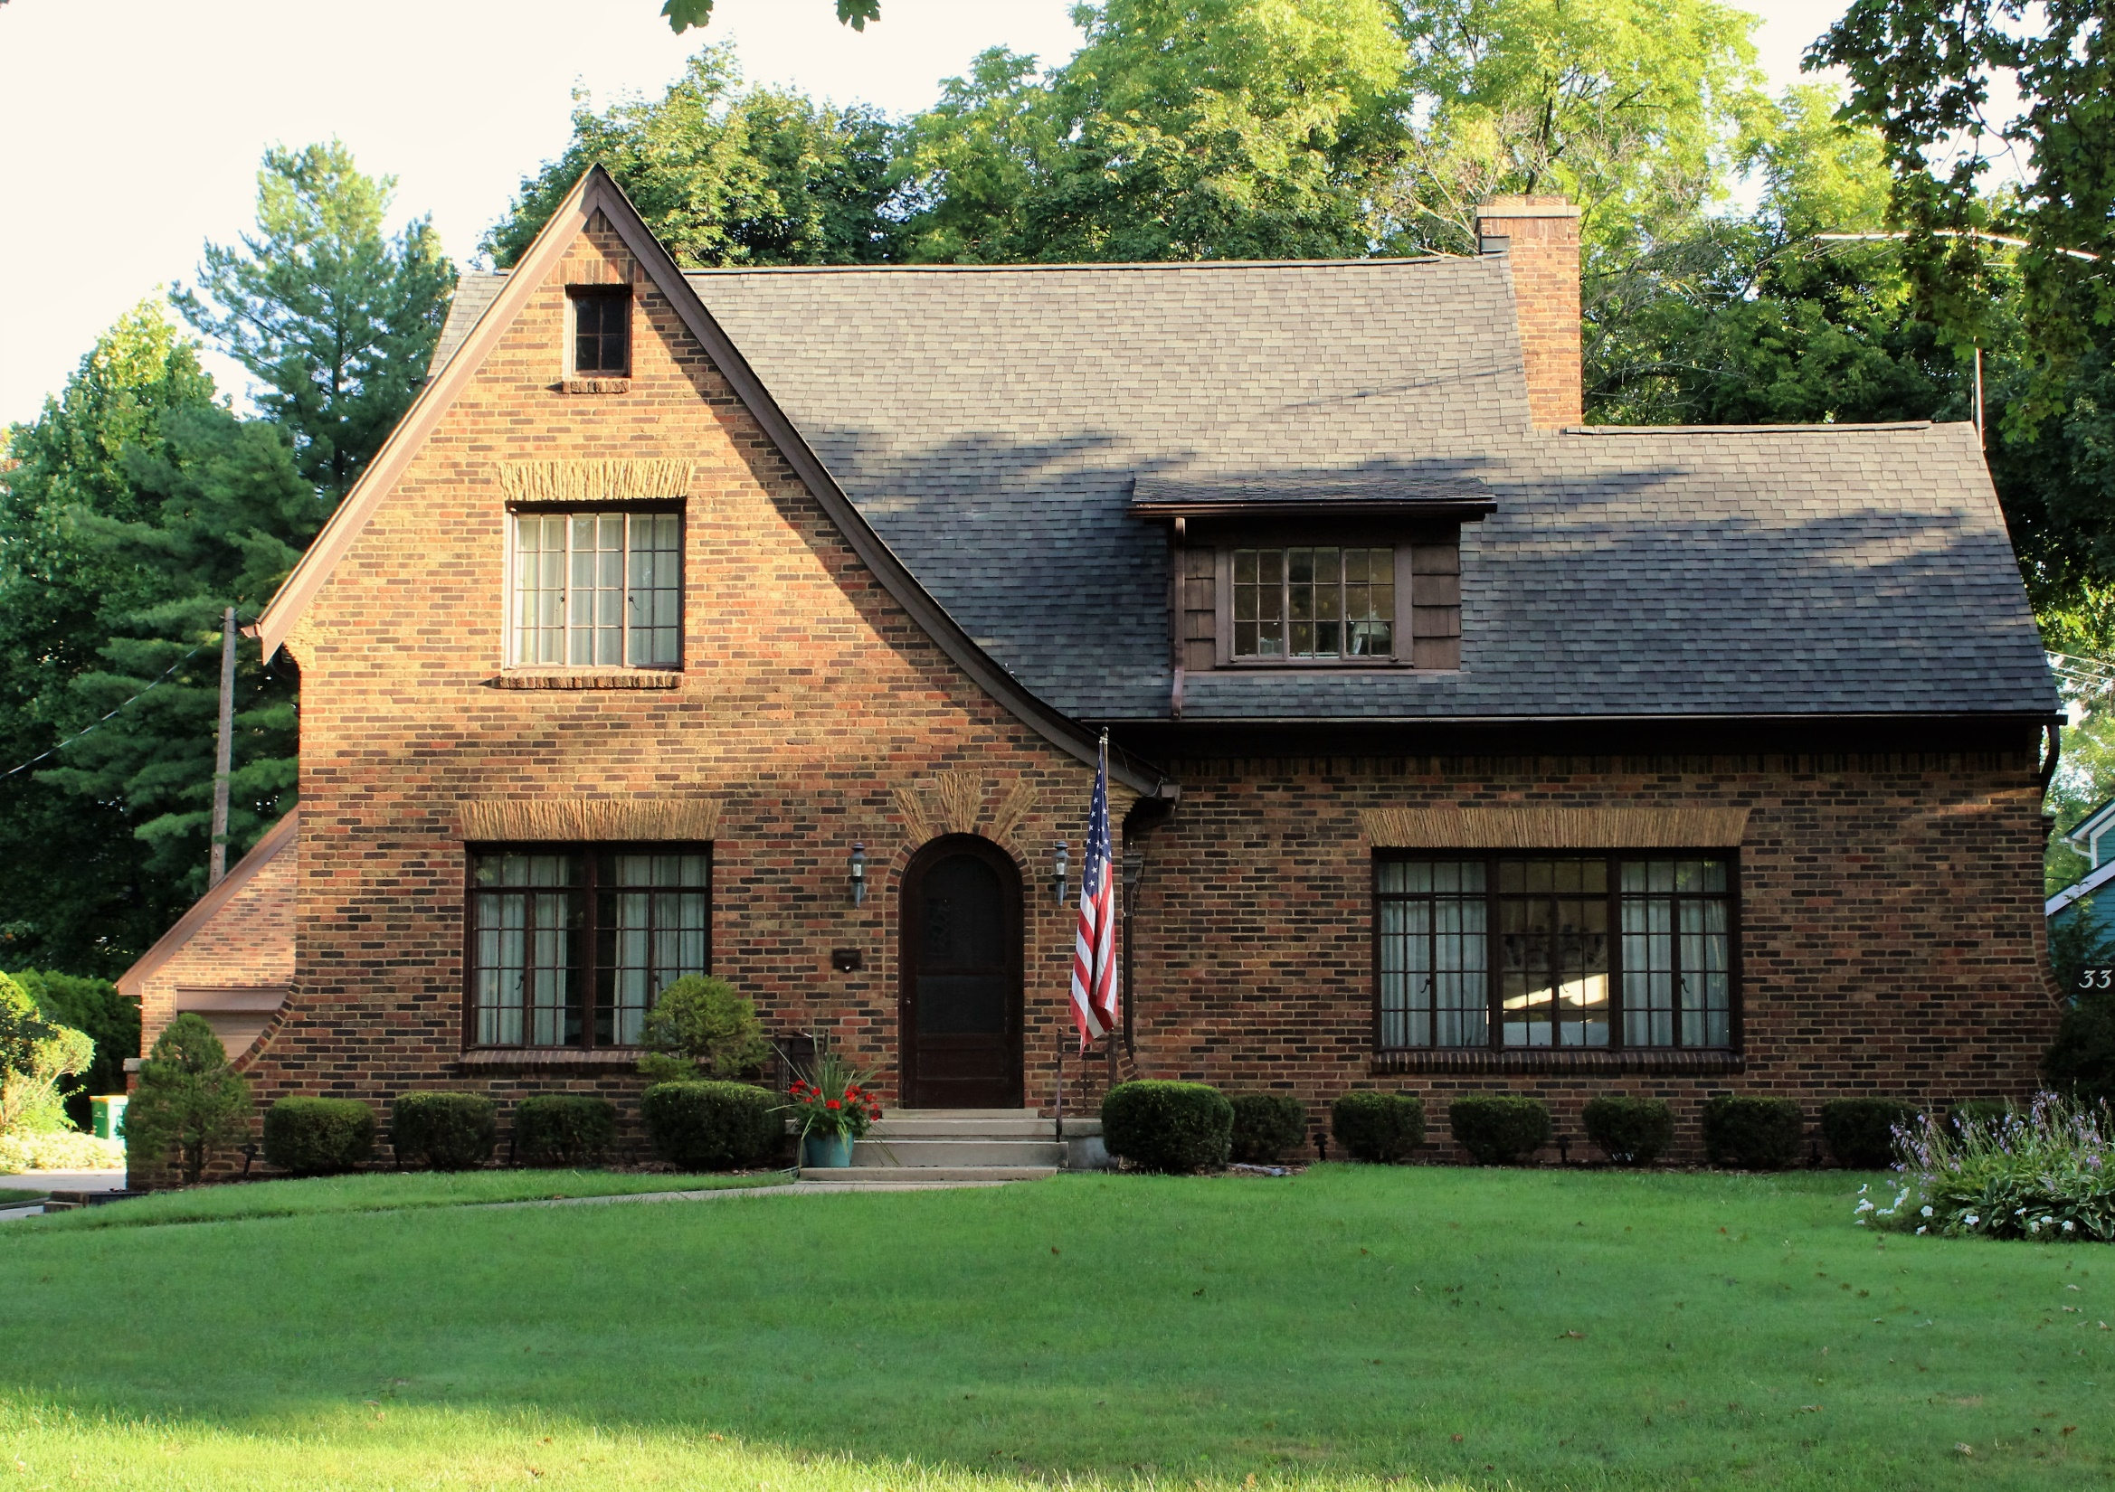
Tudor Revival, ca. 1890-1940
The early twentieth century saw a number of styles revived, such as the Tudor and the Dutch Colonial. The Tudor Revival style is based on Medieval English examples with a free interpretation.
The most distinguishing features are the prominent front gable, brickwork, casement windows and half-timbering.

Slide 30
Tudor Revival Characteristics
Gable roof with cross-gable
Overlapping gables
Flared front gable
Masonry cladding, most commonly brick or stucco
Patterned brickwork
False half-timbering
Casement windows
Window groupings

Slide 31
Tudor Revival Characteristics
Arched doors
Contrasting stone door and window surrounds
Bay and oriel windows
Elaborate chimneys with chimney pots

Slide 32
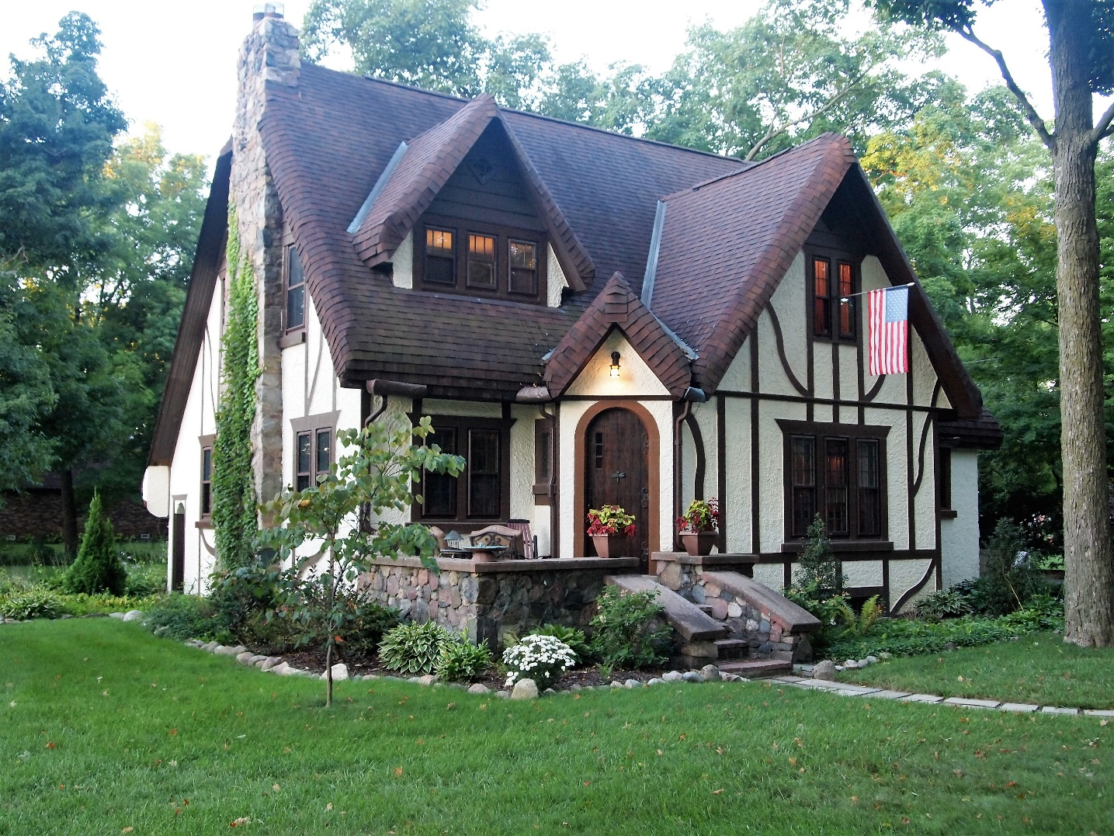
Tudor Revival- Storybook Tudor
1926
Oakewood Cottage
Farmington Hills
Architect: Emily Butterfield
Gable Roof with Cross Gables and Overlapping Gables
False Thatched Roof
Arched Door
False Half-Timbering
A subtype of the Tudor Revival style, called the Storybook Tudor, is a whimsical interpretation with more elaborate details including a false thatched roof.

Slide 33
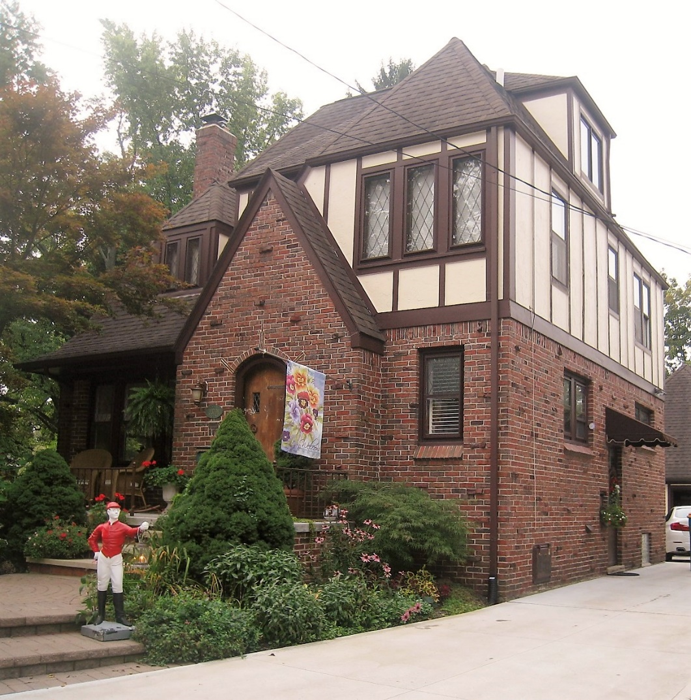
Tudor Revival
1925
Grand River Avenue
Farmington
Projecting Front Gable
False Half-Timbering
Casement Wndows
Arched Door

Slide 34
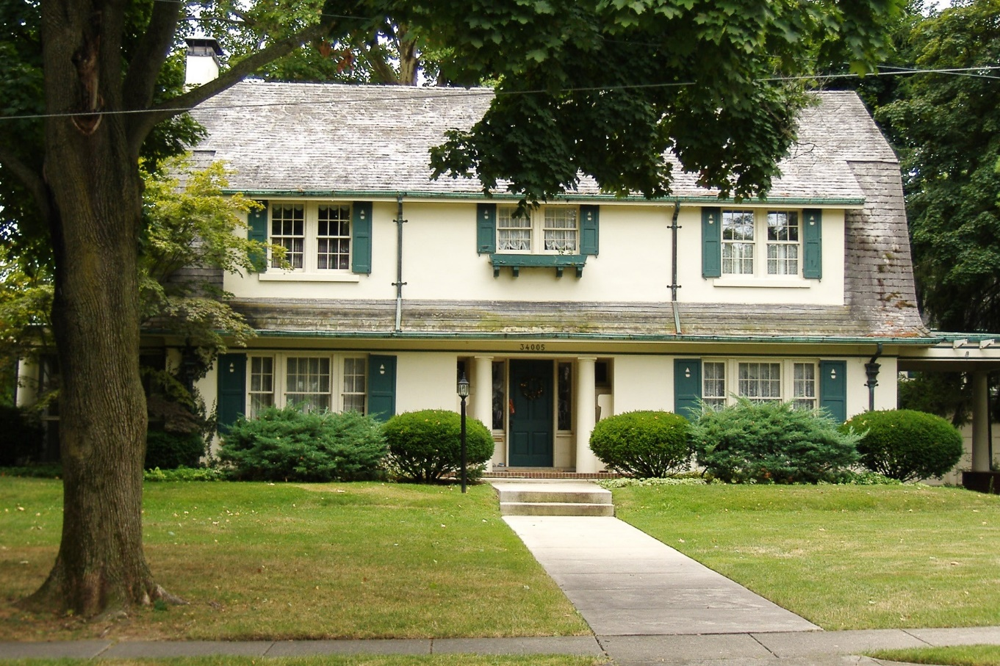
Dutch Colonial Revival, ca. 1880-1955
The Dutch Colonial Revival was part of a more generalized revival of Colonial architecture. This subtype was popularized from about 1890 onwards, which the side gambrel style starting around 1920.
A gambrel roof, either front-facing or side-facing is the most telling characteristic of this style. The style is a loose interpretation of the Dutch houses of the East Coast.

Slide 35
Dutch Colonial Characteristics
Gambrel roof
Centered door with side gambrel roof
Offset door in front facing gambrel
Dormers, either single or continuous
Columns on entry porches
Gable end chimneys

Slide 36
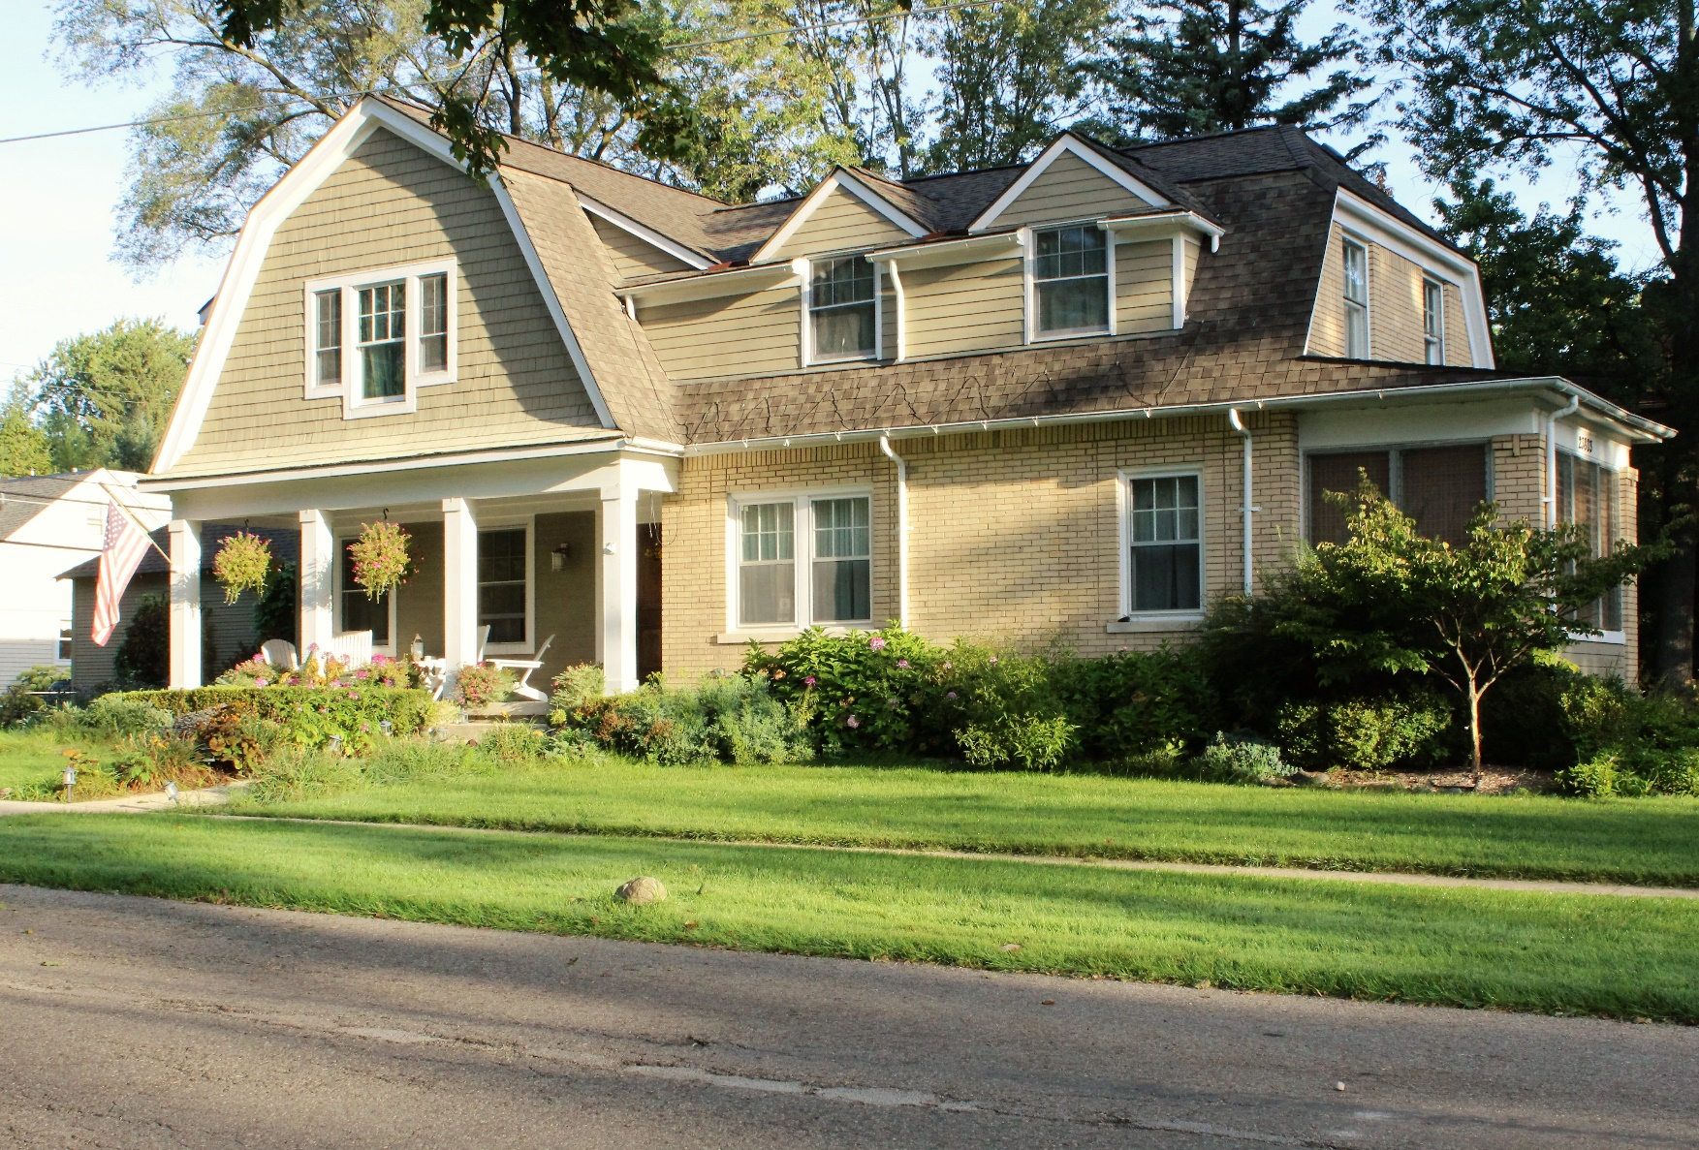
Dutch Colonial Revival
1940
Oakland Avenue
Farmington
Gambrel Roof with Cross Gambrel
Dormers
Jerkinhead
Off-Center Door

Slide 37
Dutch Colonial Revival
1924
Oakland Avenue
Farmington
Gable End Chimney
Gambrel Roof
Continuous Shed Dormer
Flared Eaves
Entry Porch Column
Centered Door

Slide 38
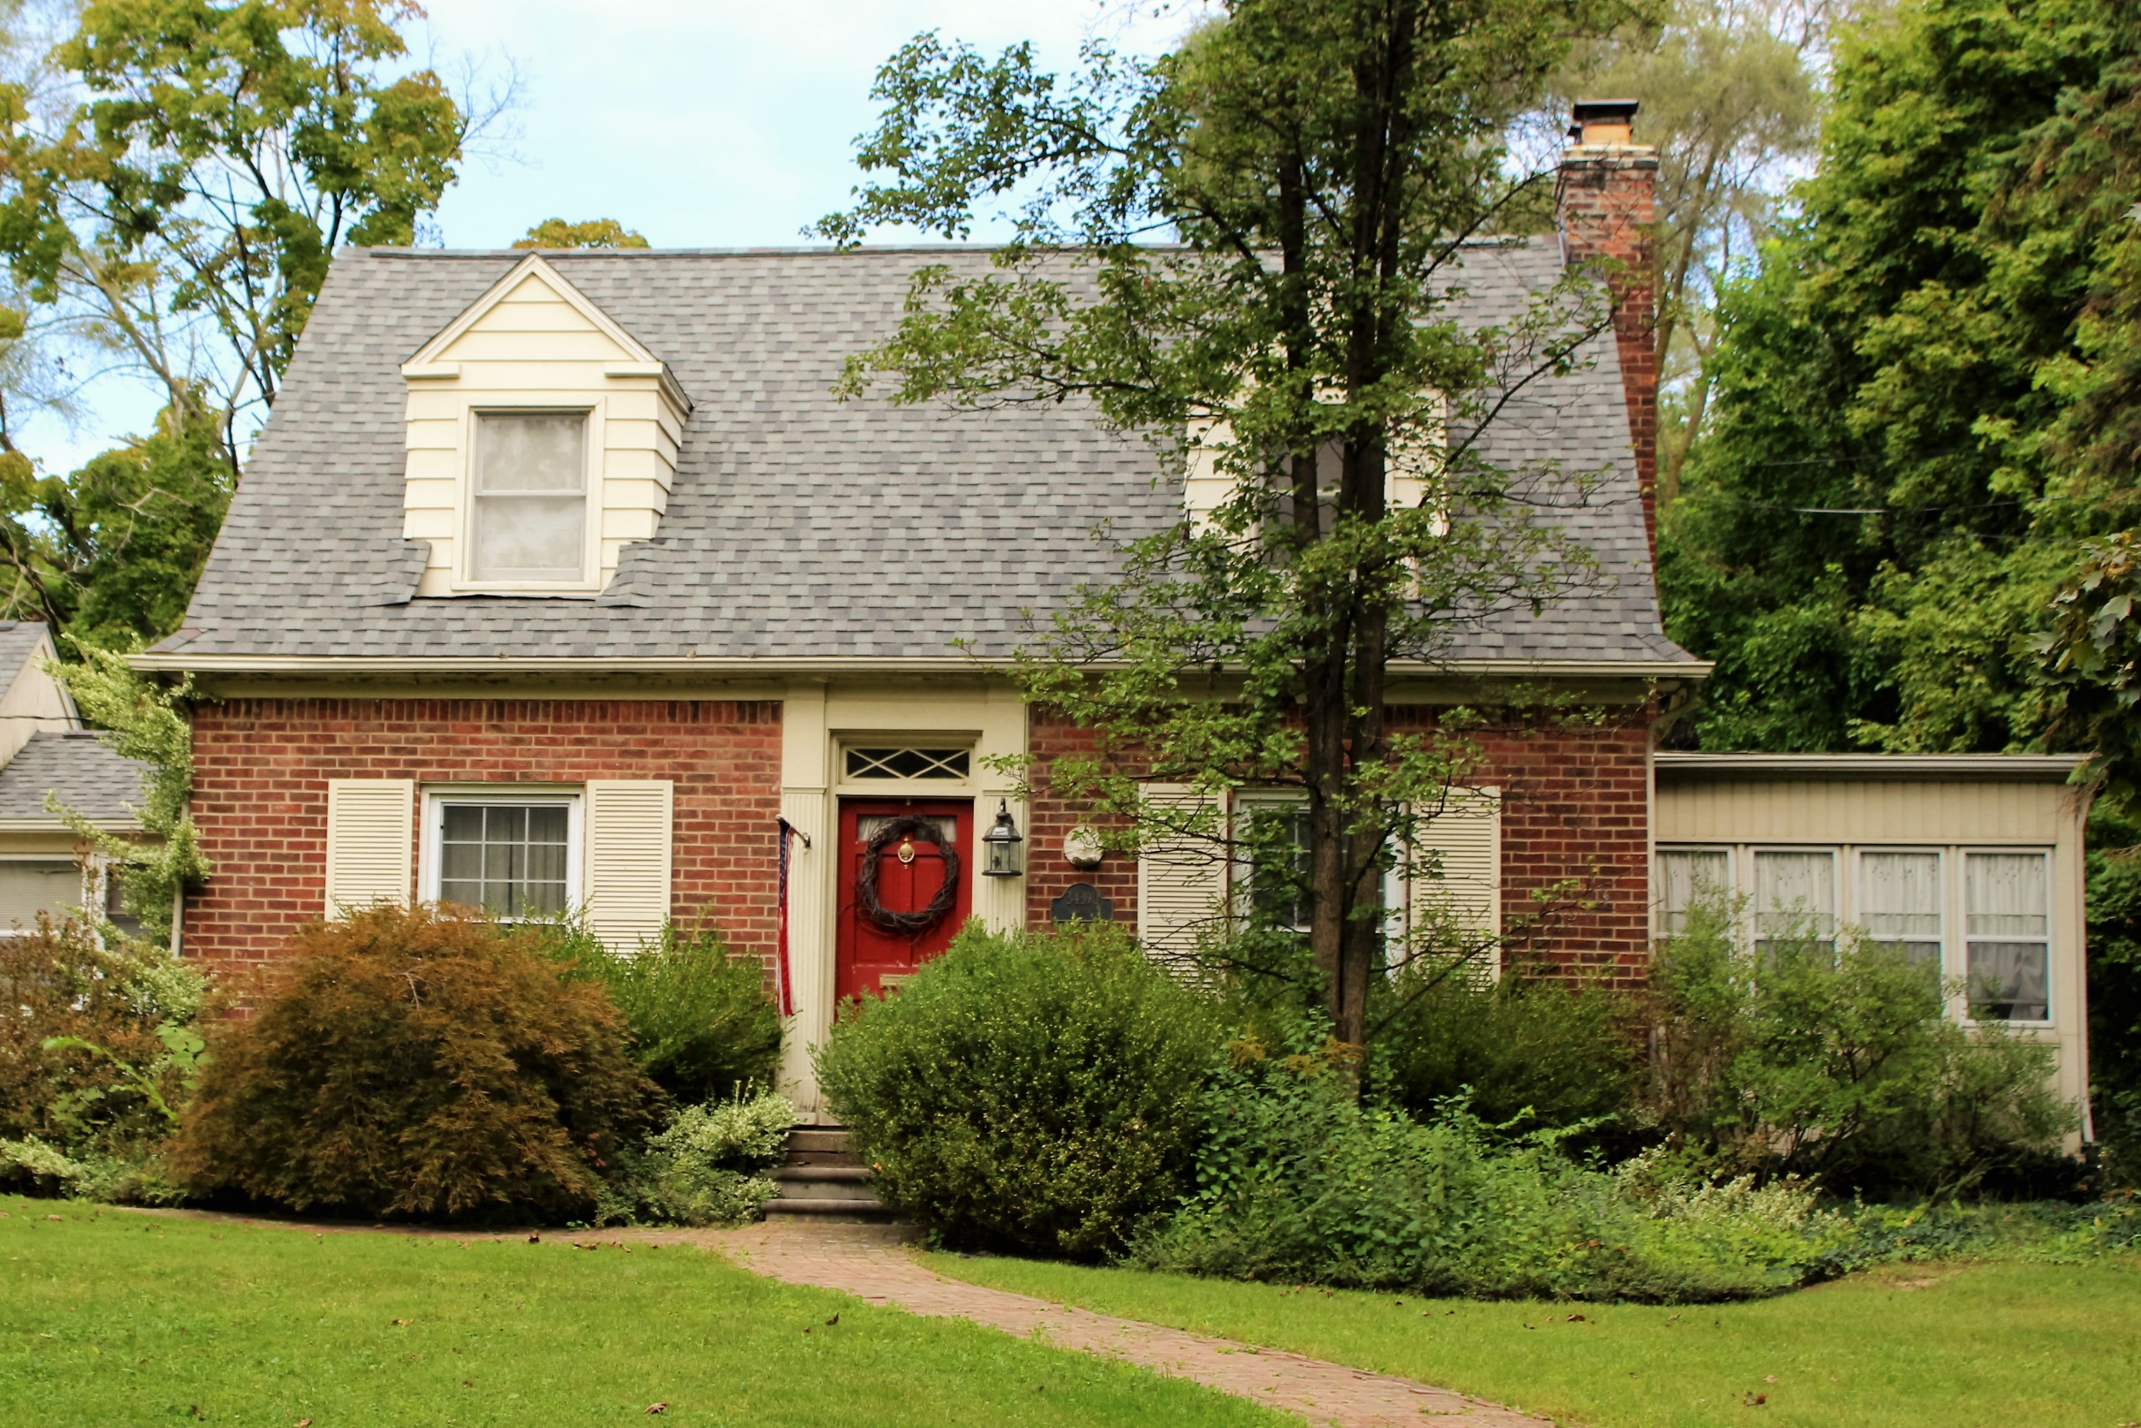
Other Colonial Revival, ca. 1880-1955
The remaining Colonial Revival style homes were a reinterpretation of the English homes of early American architecture. Most revival homes were Georgian or Federal, and Colonial Revival homes continue to be a popular architectural style.

Slide 39
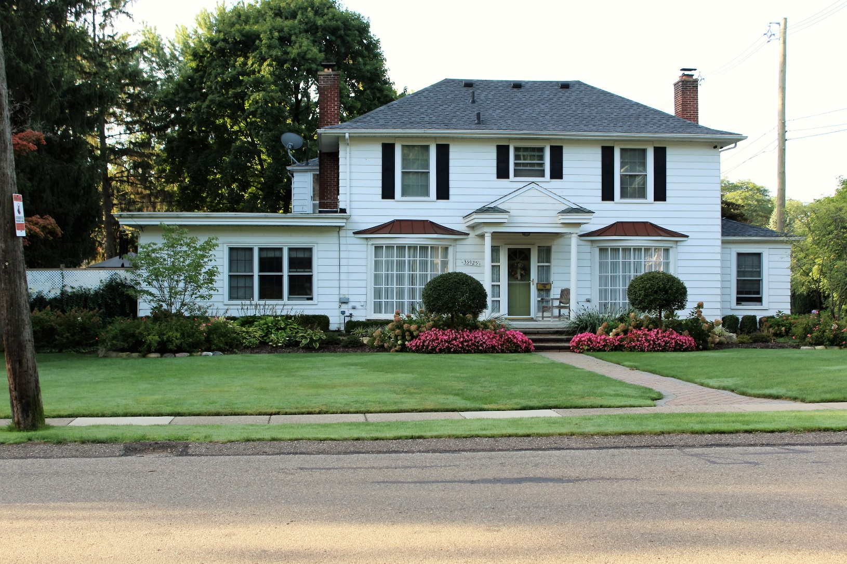
Colonial Revival
1924
Federal
Oakland Avenue
Farmington
Hipped Roof
Pedimented Porch Entry
Six-Over-Six Light Windows
One Story Side Wing
Side Lights

Slide 40
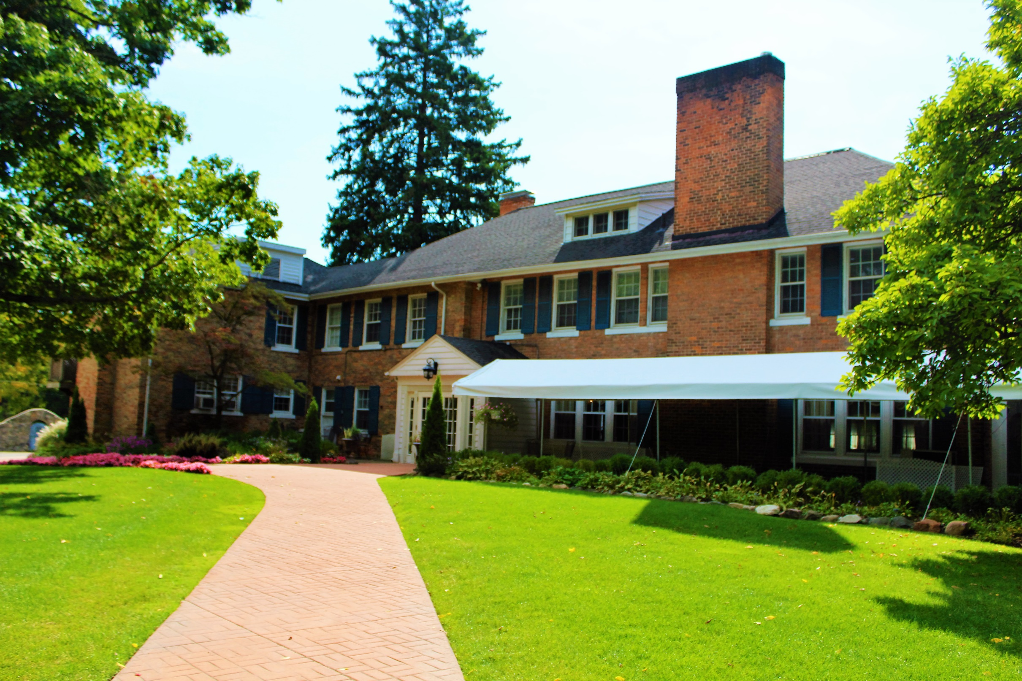
Colonial Revival
Longacre House
Georgian
Built 1869, remodeled 1918 by Marcus Burrowes
Farmington Road
Farmington Hills
Dormers
Hipped Roof
Tripled Windows
Georgian Pedimented Entrance
Brick Veneer

Slide 41
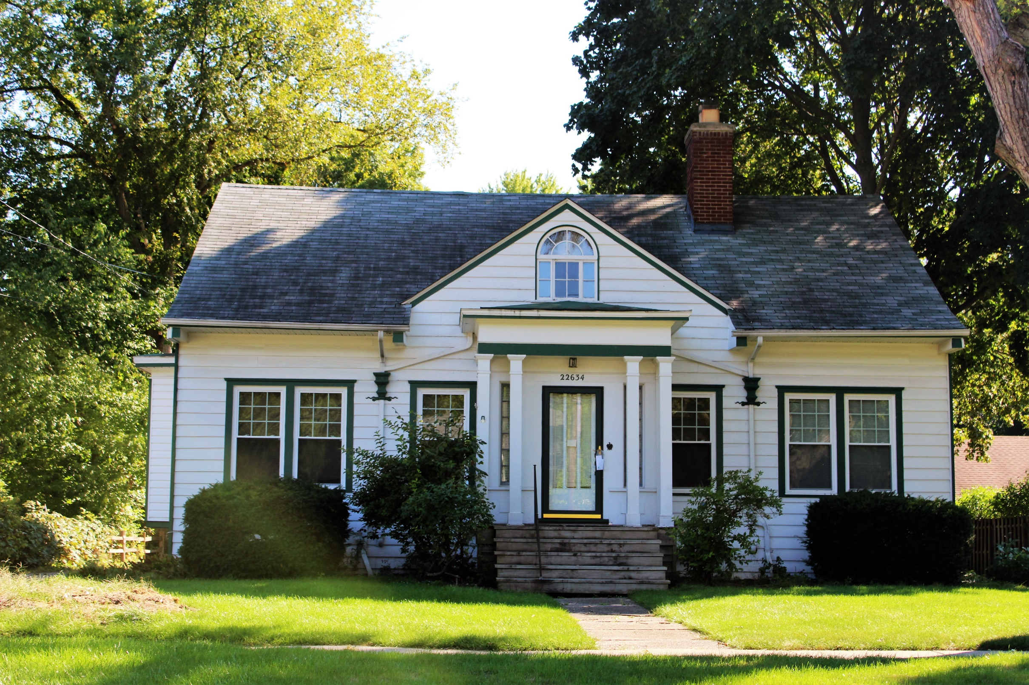
Colonial Revival
1920
Federal
Brookdale Road
Farmington
Side Gable Roof with Cross Gable
Palladian Window
Portico
Nine-Over-One Light Windows

Slide 42
French Eclectic, ca. 1920-1945
French Eclectic refers to a style that draws from centuries of French domestic architecture. Rather than the elaborate chateaux which inspired the Chateauesque style, French Eclectic was based on the more modest farmhouses of France. Steeply pitched hipped roofs, towers with conical roofs, flared eaves and masonry dominate the style.
Americans returning from the French front of World War I, along with photographs of French homes newly available to Americans during the 1920s, created the interest in French domestic architecture. Our local examples are rustic interpretations of the style.

Slide 43
French Eclectic Characteristics
Assymetrical massing
Symmetrical with hipped roof
Half-timbering
Hipped dormers
Gable dormers
Arched dormers
Arched doors
Double-hung or casement windows
Shutters
Varied roof massing

Slide 44
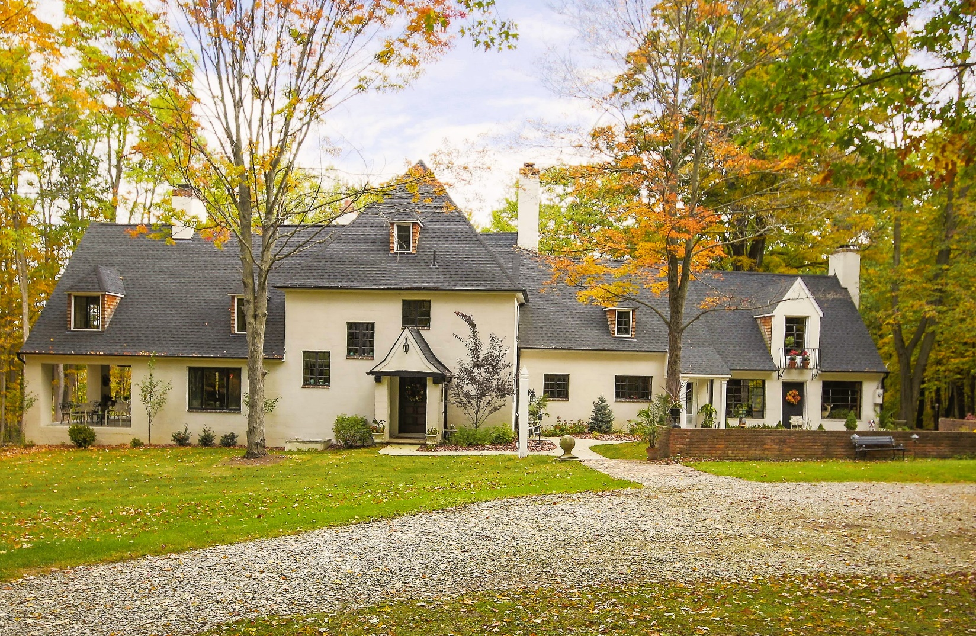
French Eclectic
Varied Roof Line
Burbrook
1924
Architect: Marcus Burrowes
Locust Lane
Farmington Hills
Hipped Roof
Gable Dormer
Hipped Dormer
Casement Windows
Entry Porch with Flared Eaves
Asymmetrical

Slide 45
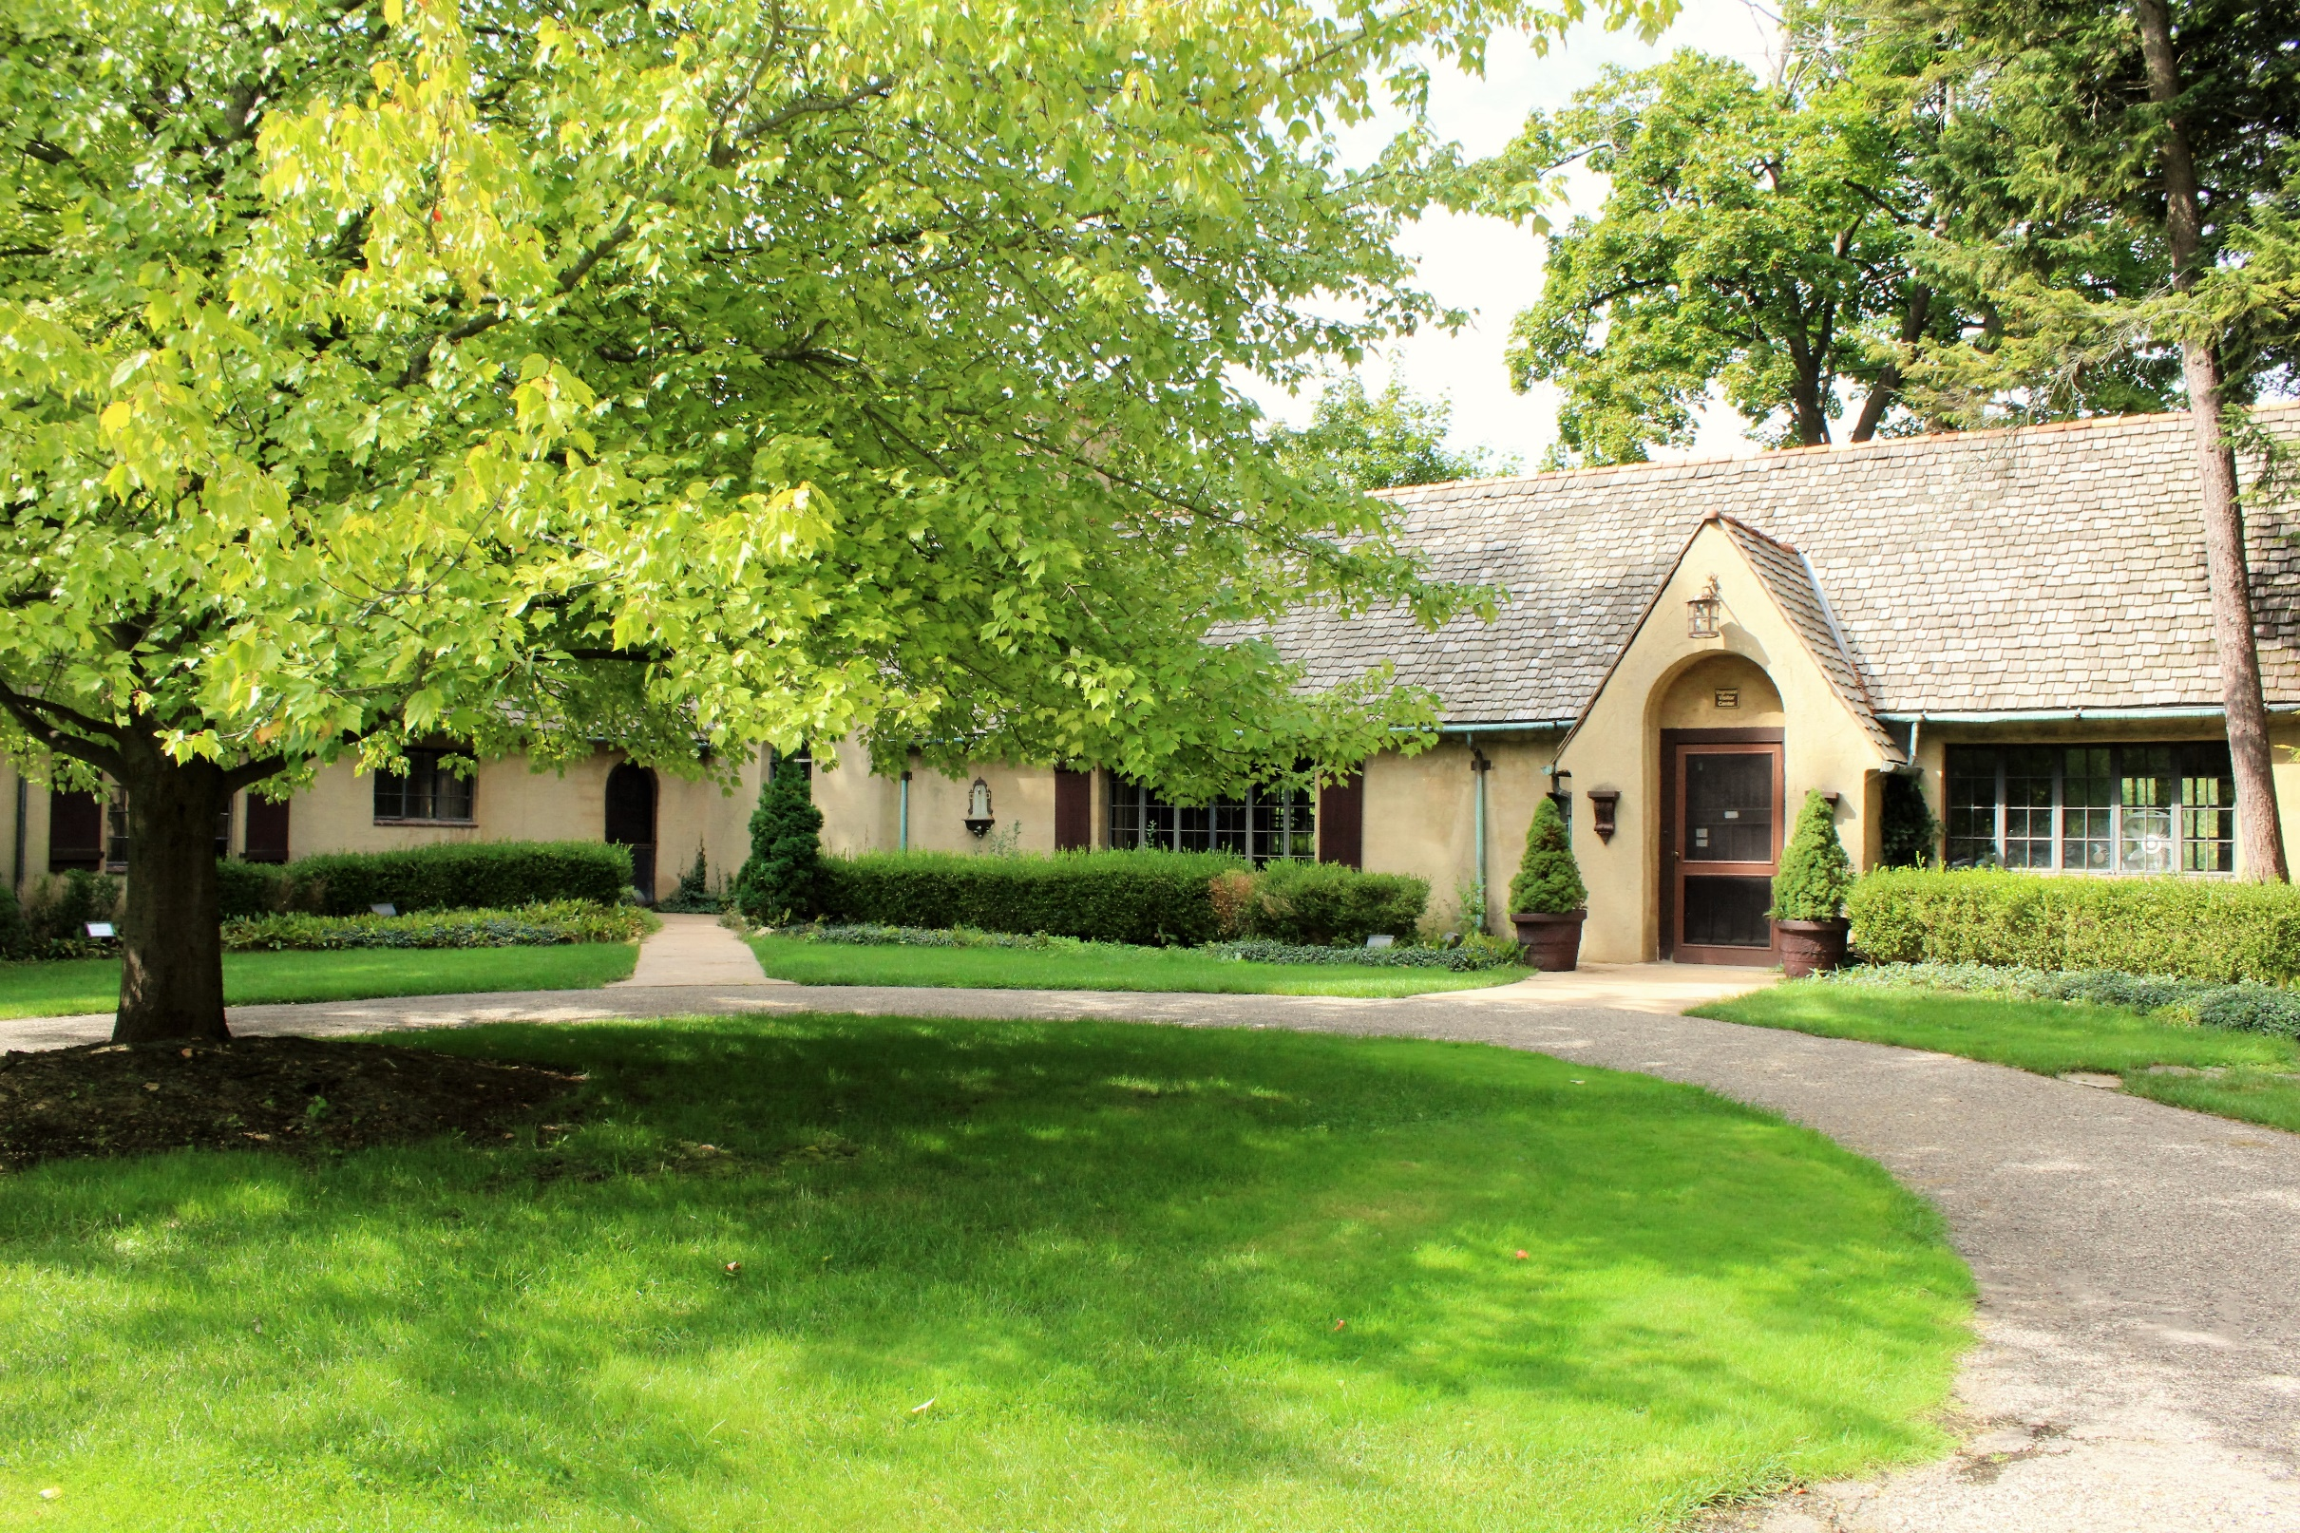
French Eclectic
Spicer House
1926
Architect: Marcus Burrowes
Heritage Park
Farmington Hills
Casement Windows
Arched Entry with Gable Porch
Asymmetrical

Slide 46
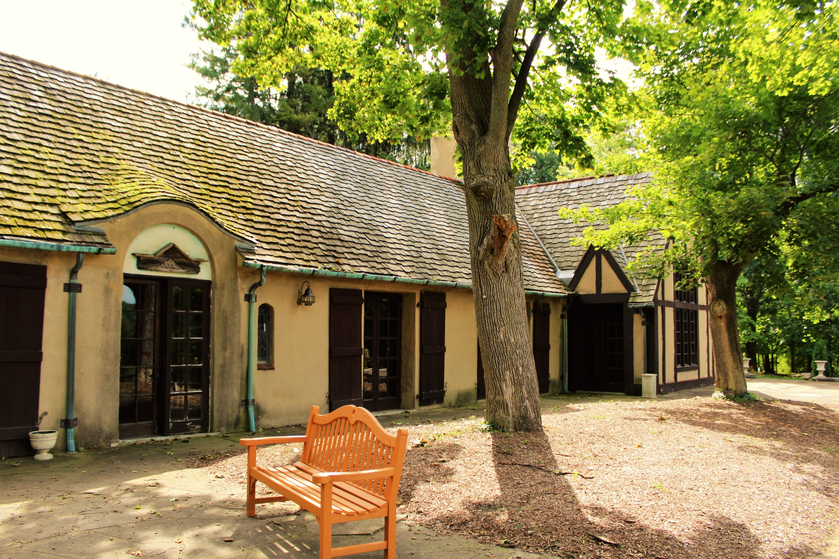
French Eclectic
Spicer House
Rear View
Shutters
False Half Timbering
Stucco

Slide 47
Prairie Style, ca. 1900-1920
The Prairie Style, from the Prairie School which included Frank Lloyd Wright. The style is characterized by a low-pitched roof, often hipped, with wide overhanging eaves. The style is dominated by horizontal lines, including ribbon windows.
In towns like Farmington, the American Foursquare is largely the example of the Prairie style that will be found. The American Foursquare has a square footprint, with a full-width front-porch and a center hipped gable in the second story. It is a fixture of the residential architecture of the early twentieth century.

Slide 48
Prairie Style Characteristics- American Foursquare
Hipped roof
Square footprint
Full-width porch with hipped roof
Centered entry
Dormer with hipped roof
Ribbon windows in dormer
Double-hung windows with multiple lights in top sash over one light
Wide over-hanging eaves

Slide 49
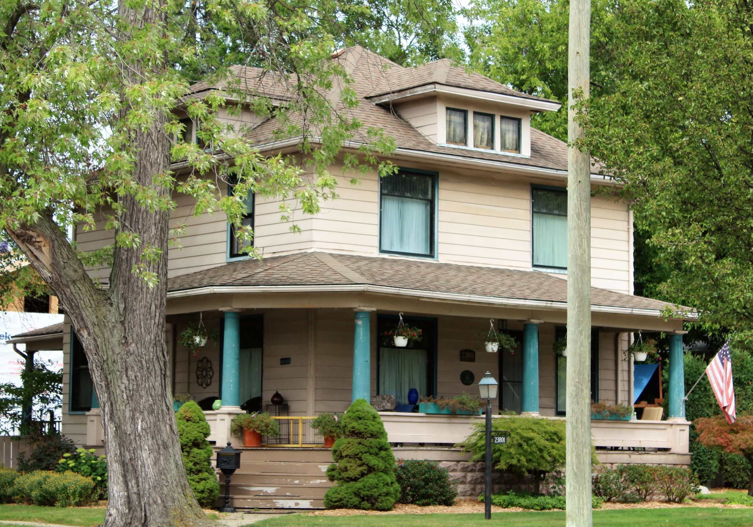
Prairie Style- American Foursquare
Hipped Roof
1912
Farmington Road
Farmington
Multi-Light Windows Over One Light
Centered Dormer with Hipped Roof
Wide Overhanging Eaves
Unique Wrap-Around Porch
Square Footprint

Slide 50
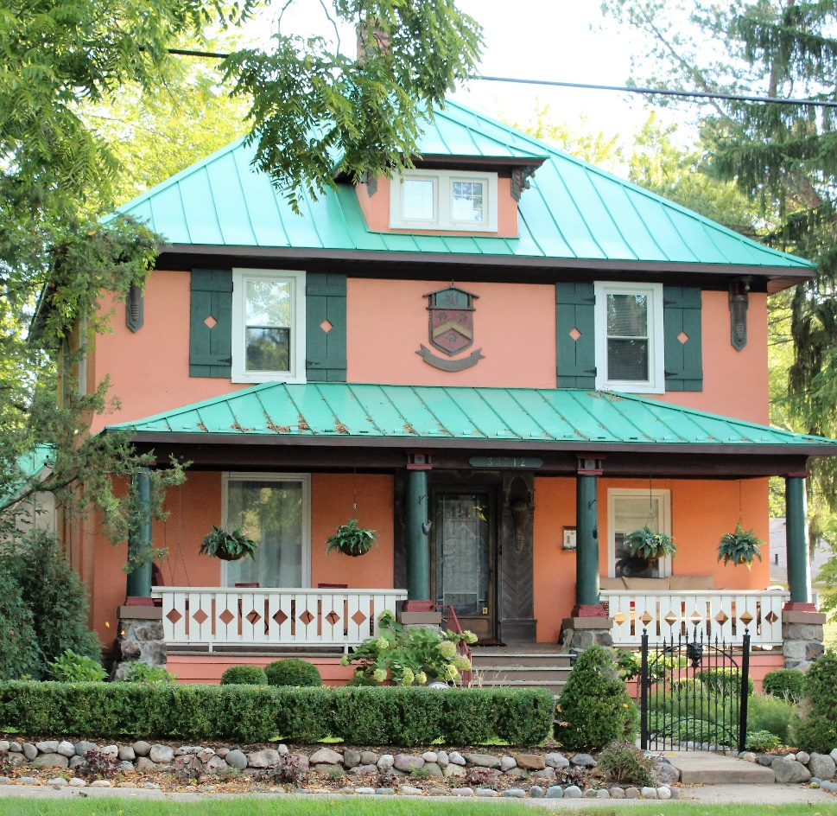
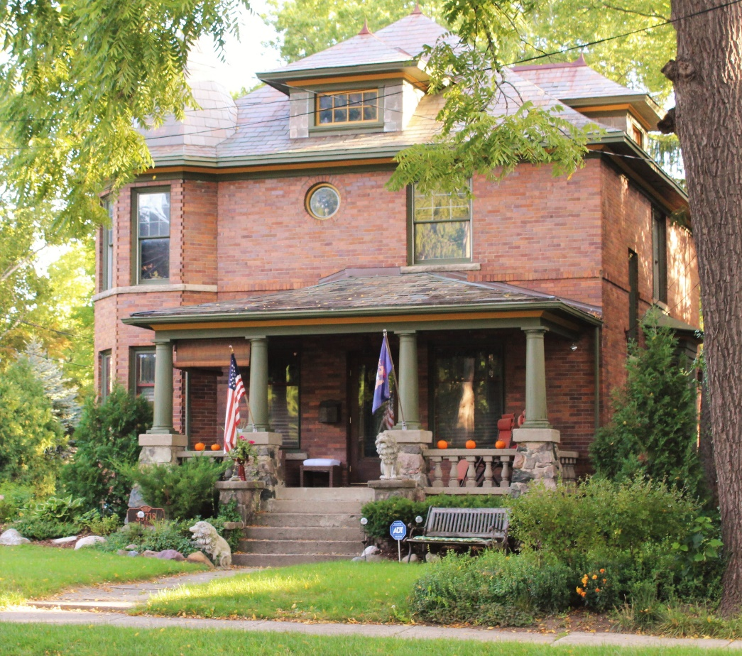
Prairie Style- American Foursquare
Masonry examples. Note the turret in the second example.

Slide 51
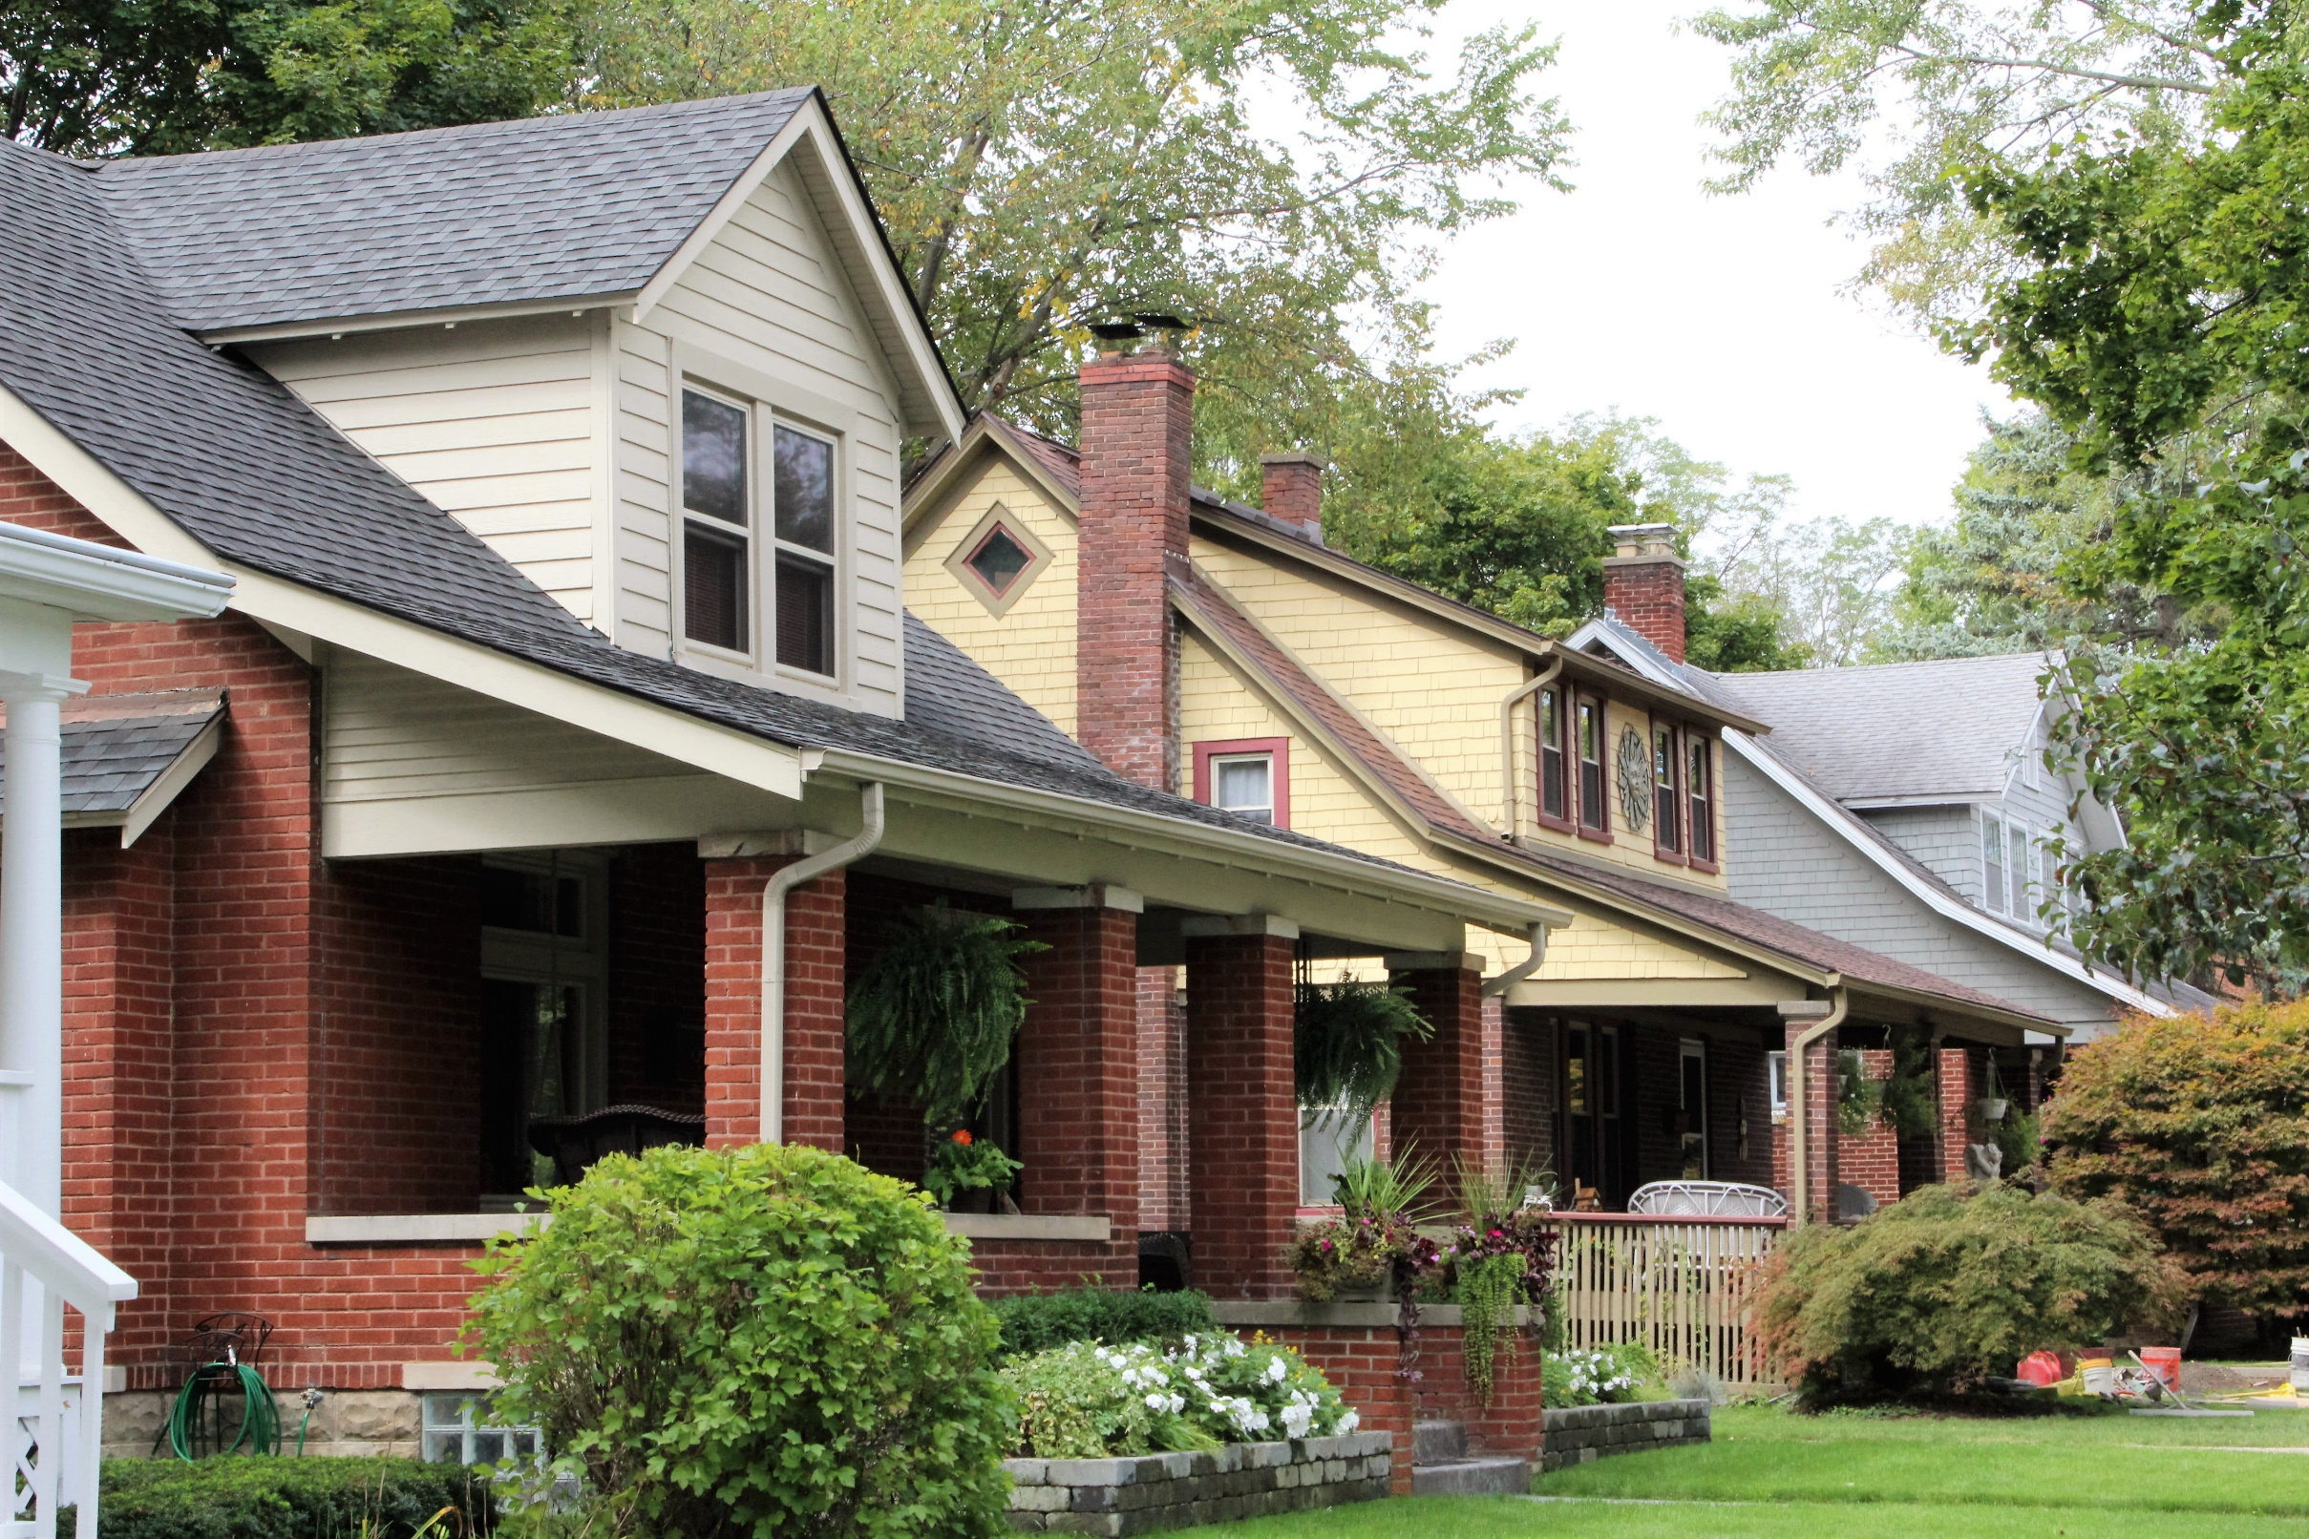
Craftsman, ca. 1905-1930
While the Craftsman style is found in several different forms, the Craftsman bungalow is the Craftsman example you are most likely to find in our community. Through the pattern books of the Greene brothers of California and kit house catalogs, the bungalow became the most popular smaller house in the 1920s.

Slide 52
Craftsman Characteristics
Side-gabled roof with gabled dormer
Large full-width porch under main roof
Porch supports are columns or battered piers
Cladding is wood, stone or brick
Exposed rafter tails
Triangular knee-braces
Stickwork in gables
Multi-light upper window sash over single light sash
Stone chimneys

Slide 53
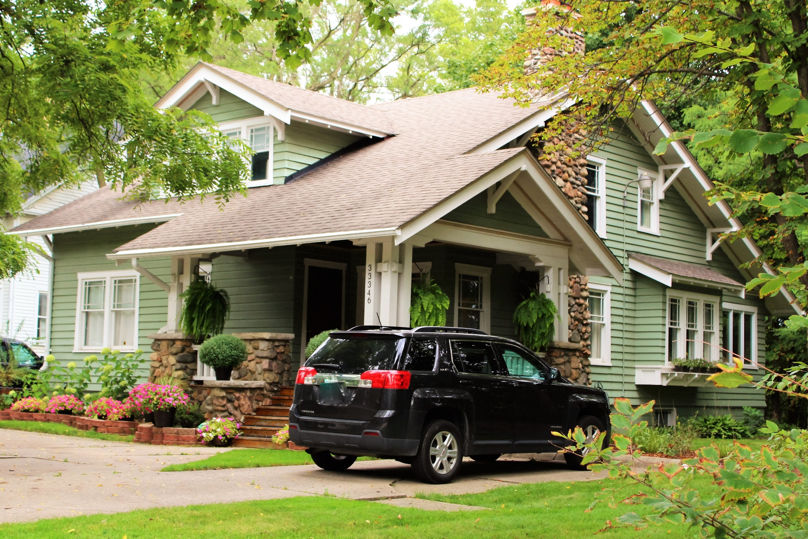
Craftsman
1920
Shiawassee Road
Farmington
Exposed Roof Rafter Tails
Knee Braces
Multi-Light Upper Sash
Stone Chimney
Battered Piers

Slide 54
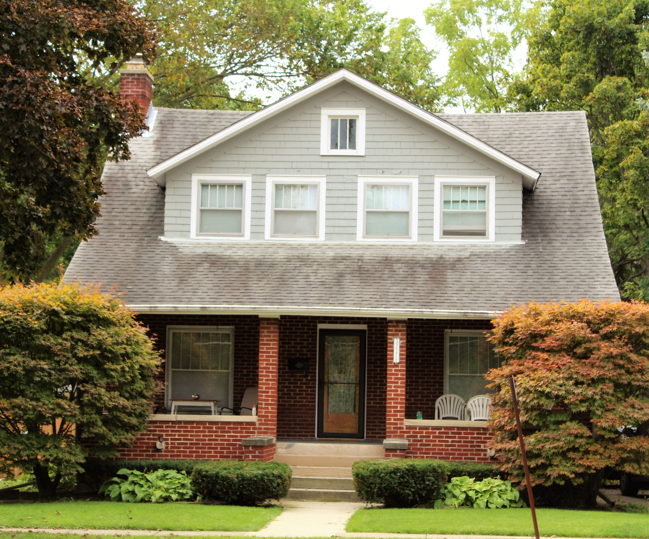
Craftsman
1922
Oakland Avenue
Farmington
Side Gable Roof
Gable Dormer
Multi-Light Upper Sash
Full-Width Porch Under Main Roof

Slide 55
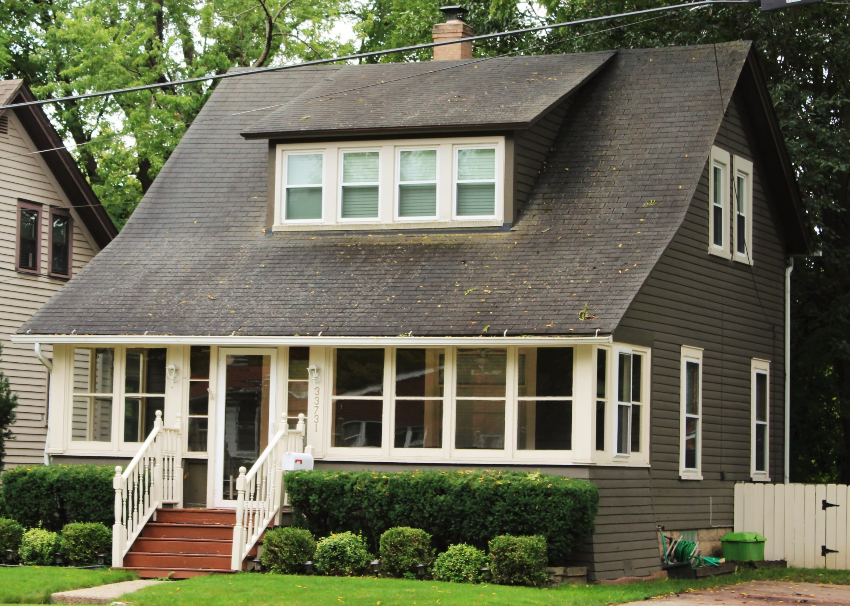
Craftsman
1920
Shiawassee Road
Farmington
Shed Roof Dormer
Full-Width Enclosed Porch
Side Gable Roof

Slide 56
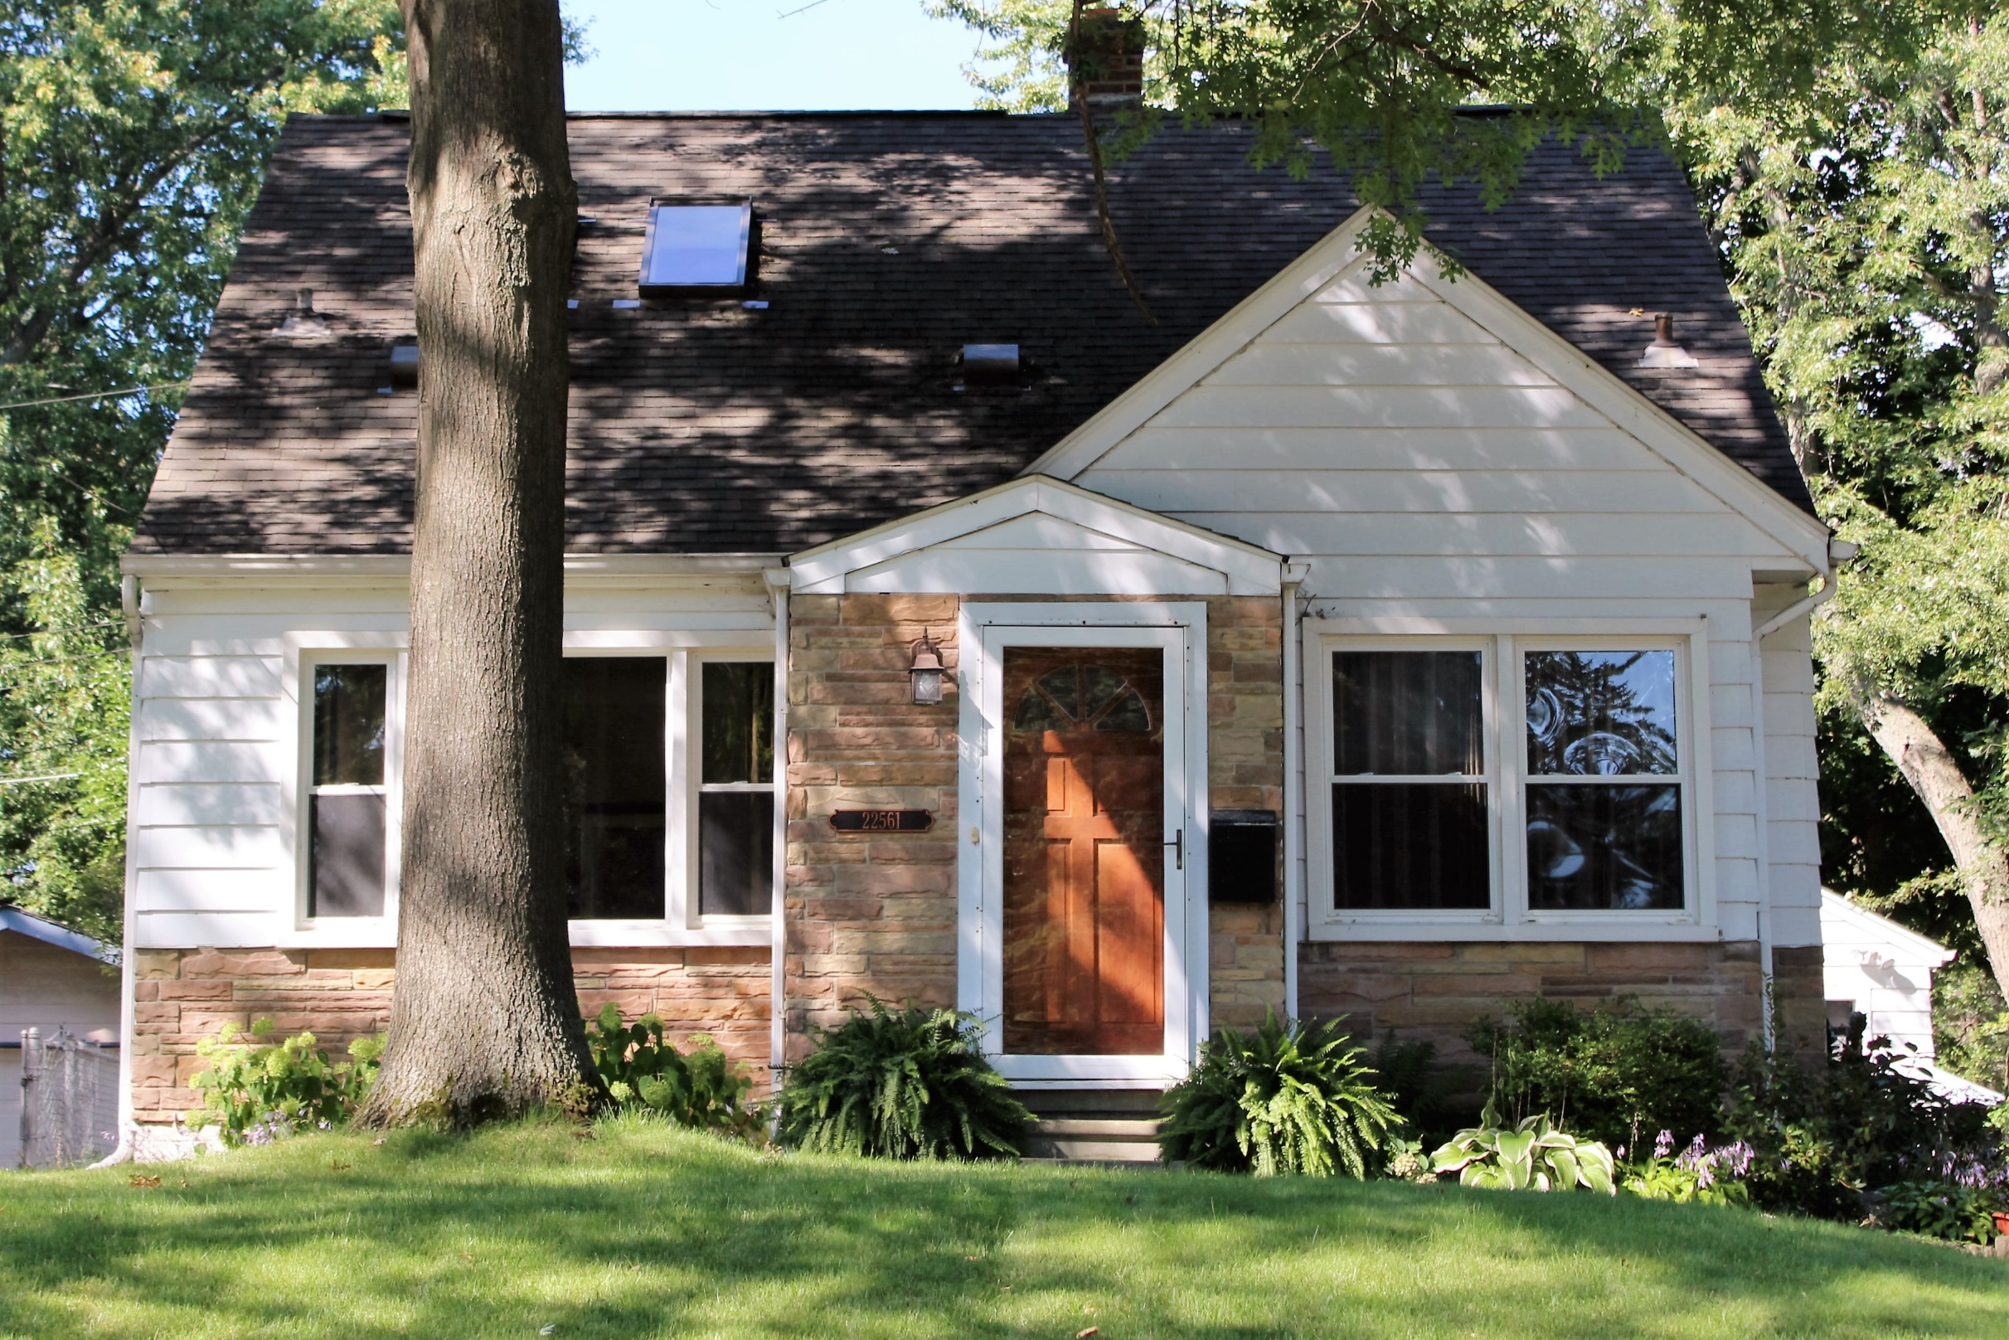
Minimal Traditional, ca. 1935-1950
The Minimal Traditional style was a response to the economic depression of the late 1920s. It was an unornamented revivalist style that can now be found en masse in most cities around the nation.

Slide 57
Mid-Century Modern, ca. 1945-1980
Innovative, minimalist design characterizes Mid-Century Modern. The world is abuzz with this era of design which encompasses architecture, furniture and much more. The scope of design for Mid-Century Modern is broad, but is dominated by horizontal lines, a lack of ornamentation, large windows and flat planes.
A number of prominent Mid-Century architects have works in the Metro Detroit area, including Eero Saarinen and Ludwig Mies Van der Rohe. Walter Gropius’ student, William Kessler designed our community’s two Mid-Century homes which are designated historic districts in Farmington Hills.

Slide 58
Mid-Century Modern Characteristics
Large panes of glass
Flat roofs
Flattened gable roofs
Exposed structural elements
Open space
Materials such as steel and plywood
Split-level spaces
Harmony with nature
Lack of ornamentation
Flat planes
Experimentation with shapes

Slide 59
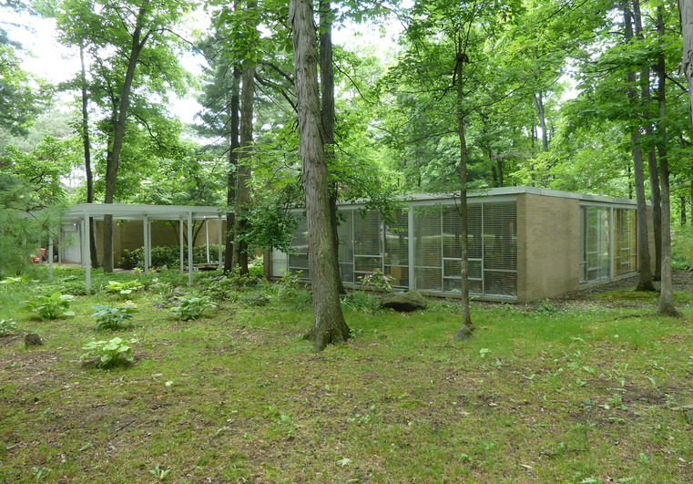
Mid-Century Modern
1959
Jack Beckwith House
Architect: William Kessler
Farmington Hills
Exposed Structural Elements
Flat Roof
Open Floor Plan
Large Panes of Glass
Integrated with Nature

Slide 60
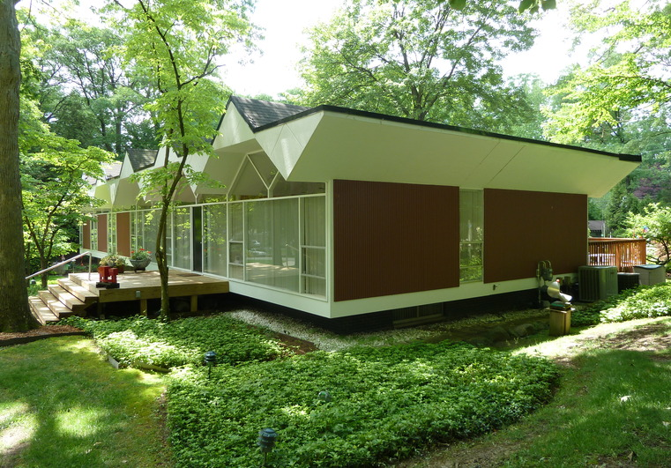
Mid-Century Modern
Experimentation with Shapes
1960
Arthur Beckwith House
Architect: William Kessler
Farmington Hills
Use of Steel
Large Panes of Glass
Flat Planes
Exposed Structural Elements
Integration with Nature

Slide 61
Are you ready to test your knowledge?

Slide 62
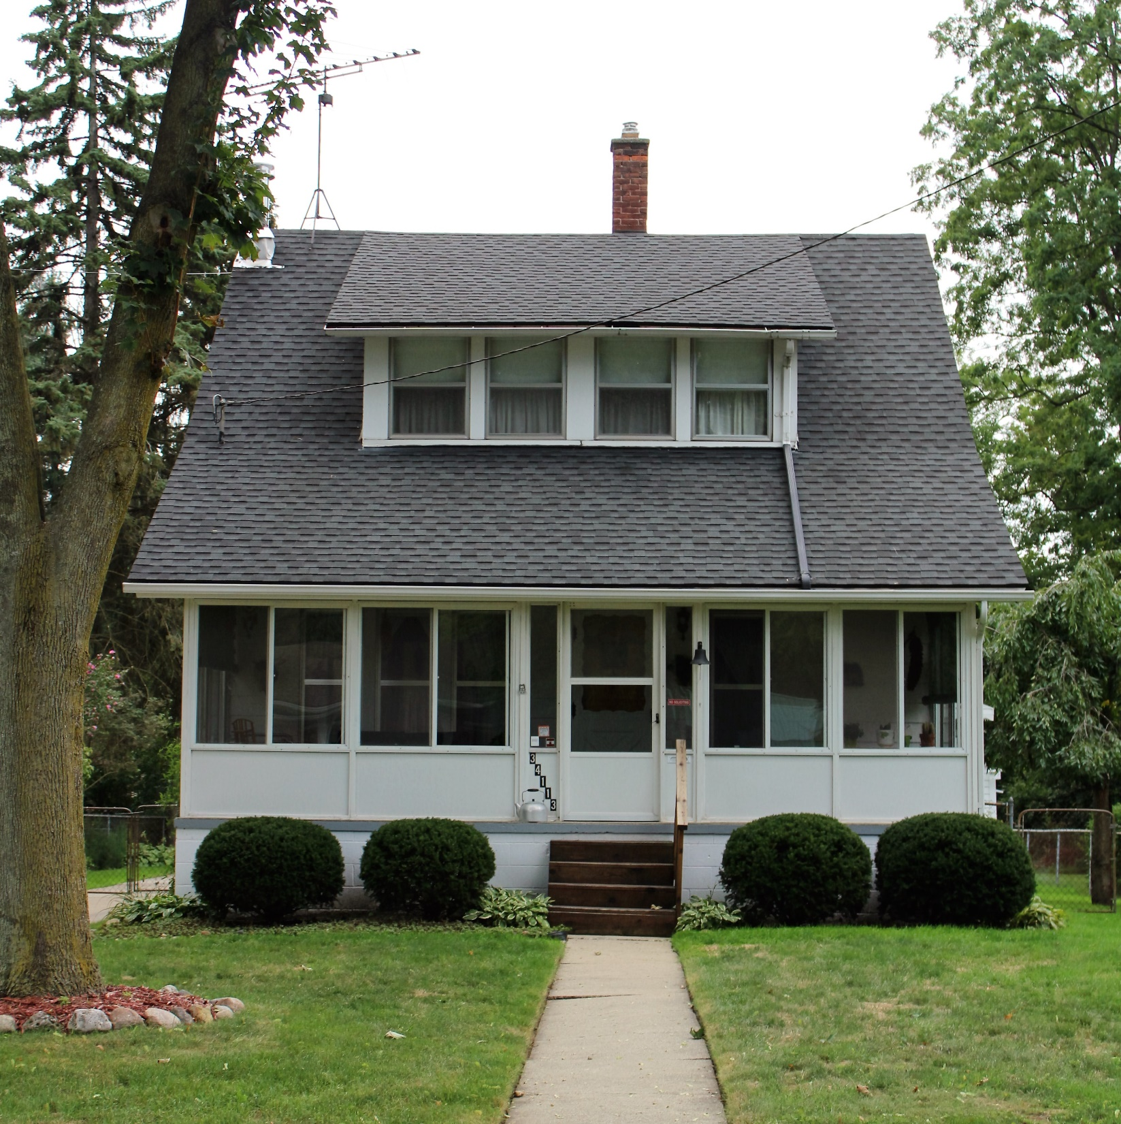

Slide 63
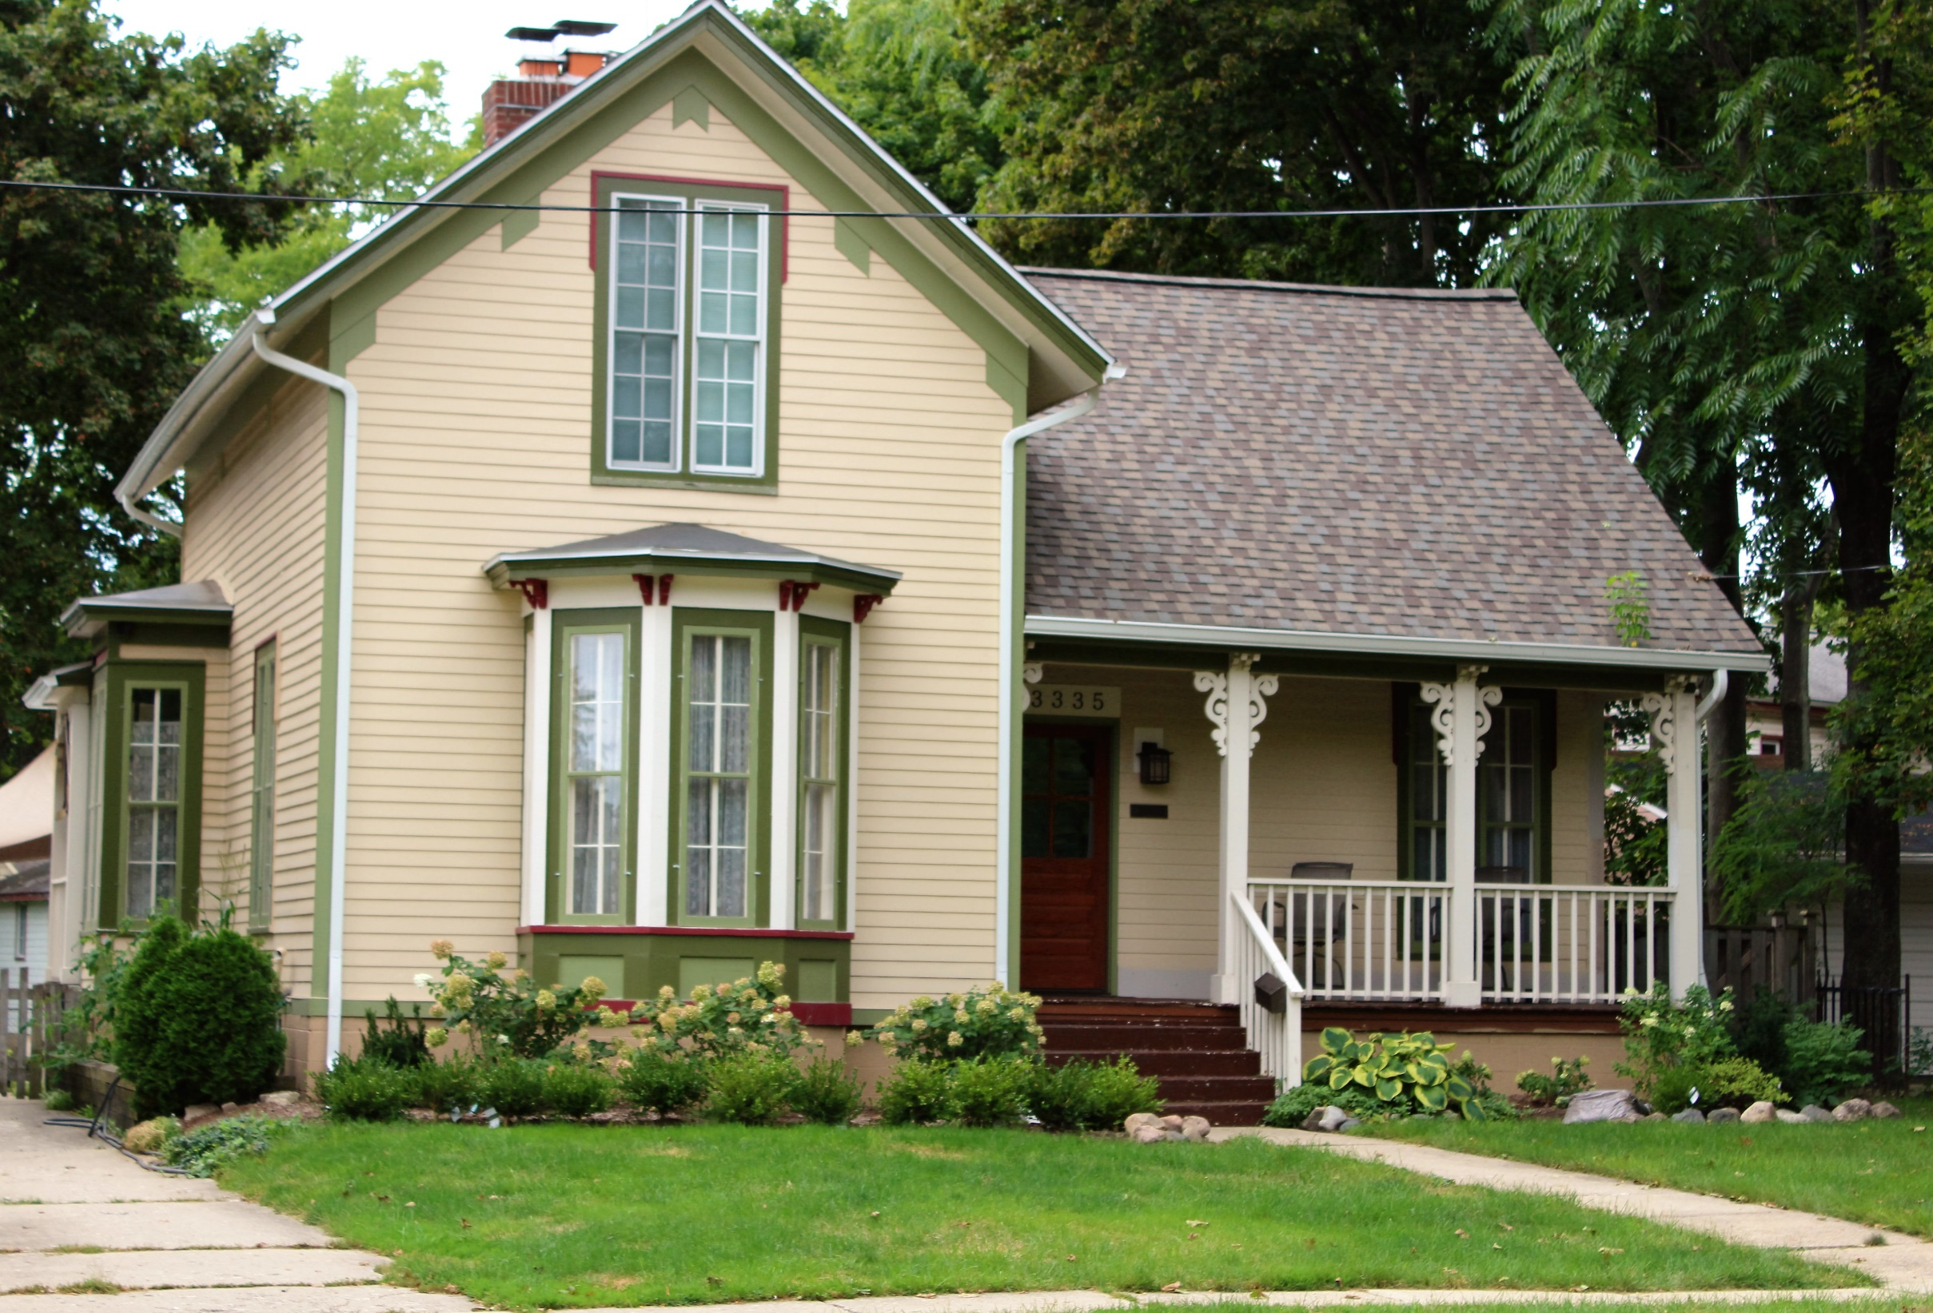

Slide 64
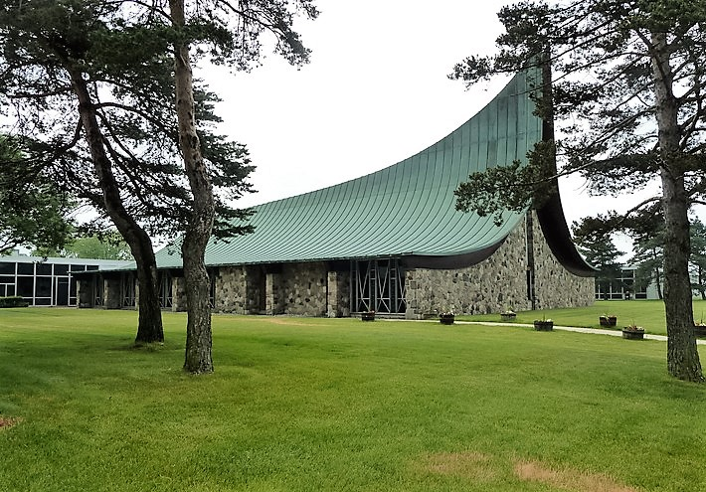

Slide 65
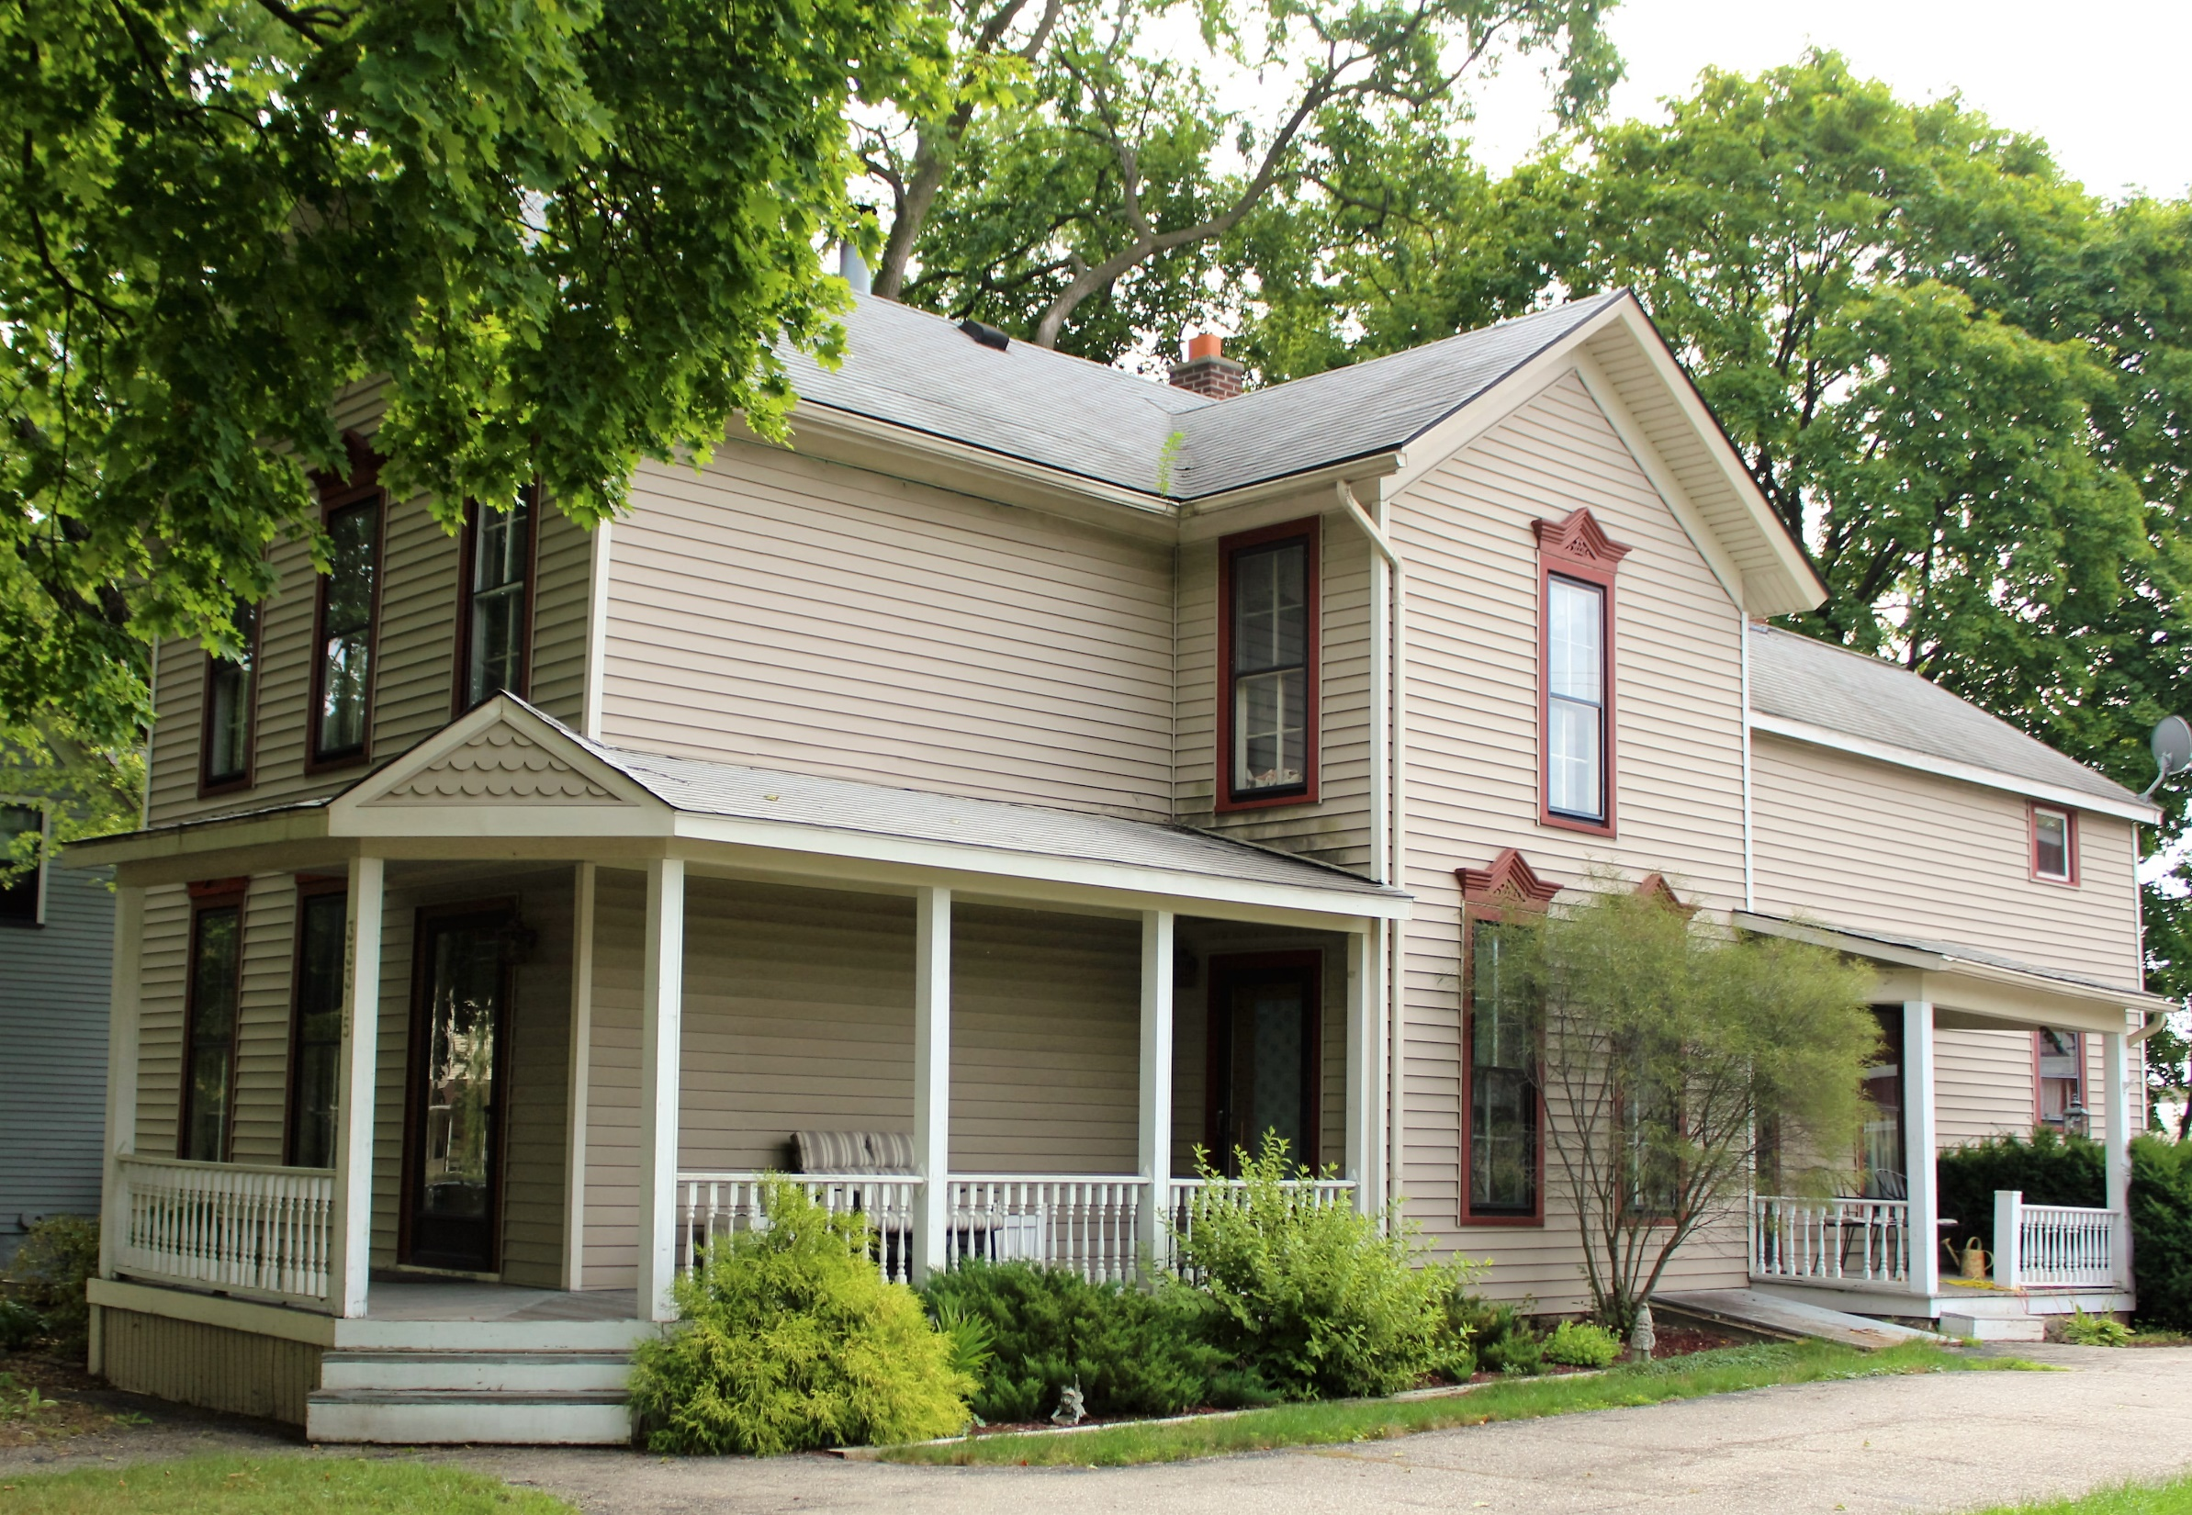

Slide 66
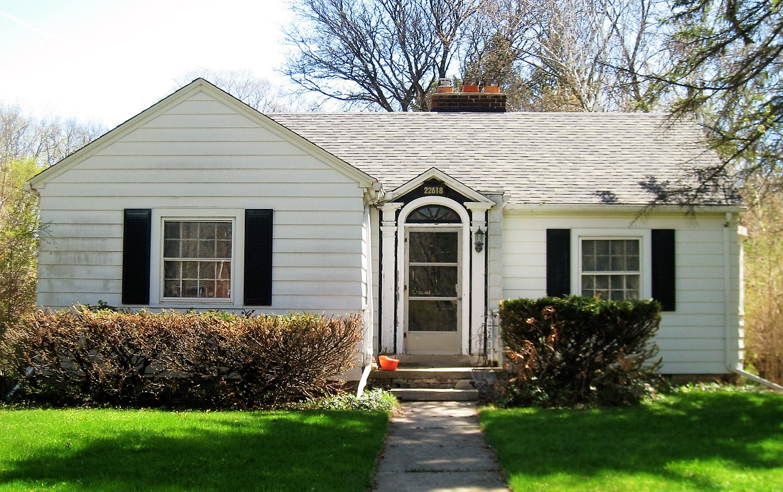

Slide 67
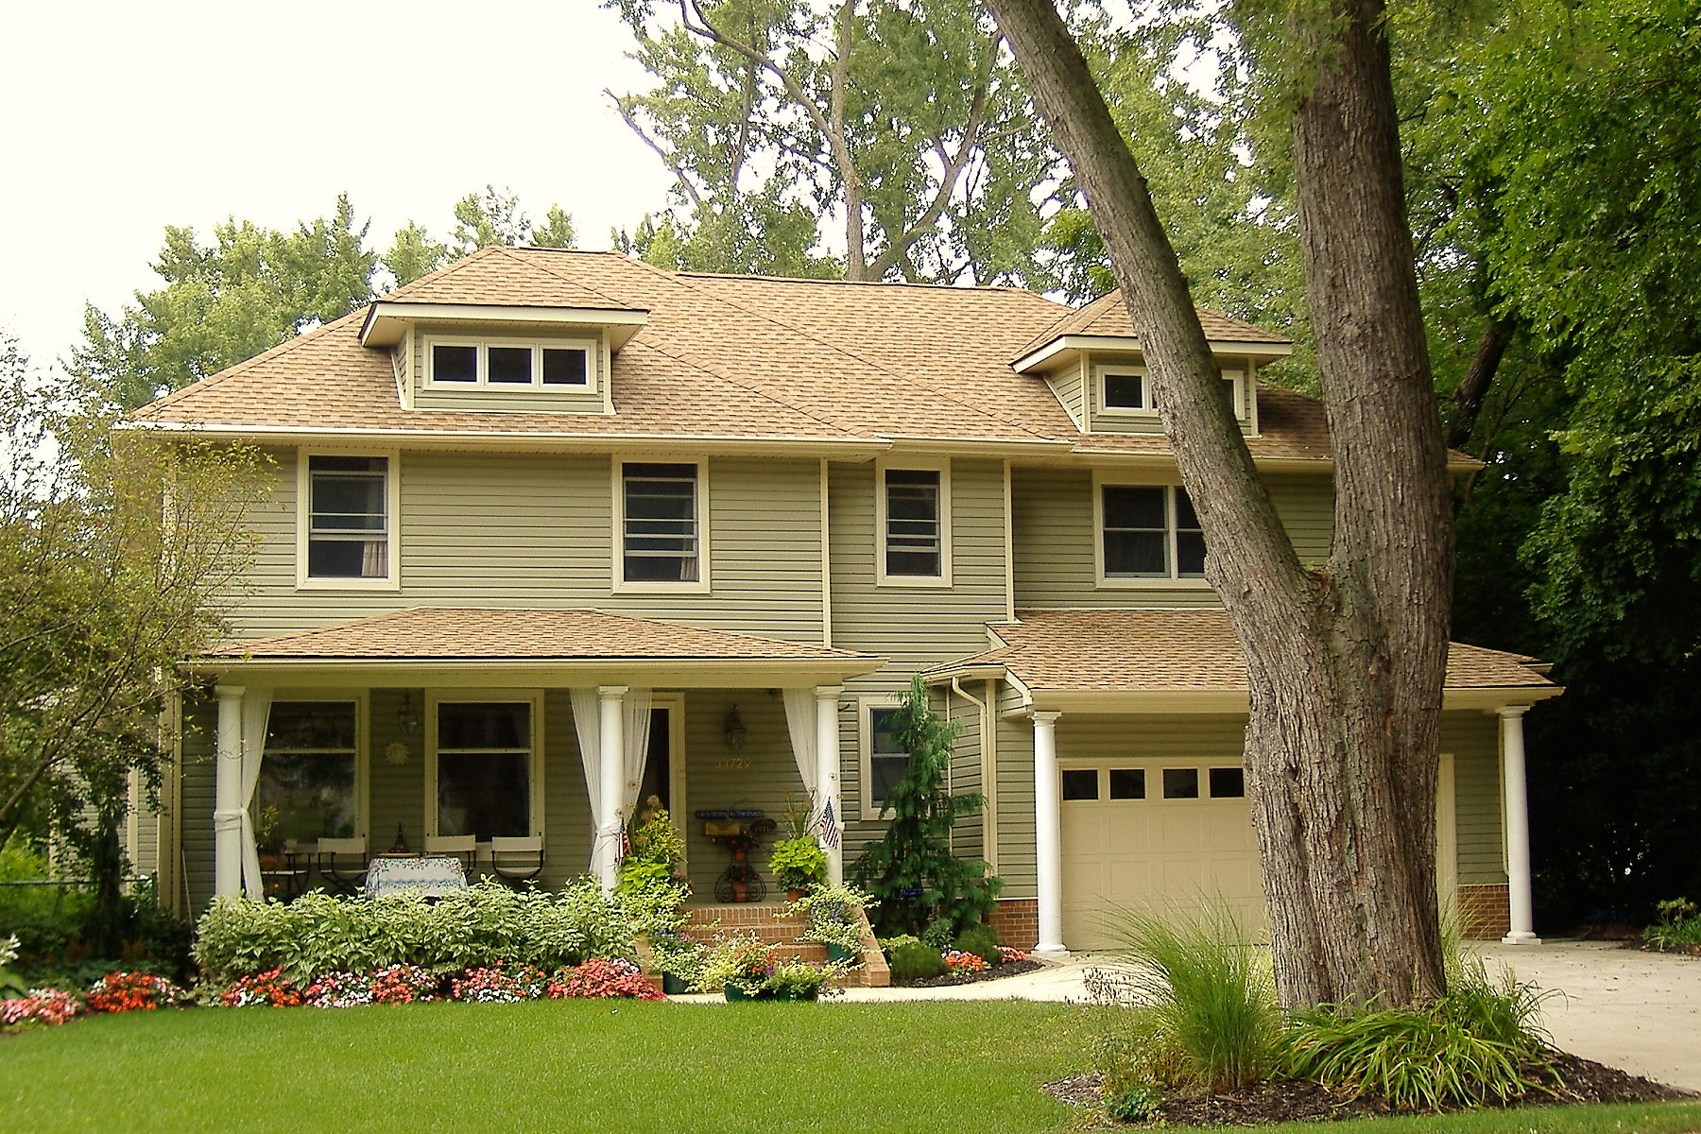

Slide 68
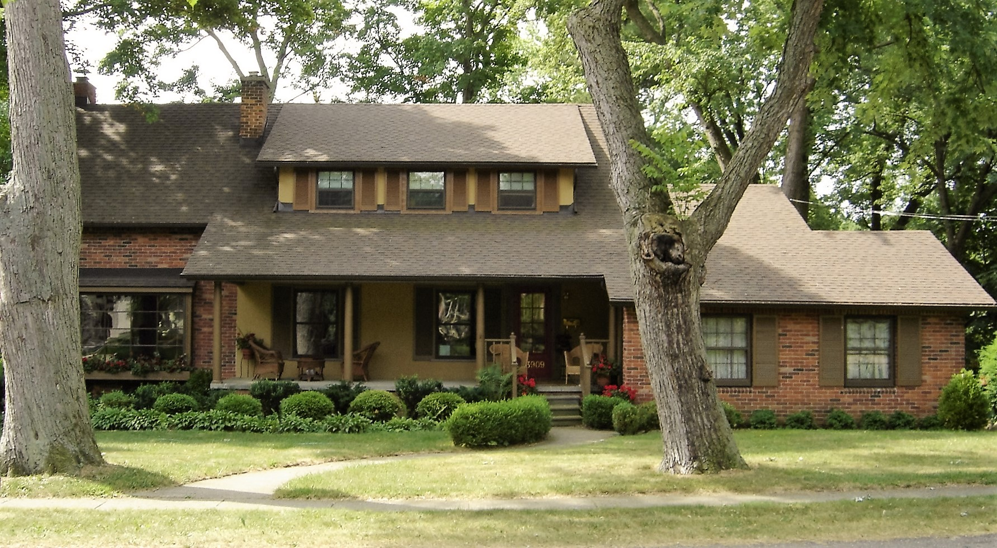

Slide 69
Questions?

