Slide 1
Researching Your Historic Home:
Focus on Farmington and the Hills
Brought to you by Preservation Farmington

Slide 2
Where to begin?

Slide 3
The Farmington Library Main Branch, Heritage Room
Early Land Records & Maps
  Land Grant Records – First Land Owners- Oakland Co. /Unit 4C 977.438 C
  Family Maps of Oakland Co., MI /Unit 4C 977.438 C
  Oakland Co. Farmington Twp Deeds 1826- 1852 /Unit 4C 977.438 C
  Land Conveyances, Blue Notebook #7, Unit 1B
  Land Owners Maps of Historical Farmington Twp 1822-1830/Unit 4C 977.438 S
Directories
  City Directories, beginning 1939 / Unit 2B
  Telephone Directories /Unit 2B

Slide 4
The Farmington Library Main Branch, Heritage Room
Maps
  Sanborn Fire Insurance Maps, Farmington 1926 and 1933
  1870 Farmington Township Map, held in Archive Room in Volunteer Map Box
  Farmington Twp Indian Trails, 1976, held in Archive Room
  Farmington Township Map, ca 1830, in Archive Room
  Farmington Map, Eastern Part 1834, in Archive Room
  Farmington Map, Eastern Part 1841, in Archive Room
  Farmington Power’s Plat, 1846, in Archive Room
  Oakland County Civil War Poster Map
  Farmington Map, 1857, in Archive Room
  Farmington Township Map, 1872, in Archive Room
  Farmington Twp Street Map, 1930, in Archive Room
  Farmington Twp Street Maps, 1962, 1965 and 1971
  Additional city maps going forward in time

Slide 5
The Farmington Library Main Branch, Heritage Room
Tax Rolls
  Oakland Co. Farmington Twp Tax Rolls, 1841-1897 /Unit 4C 977.438 F
Family Histories
  Family genealogies /Unit 2C 929.2 C
  Robert Cook Collection Surname Indexes and Binders
  Farmington’s Centennial Families (Book) /Unit 4C 977.438 F
Historic Newspapers (available online and in the library)
  Farmington Enterprise, 1888-2003, searchable
    (Research-> Newspapers/Periodicals ->Farmington Historical Newspapers)

Slide 6
Other Resources
Ancestry.com (free at the library)
  Census Data
  Land Grant Copies
  Records on the individuals who settled and lived at your property
BLM- GLO (Bureau of Land Management- General Land Office Records)
  Federal Land Patent Deeds
  Survey Plats and Field Notes
  Tract Books
  Online at https://glorecords.blm.gov/default.aspx

Slide 7
Land Development and Plat Maps
Michigan was platted between 1815 and 1860. By 1824, land grants were being issued for the area that would become Farmington.
Land was divided into Townships and Ranges. Each Township /Range was then divided into 32 sections with each section comprising 640 acres. Land was granted in acres, with a description related to the section. A description might appear as such:
The E ¼ of W ½ of section 28,T1N R9E.
Section 16 was always reserved for the “school section”. A school would be located in this section, and any income from this section such as rent or lumber sales, would go to fund the school.

Slide 8
Land Development and Plat Maps
Indian School Reserve Site
In Farmington, there was an Indian School Reserve site. Land Owners Maps of Historical Farmington Township gives background information on this location, and it is well worth a read. If you live in an area which was part of this Reserve, don’t be surprised if you find Native American artifacts as it was a favorite camping ground for various First Nation peoples.

Slide 9
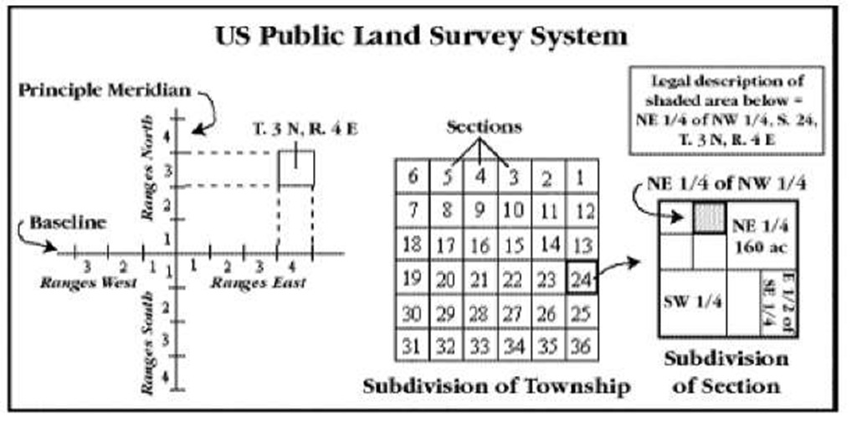
Land Development and Plat Maps
The basics for reading plat maps:
Plat maps are divided into TOWNSHIPS and RANGES.
Townships were divided into 32 sections. Sections are laid out to be one mile square.

Slide 10
Land Development and Plat Maps
Farmington and Farmington Hills are primarily in Township 1 North Range 9 East (T1N R9E).
Farmington is generally found in sections 28, 27 and 26.
As the boundaries for Farmington and the Hills don’t follow the township boundaries exactly, you should keep this in mind as you search for your property on plat maps.
The original land ownership grants are called PATENT DEEDS.

Slide 11
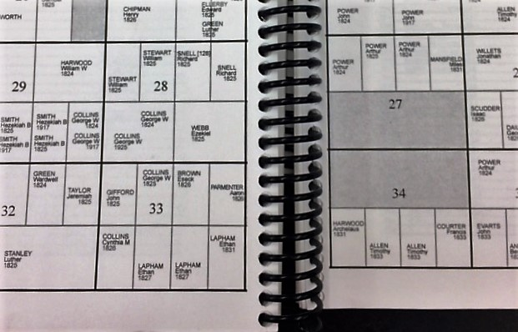
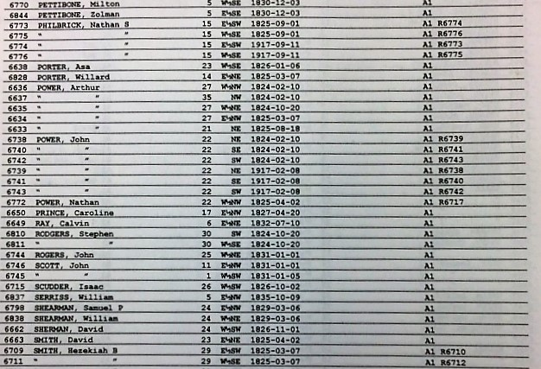
Early Land Ownership Reference
Family Maps of Oakland County, Michigan
The family maps book shows the original land patent deeds issued in Oakland County. The book is divided into Townships with names listed in both map form and list form. Names and year of the patent deed are listed.

Slide 12
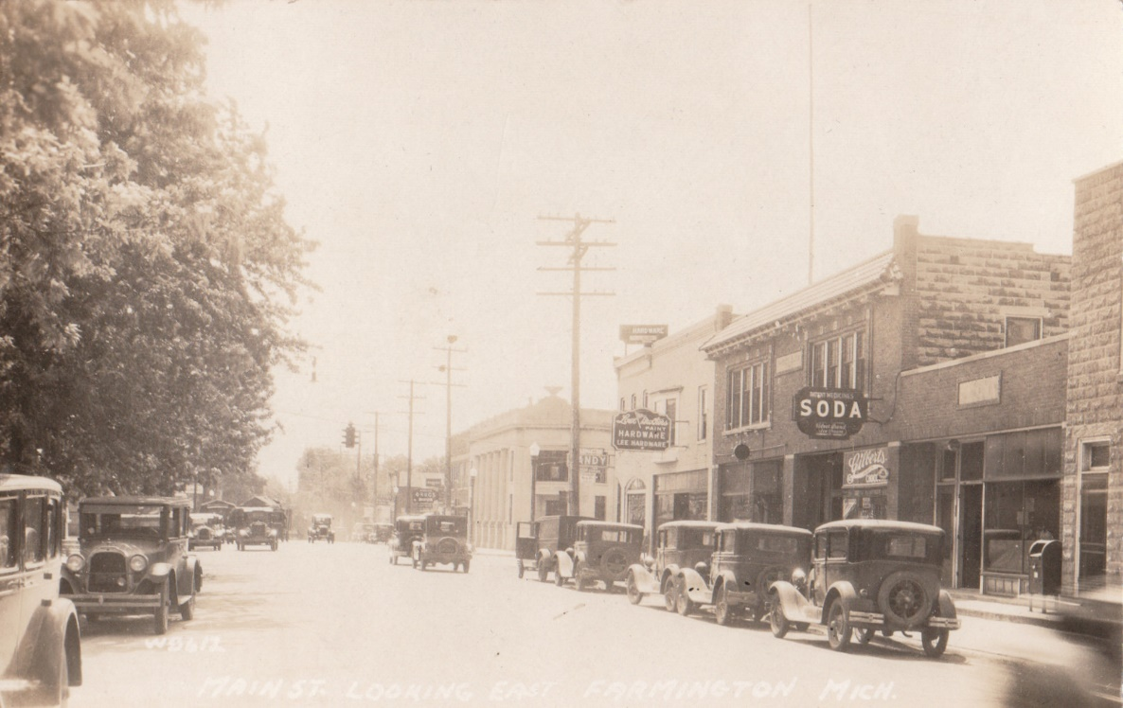
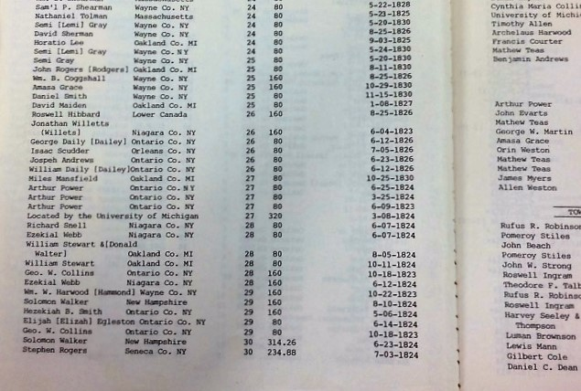
Early Land Ownership Reference
First Land Owners of Oakland County, Michigan
Published by the Oakland County Genealogical Society, this book is another source of land patent deed information. There are no maps in this resource, however it has more information about the individuals and the acreage. It shows the number of acres, as well as the county of residence of the patentee and the date of the patent. In example 4, we see that the patent date might differ from other sources.

Slide 13
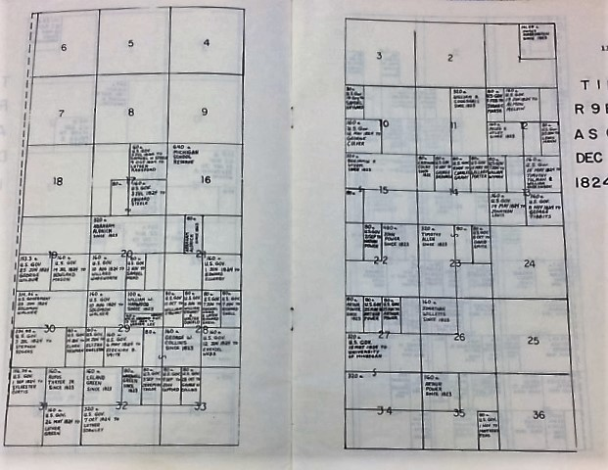
Early Land Ownership Reference
Land Owners Maps of Historical Farmington Township, Vol 1 1822-1830
Published by the Farmington Genealogical Society in 1986, this resource is a very helpful reference tool that shows changes in land ownerships in the format of maps. It also gives background information on some interesting topics such as the Indian School Reserve and how it was transferred to the University of Michigan, as well as an explanation of the school section (Section 16)

Slide 14
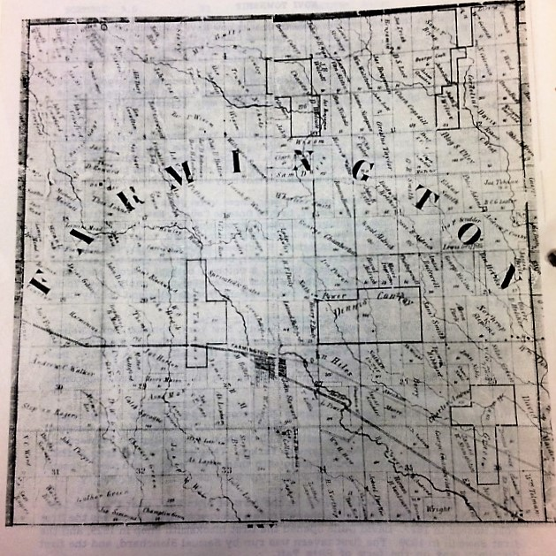
Early Land Ownership Reference
1857 Plat Map- Oakland County (Blue Binder)
Although somewhat hard to read, the plat map is arranged by township and has a list of the land holders per section. This is a photo copy of the plat map itself.
When looking at maps such as this one with roads and topographical features, remember to look for landmarks such as the Rouge River, Grand River Avenue and Shiawassee. Remember these were Indian trails, and were established already by the time Arthur Power arrived.

Slide 15
Early Land Ownership Reference
Oakland County, Michigan/ Farmington Township Deeds 1825-1850:
Commissioner’s, Mortgage, Quitclaim and Warranty
As you probably know, every time a property is conveyed from one owner to another, a deed is issued. There are different types of deeds issued, such a mortgage deed when there is a mortgage on a property. A quitclaim deed is issued when a property is given from one owner to another such as in an inheritance. A warranty deed is the type of deed most often used in real estate transactions with buyers and sellers.
This book lists land conveyances, including name, section, date and type of deed. There is an index sorted by name with references to the pages with legal descriptions.
Land Conveyances Binder
This binder was hand compiled by Robert Cook and includes dates, parties involved, descriptions and in some cases liber and page numbers, considerations and a pictorial representation of the land transferred.

Slide 16
City Directories- What Can You Find?
Residents at your address, not necessarily the owner. Occupations are usually listed in early editions.
Advertisements for local businesses
A history of Farmington, including boundaries
Many of the addresses of Farmington Hills will not be in these directories, as the boundaries of Farmington Township were between Nine and Ten Mile Roads north to south, between Gill and Orchard Lake Roads east to west.

Slide 17
City Directories
If you don’t have much time to dedicate at the beginning of this process, start with online City Directories. The Farmington Public Library has Farmington City Directories available through their website. This is how I usually start historic house research in Farmington.
The downside? They’re cumbersome to search as the Find feature is not effective at capturing all entries for streets due to inconsistencies in how street names are listed and abbreviated in the directories. You’ll find it’s fun to see the advertisements in the directories and will probably enjoy the search!
Our earliest directories start in 1939. Go to www.farmlib.org, select Research, Special Collections, Local History.
http://www.farmlib.org/local-history/

Slide 18
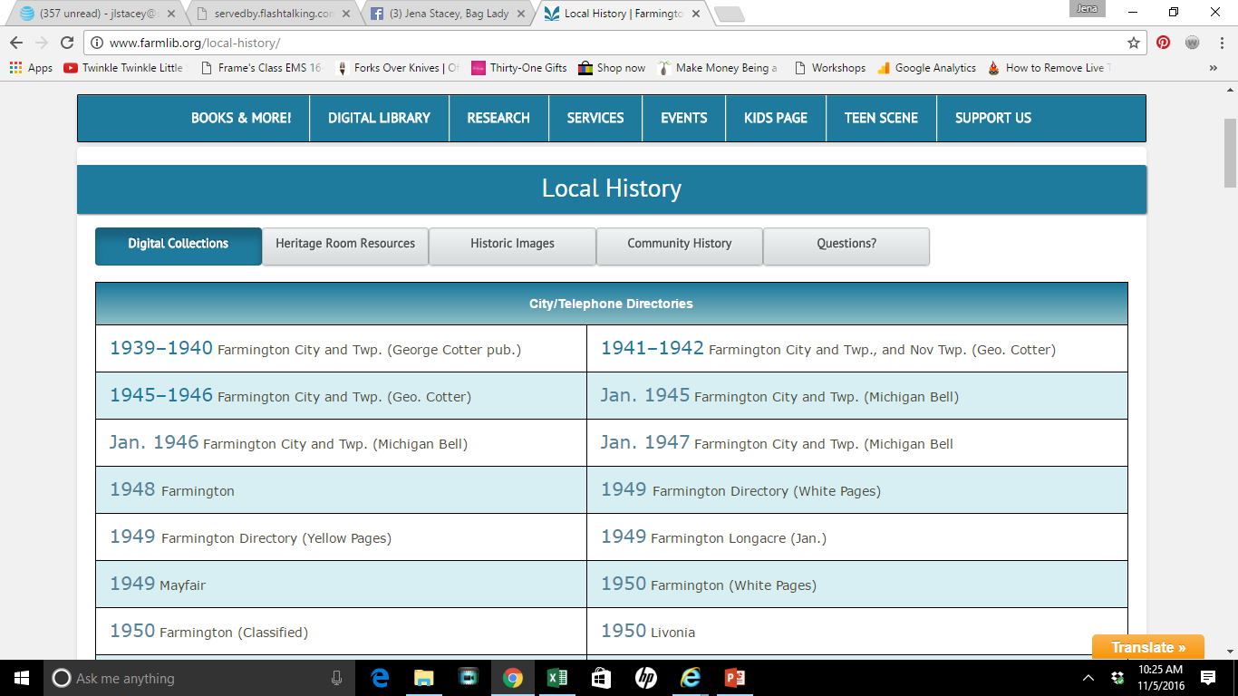
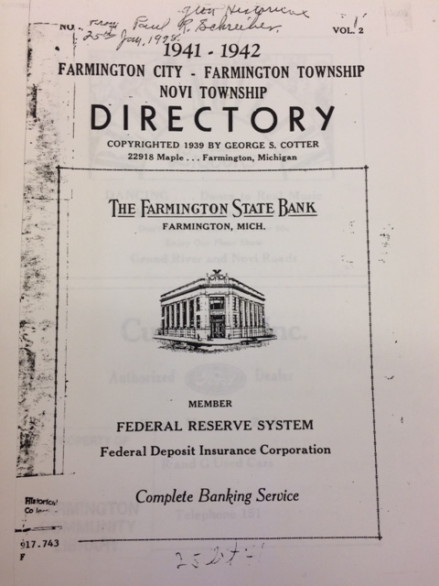
City Directories

Slide 19
Census Records
Addresses were not listed on United States Federal Census records until 1930. From that point forward, searching census data can yield some interesting results. Census records are taken every ten years, and over time the data recorded on censuses has varied. Information can include country of birth of parents, occupation, whether the occupant owns or rents the house, the names of all home occupants, whether the household has a radio (yes, that was on a census!) and whether the person was in school or unemployed.
Prior to that time, the records are better for verification that someone lived in the area. Keep in mind that prior to 1850, only the head of the household was listed by name. All other occupants were denoted by age, gender and race. Census records have only been released through 1940 due to the “72-year rule”.

Slide 20
Sanborn Fire Insurance Maps
Sanborn Fire Insurance maps were created by the Sanborn Fire Insurance Company. These maps denoted footprints and composition of buildings, which is very helpful for researchers. The Farmington Sanborn maps were really focused on our downtown Farmington area. They were not issued for Farmington Township.
Sanborn maps are available for the years 1926 and 1933 for Farmington, and are available on the Farmington Community Library’s website: http://www.farmlib.org/local-history/. Scroll to the bottom of the page for Maps.

Slide 21
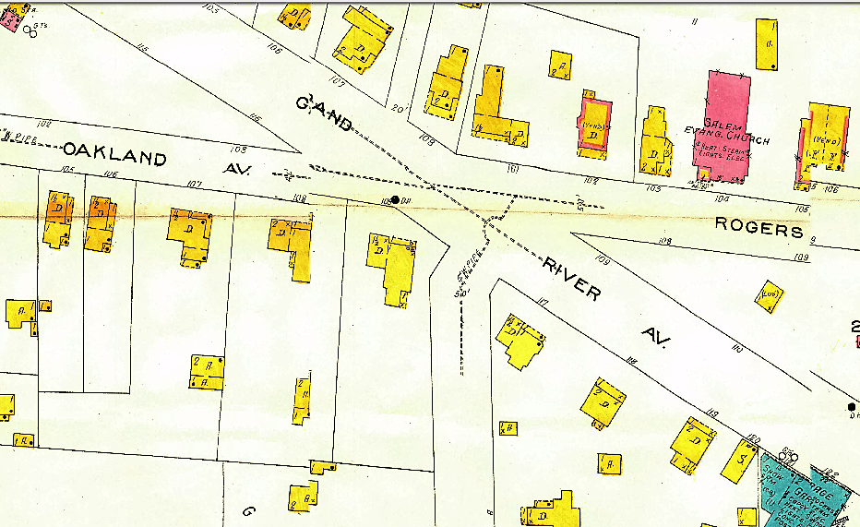
Sanborn Fire Insurance Maps

Slide 22
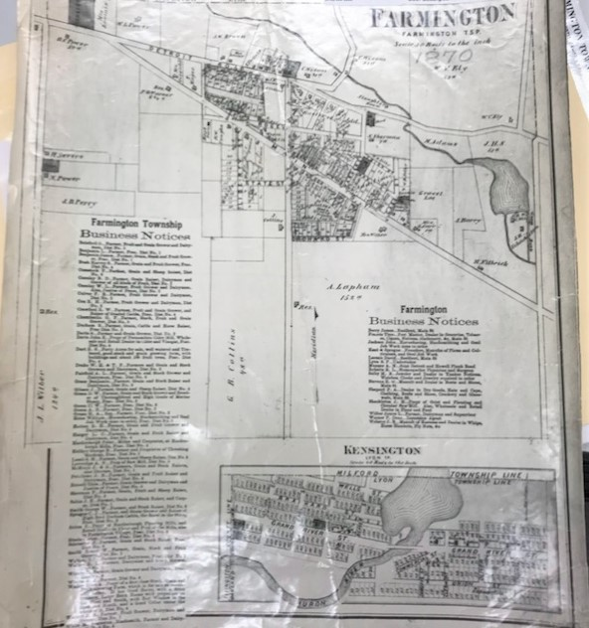
Historic Maps
1870 Map of Farmington

Slide 23
Local History Books
Our community library has several insightful books for your research written by our local historians Lee Peel, Ruth Moehlman and Brian Golden. Here are a few key books for your research:
Heritage Homes of Farmington: If Walls Could Talk by Ruth Moehlman 977.438 M
Farmington: A Pictorial History by Lee S. Peel 977.438 P
Farmington, Michigan in the Early 1900s by Harley Walters 977.438 W
Farmington: A Pictorial History Photograph Collection by Brian M. Golden 977.438G
Farmington Hills Historic District by the City of Farmington Hills Historic District Commission 977.438 F
The Making of America: Farmington and Farmington Hills by Debra Ann Pawlak, 977.438 P
Farmington’s Centennial Families by the Farmington Hills Historical Commission 977.438 F
Farmington History: 1824 – 1889 (articles by P. Dean) 977.438 W
Farmington: 1824 – 1908 Brief Histories & Biographies (Nathan Power’s Journal) 977.438 P

Slide 24
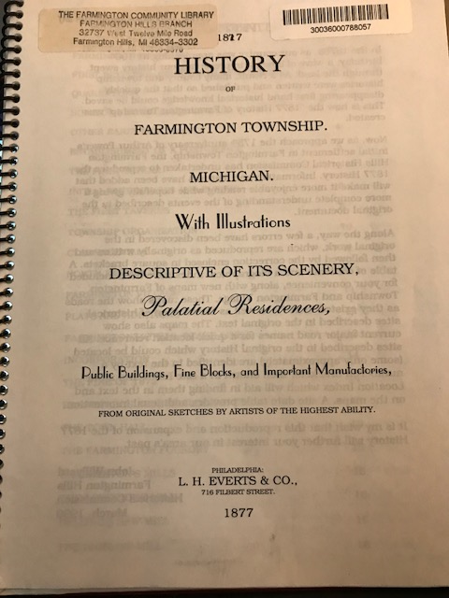
1877 History of Farmington Township Michigan
This volume of sketches published by the L.H. Everts & Co of Philadelphia was reproduced and expanded by John Willyard of the Farmington Hills Historical Commission in 1999. It describes the founding of Farmington by Arthur Power along with the description of early settlers and the industries they started in the community. According the 1877 History of Farmington Township, Timothy Tolman constructed the first timber-framed house in Farmington in 1828.
Of particular importance to the historic home researcher are the biographical index and site index found in the back of the small book.

Slide 25
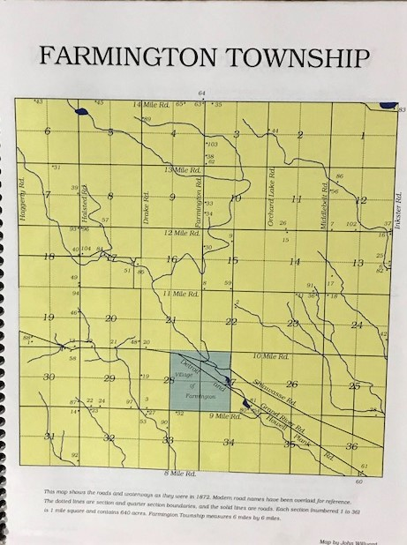
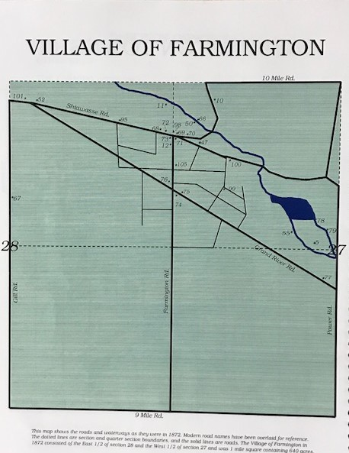
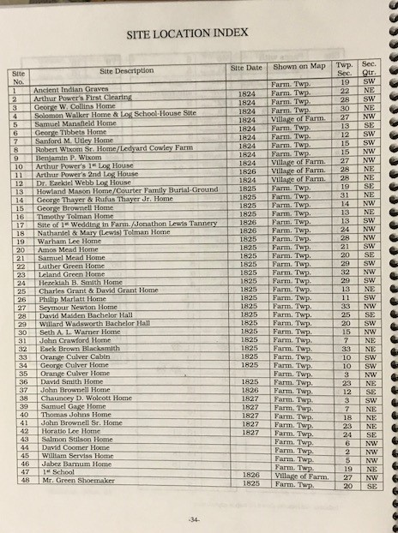
1877 History of Farmington Township Michigan

Slide 26
Heritage Homes of Farmington
Ruth Moehlman’s book is based on a series of articles she wrote in the Farmington Forum. As an original member of the committee that created the historic district in Farmington Hills and long-term member of the FH Historic District Commission, Moehlman shares her wealth of knowledge in her book.
The book is structured by original settlement areas of Farmington Township, topics in the development in the area as well as a few sections focused solely on architecture. Most houses found in the book will be from the nineteenth century and early twentieth century, although land development and original settlers will be covered which can offer early settlement information of the land on which your home sits. Moehlman’s book also serves to give context to the area when your home was built and what was going on the community at that time.

Slide 27
Farmington: A Pictorial History
As the title describes, Lee Peel’s book focuses heavily on photographs, but it also has textual information on the development of Farmington. You may find your home in the photographs, and you will definitely find photos of our community before the construction boom of the 1940s. The majority of Farmington’s housing stock is considered historic, as it is older than 50 years old, but Peel’s book concentrates more extensively on Farmington before the 1940s.

Slide 28
Surname Indexes- Robert Cook Collection
The surname indexes cross-reference surnames with reference material available in the Heritage Room. Included in the information cross-referenced is:
  Biographical Sketches
  Naming of Cities, Towns and Lakes
  Family Group Sheets
  Family History Articles
  Land Conveyances
  Marriages
  Obituaries
  Wedding, Birthday and Anniversaries
  Biography of Early Families
Surname Index – Heritage Room Unit 1B 000.IDX (Blue Binder)
Biographies of Early Families – Heritage Room Unit 1B 000.VL-BEF (Blue Binder #1)
Farmington History Articles – Heritage Room Unit 1B 000.RBC (Blue Binder #4 & #5)
Family Group Sheets – Heritage Room Unit 1B 000.RBC (Blue Binder #3)

Slide 29
Ruth Moehlman History Articles
Ruth Moehlman wrote the Heritage Homes book, and wrote a large array of history articles. The library has indexed these articles by subject and by surname. A great of history of Farmington and its residents is contained in these articles, making it an integral source of history for your house research.
Index to History Articles by Moehlman (found in Heritage Room Unit 1C)
History Articles by Moehlman, Books 1-3 Heritage Room Unit 1C 000.VF, VFHAM-1 through VFHAM-2

Slide 30
Heritage Collection Photos
The library Heritage Room has a collection of photos included in 16 binders. The collection is indexed by subject, but the subject “Surname” has an alphabetical listing by surnames. Photos of individuals, groups, homes, businesses and streetscapes, amongst others, are found in these volumes. The indexes and volumes are found in the Unit 4C.

Slide 31
Deed Research
Deed Records for Farmington and Farmington Township are located at the Oakland County Clerk’s Office in the courthouse building in Pontiac, 1200 North Telegraph Road, Pontiac.
The easiest way to do deed research is to work backward. As technology changed, so did the storage methods for deeds. Recent deeds are available online through monitors in the clerk’s office. Many deeds are stored in card catalogs located in the clerk’s office as well. The oldest deeds, however, are located in the basement in ledgers.
The deeds will list the deed type, the seller’s name and the purchasers name as well as an address. For the oldest records, the land will have a legal description rather than an address. These records will be need to be traced by name rather than an address. The oldest deeds have been collected in several different books at the library, as described previously.

Slide 32
Examples

Slide 33
Foundational Information From Heritage Homes of Farmington
In 1815, the surveying of Michigan began. By 1820, land in Michigan was selling for $1.25 an acre. The Erie Canal was not completed until 1825, meaning our settlers had to traverse dangerous conditions along the bottom of Lake Erie to come to Michigan. The Power group who arrived in 1824 came by sleigh in the winter, which allowed easier passage over this area. Once the Erie Canal was built, travel to Michigan was much easier and safer.
The land settled which was to become Farmington was very attractive to pioneers due to its proximity to three major trails, the river and numerous springs. A river was key to any settlement as a mill could be run on a river.
Agents and speculators bought much of the land, thus your property history will likely show frequent ownership changes in the early years of prospecting.

Slide 34
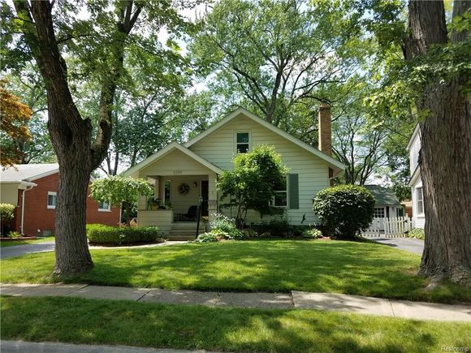
Example: Maple Avenue, Farmington, 1924

Slide 35
Example: Maple Avenue, Farmington, 1924
Step 1: Land Patent and Land Conveyances
A review of the Land Conveyances binder shows that the original land patent for the area including Maple Avenue was to the University of Michigan, dated May 15, 1824. Prior to that it was referred to on maps as “Indian Reserve School”.
The Land Owners Maps of Historical Farmington Township gives us a good rundown of early land transference:
1817 – Indian Reserve School
1824 – Title conveyed to U of M
May 1, 1830 – U of M to Miles Mansfield
The 1857 Oakland County Plat Map shows that T. Little owns an unspecified number of acres of the area that now encompasses Maple Avenue. This leaves us a gap between 1830 and 1857, but we can look for more information in the land conveyances binder.

Slide 36
Example: Maple Avenue, Farmington, 1924
Step 1: Land Patent and Land Conveyances continued
We have a head start on our research, and can use the land owner names we have to follow the trail of land exchange. At this point, we can use two books for reference. As land is subdivided more and more, legal descriptions get more complicated and hard to follow.
I used the Land Conveyances from Farmington Township 1824-1866 binder and the Oakland County, Michigan/ Farmington Township Deeds 1825-1850: Commissioner’s, Mortgage, Quitclaim and Warranty binder to follow the chain.
The first entry in the Deeds book is a warranty deed showing Miles and his wife Samantha sold this property (East ½ of SW ¼ of Section 27) plus 220 acres to John Hiles on July 25, 1833. Next on I search on John Hiles and find that less than two years later John and Phebe Hiles sold the parcel to Samuel Mansfield on January 22, 1835.

Slide 37
Example: Maple Avenue, Farmington, 1924
Step 1: Land Patent and Land Conveyances continued
The next step is a little harder to find the land transfer. After reviewing all of the entries for Samuel Mansfield and cross referencing with the Land Conveyances binder, I figure out that Samuel and Olive Mansfield sold a small portion of the parcel to Edmund Lampson on June 23, 1836.
After holding the parcel for twelve years, the Lampsons sell it to Orrin Bush and Joseph Sage Jr. on September 15, 1848.
Next I’ll look at City Directories online. I start with the earliest edition. Keep in mind there may be multiple individuals listed for a single residence, especially in the years during WWII and directly after the war. I found the following:

Slide 38
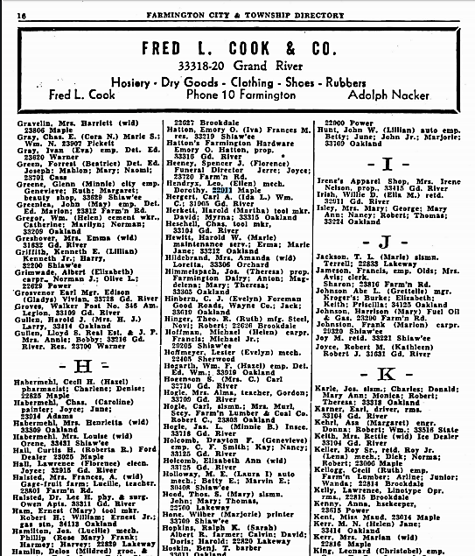
Example: Maple Avenue, Farmington, 1924
Step 1: Land Patent and Land Conveyances continued
1939-40 Leo & Ellen Hendryx, daughter Dorothy. Leo is a mechanic.
1941-42 Leo & Ellen Hendryx, 1 child. Leo is an auto mechanic; Geo W Hendryx, carpenter
1945-46 Leo & Ellen Hendryx, 2 children.
Jan 1945 – Leo Hendryx
Jan 1946 – Leo Hendryx
Jan 1947 – Leo Hendryx
1948 – Leo Hendryx
1949 – Leo Hendryx
1950 – Leo Hendryx

Slide 39
Example: Maple Avenue, Farmington, 1924
United States Federal Census
1930 Census: Leo Hendryx, age 29, owns house, mechanic in a garage; wife Ellen, age 26
1940 Census: Leo Hendryx, age 39, owns house, completed 3rd year of high school. Leo earned $1500 a year, and his house was worth $4000. Wife Ellen didn’t work, and went through year 2 of high school. In the census, their daughter Dorothy was now 8 and in 3rd grade.

Slide 40
Example: Maple Avenue, Farmington, 1924
Land Conveyances and Property Ownership
1817 – Indian Reserve School
1824 – Title conveyed to U of M
May 1, 1830 – U of M to Miles Mansfield
July 25, 1833 – Miles and Samantha Mansfield to John Hiles ($2500)
January 22, 1835 – John and Phebe Hiles to Samuel Mansfield ($2000)
March 11, 1837 – Samuel and Olive Mansfield to Edmund Lampson ($350)
September 15, 1848- Edmund and Anna (Amy) Lampson to Orrin Bush and Joseph Sage, Jr. ($1200)
1857 – T. Little owns the strip of land
1924 – House Built
Leo Hendryx was 23 when the house was built and married at 23. It is likely
Hendryx built the house.

Slide 41
Example: Maple Avenue, Farmington, 1924
Land Conveyances and Property Ownership
1930 Leo & Ellen Hendryx (Owns Home)
1939-40 Leo & Ellen Hendryx, daughter Dorothy. Leo is a mechanic.
1941-42 Leo & Ellen Hendryx, 1 child. Leo is an auto mechanic; Geo W Hendryx, carpenter
1945-46 Leo & Ellen Hendryx, 2 children.
Jan 1945 – Leo Hendryx
Jan 1946 – Leo Hendryx
Jan 1947 – Leo Hendryx
1948 – Leo Hendryx
1949 – Leo Hendryx
1950 – Leo Hendryx

Slide 42
Example: Maple Avenue, Farmington, 1924
Who Were They?
Although most of these records predate the house, the men and woman who owned the property are still part of the history of a home. With that in mind, we will discuss the early property owners of our example homes.
John Hiles
John Hiles was a farmer near Ten Mile and Power Road. When he married his wife Martha, he built a small cottage on Shiawassee Road. Later, son John Parker Hiles added a second story to the house. John Parker Hiles is listed as a Civil War veteran, and records show he enlisted in the cavalry for the Civil War while still a teenager. John Hiles’ wife Phebe was a founding member of the Methodist Episcopal Church in Farmington, joining the “class” of 1829.

Slide 43
Example: Maple Avenue, Farmington, 1924
Who Were They? (cont.)
Samuel Mansfield
In 1827, a circuit rider named Reverend John A. Baughman showed up in Farmington. The Methodist Episcopal Church was later founded by him but prior to that, he conducting services for the church at Samuel Mansfield’s house every six weeks.
Samuel Mansfield built the first timber-framed structure, a barn, in 1826 according to the 1877 History of Farmington Township. It was likely located on this parcel of land.
Another tidbit from the 1877 History – Samuel Mansfield built one of the first potash works in the town and built a saw mill in 1833, “…on the mill-stream a few rods below the centre of the village.” Mansfield was obviously a very prominent early settler of Farmington.

Slide 44
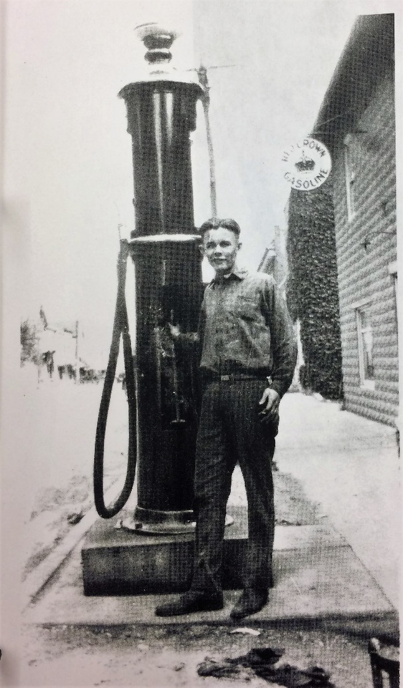
Example: Maple Avenue, Farmington, 1924
Who Were They? (cont.)
Leo Hendryx
Leo Hendryx and his wife probably built the home on Maple Avenue. At 23 he married his wife Ellen. Hendryx came from a family that had been in Farmington since 1877, when his grandfather moved to Farmington Township from Livonia.
Hendryx is mentioned in several Farmington Enterprise articles, highlighting a little bit about his life. We know that he was one of seventeen to pass the Oakland County 8th grade exam and moved on to Farmington High School in 1915. In that same year, he and sixteen other Farmington boys formed the Farmington Silver Cornet band in which he was an alto player.

Slide 45
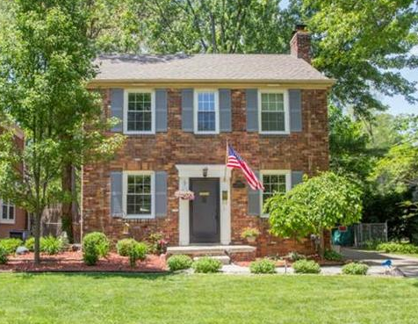
Example: Brookdale Road, Farmington, 1941

Slide 46
Example: Brookdale Road, Farmington, 1941
Step 1: Land Patent and Land Conveyances
A review of the Land Conveyances shows that the original land patent for the area including Maple Avenue was to the University of Michigan, dated May 15, 1824. Prior to that it was referred to on maps as “Indian Reserve School”.
The Land Owners Maps of Historical Farmington Township gives us a good rundown of early land transference:
1817 – Indian Reserve School
1824 – Title conveyed to U of M
November 22, 1828 – U of M to Ebenezer Stewart
The 1857 Oakland County Plat Map reflects Abraham Power as the owner at that time. Again, we will look at the gap coming up.

Slide 47
Example: Brookdale Road, Farmington, 1941
Step 1: Land Patent and Land Conveyances continued
On May 25, 1841, a record in the Deeds binder indicates that West ½ of the SE ¼ of Section 27 was quitclaimed to Nathan Power for a consideration of $500. Interestingly, just a few months later Nathan Power quitclaims it back to Stewart for $50! It is finally sold to Nathan Power on February 5, 1844 by Ebenezer and Mary Stewart for $200.
Next, we will look at Farmington City Directories.

Slide 48
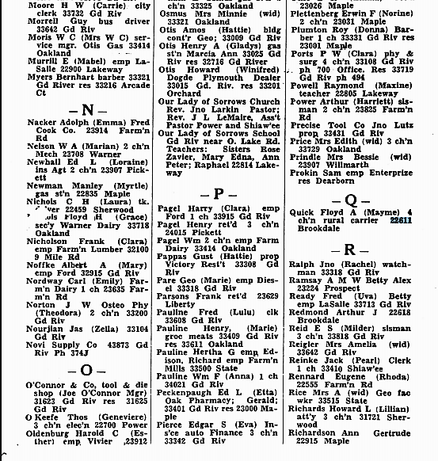
Example: Brookdale Road, Farmington, 1941
Step 1: Land Patent and Land Conveyances continued
1941-42 Floyd A. and Mayme Quick, 4 children. Floyd is a rural carrier (postal carrier).
1945-46 F A and Mayme Quick (*note, listed as 26111 Sherwood)
Jan 1945 – Floyd A Quick
Jan 1946 – Lloyd H Quick Jr.
Jan 1947 – Lloyd H Quick Jr.
1948
1949 – Lloyd H Smith Jr.
1950 – Lloyd H Smith Jr.

Slide 49
Example: Brookdale Road, Farmington, 1941
Land Conveyances and Property Ownership
1817 – Indian Reserve School
1824 – Title conveyed to U of M
November 22, 1828 – U of M to Ebenezer Stewart
May 25, 1841 – Ebenezer Stewart (quitclaim) to Nathan Power ($500)
September 27, 1841 – Nathan Power (quitclaim) to Ebenezer Stewart ($50)
February 5, 1844 – Ebenezer and Mary Stewart to Nathan Power
1857 Abraham Power
1941-42 Floyd A. and Mayme Quick, 4 children. Floyd is a rural carrier (postal carrier).
1945-46 F A and Mayme Quick (*note, listed as 26111 Sherwood)
Jan 1945 – Floyd A Quick
Jan 1946 – Lloyd H Quick Jr.
Jan 1947 – Lloyd H Quick Jr.
1948
1949 – Lloyd H Smith Jr.
1950 – Lloyd H Smith Jr.

Slide 50
Example: Brookdale Road, Farmington, 1941
Who Were They?
Nathan Power
I’m sure you recognize the Power name. Nathan Power was a son of Arthur Power who came to what would become Farmington in 1826 to join his father at the age of 25. He was not part of the original party to come to Farmington; he had been given the task of managing the Power land in Farmington, New York, with his sister Mary. Power kept a diary which provides a great amount of historical information about early Farmington and his life. In his diary he mentions some key roles in his life, unfortunately he doesn’t expand with details. Power taught school for 1827-28, though no details beyond that were recorded. Nor were any further details recorded on his being elected to the legislature from the Fifth District in 1854.
Farmington was reputed to be on the Underground Railroad. This is highly likely due to the Quaker’s belief in freedom for all people. Due to the secretive nature of the Railroad, little record exists. In Power’s diary, however, he makes one mention of having a colored man for breakfast at his home in 1860, with no further mention. This is verification of our early founders participating in the Underground Railroad.

Slide 51
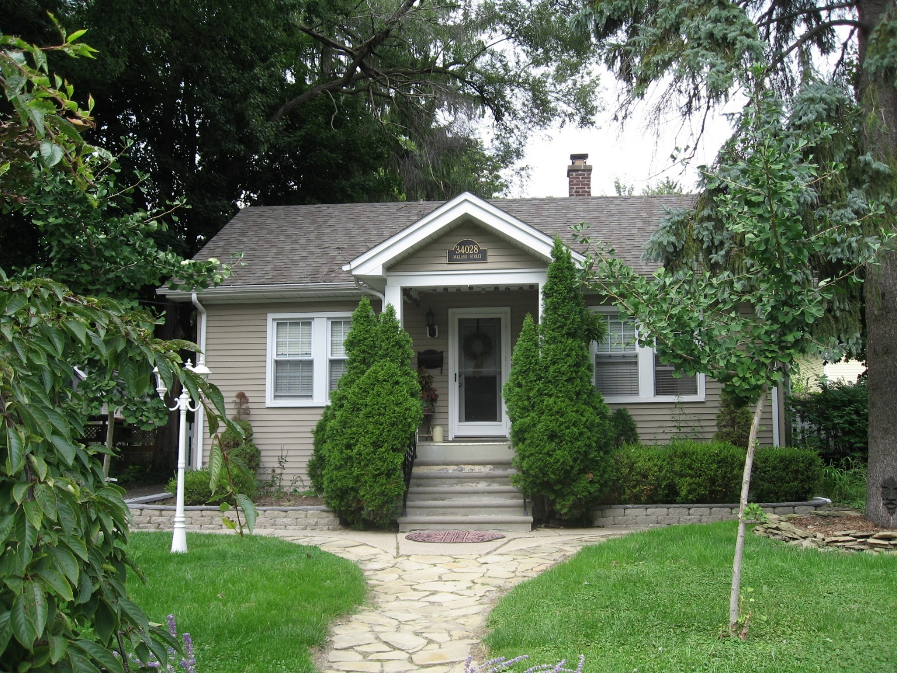
Example: Oakland Street, Farmington, 1915

Slide 52
Example: Oakland Street, Farmington, 1915
Step 1: Land Patent and Land Conveyances
After cross-referencing a map of Farmington with the patent map from the Family Maps of Oakland County, MI, I found that Richard Snell acquired the West ½ of the North East ¼ of Section 28 on April 1st, 1825. The First Land Owners of Oakland County book shows that Snell came from Niagara County, New York.
The Land Owners Maps of Historical Farmington Township shows a different picture for the original patent deed for the West ½ of the North East ¼ of Section 28- the patent deed went to Ezekiel Webb during 1824 but by December 31, 1824 Richard Snell had ownership.
1824- Ezekiel Webb
1824- Ezekiel Webb to Richard Snell
November 18, 1826 – Richard & Mary Snell to Arthur Power

Slide 53
Example: Oakland Street, Farmington, 1915
Step 1: Land Patent and Land Conveyances continued
Using landmarks such as the convergence of Grand River and Shiawassee, I’m able to find that the land where this house now stands was owned by M. Bottsford (Botsford) in 1857 according to the 1857 Plat Map for Oakland County.
A look at City Directories yields the following:
1939-40 Harley & Lucille Walters, children Valery and Gary. Harley works at Detroit Edison.
1941-42 Harley & Lucille Walters, 2 children. Harley works at Edison.
1945-46 Harley & Lucille Walters, 2 children
Jan 1945 - Harley Walters
Jan 1946 – Harley Walters
Jan 1947 – Harley Walters
1948 – Harley Walters
1949 – Harley Walters
1950 – Harley Walters

Slide 54
Example: Oakland Street, Farmington, 1915
US Federal Census
1930- Harley Walters, aged 25 and owned home, salesman for a public utility; Wife Lucille, aged 21; daughter Valery, aged 6 months.
1940- Harley Walters, aged 35, owned home and was in sales for a public utility (Detroit Edison). Both Harley and Lucille Walters completed high school. Daughter Valery was 10 in 1940 and in 4th grade.

Slide 55
Example: Oakland Street, Farmington, 1915
Land Conveyances and Property Ownership
1824- Ezekiel Webb
1824- Ezekiel Webb to Richard Snell
November 18, 1826 – Richard & Mary Snell to Arthur Power
1857- M. Botsford
1930 Harley & Lucille Walters (Census)
1939-40 Harley & Lucille Walters, children Valery and Gary. Harley works at Detroit Edison.
1941-42 Harley & Lucille Walters, 2 children. Harley works at Edison.
1945-46 Harley & Lucille Walters, 2 children
Jan 1945 - Harley Walters
Jan 1946 – Harley Walters
Jan 1947 – Harley Walters

Slide 56
Example: Oakland Street, Farmington, 1915
Land Conveyances and Property Ownership
1948 – Harley Walters
1949 – Harley Walters
1950 – Harley Walters
1982- Richard and Lynn Yezbick

Slide 57
Example: Oakland Street, Farmington, 1915
Who owned my property?
You probably see a couple familiar names in your history if you know any Farmington history. Dr. Ezekiel Webb was one of Farmington’s original founders. He was the first doctor in Farmington and also established the first post office, acting as postmaster delivering mail while practicing medicine. His house on Farmington Road is the only surviving original log cabin in Farmington. Although the land patent was in his name, he immediately transferred ownership to Richard Snell. According to Ruth Moehlman in her book, Heritage Houses of Farmington: If Walls Could Talk, Snell may have been a land speculator or land agent for Arthur Power.
Arthur Power, who bought the land from Snell, was the founder of Farmington. He was the first settler to come from New York and was heavily involved in land speculation. He was a Quaker who came with some of his sons from New York to scout out the territory before settling the whole family.

Slide 58
Example: Oakland Street, Farmington, 1915
Who Were These People? (cont.)
Harley Walters
Harley Walters was a kindred spirit – he loved history, especially Farmington history. Walters managed the Farmington branch of Detroit Edison, where he worked with customers on a variety of issues. A “Know Your Farmington Merchant” article in the Farmington Enterprise dated November 10, 1949 highlighted Walters. The article finished by sharing that if one were to invite Harley Walters to dinner, “…he likes steak and chicken but is prejudiced against cooked onions.”
Harley Walters also wrote a number of articles for the Farmington Enterprise about the history of Farmington. In an article from 1959, Walters writes about the history of the Webster house located at Liberty and Grand River which had just been torn down. In 1960, he wrote a four-part series about “Farmington Fifty Years Ago”. His knowledge was broad in scope as he also wrote about early Farmington history for the Enterprise.

Slide 59
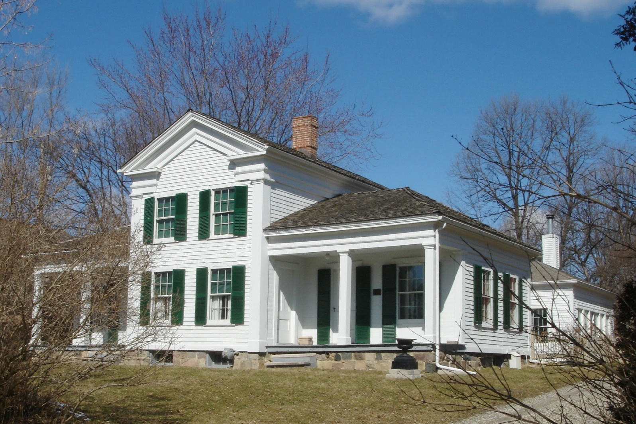
Example: Royal Aldrich House, 11 mile, Farmington Hills, 1842

Slide 60
Example: Royal Aldrich House, 11 mile, Farmington Hills, 1842
Step 1: Land Patent and Land Conveyances
After cross-referencing a map of Farmington Hills with the patent map from the Family Maps of Oakland County, MI, I found that “Esec Aldrige” was issued the patent deed to the South West ¼ of Section 14 on February 10, 1824.
Additional research in the First Land Owners of Oakland County book shows that the name was either Esee Aldridge or Esek Aldrich. So, we have three possible names for the individual who got the original land patent. There are other Aldrich land patent owners in the area, and the name of the house is the Royal Aldrich House, so Royal Aldrich was probably a descendent Esek/Esee Aldrich. We might find more as we continue to research. The book indicates Aldrich was from Ontario County, New York and that the date of the patent was October 12, 1822 for 320 acres.

Slide 61
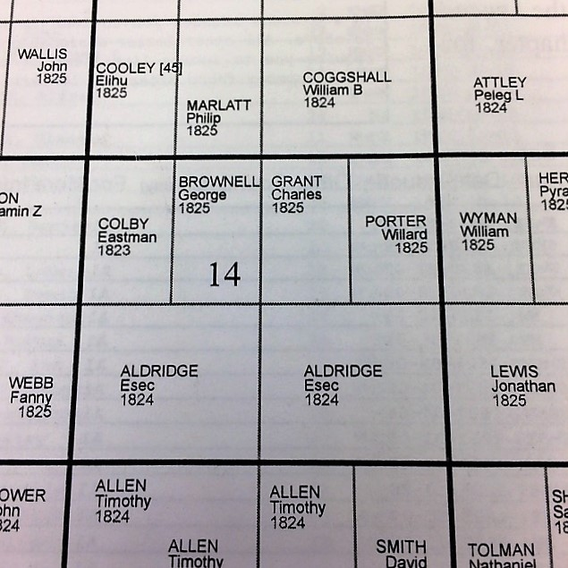
Example: Royal Aldrich House, 11 mile, Farmington Hills, 1842
Step 1: Land Patent and Land Conveyances

Slide 62
Example: Royal Aldrich House, 11 mile, Farmington Hills, 1842
Step 1: Land Patent and Land Conveyances
The Land Owners Maps of Historical Farmington Township shows only the original patent deed on the maps. On maps after that year, the section half owned by Aldrich appears blank. Although misleading, Aldrich still owned the property at this time.
By the 1857 Plat Map of Oakland County, Royal Aldrich is now the owner of the South West ¼ of Section 14. By this time Aldrich has built the house that now stands on the property.

Slide 63
Example: Royal Aldrich House, 11 mile, Farmington Hills, 1842
Step 1: Land Patent and Land Conveyances
Next, we will look at City Directories. For Royal Aldrich House, we have to look at the Farmington Township section of the directories.
1939-40 Fred and Vina Bade. Fred is a farmer.
1941-42 Fred and LaVina Bade. Fred is a farmer.
1945-46 Fred and Vina Bade.
Jan 1945 - Fred H. Bade
Jan 1946 – Fred H. Bade
Jan 1947 – Fred H. Bade
1948 – Fred H. Bade
1949 – Fred H Bade
1950 – Fred H Bade

Slide 64
Example: Royal Aldrich House, 11 mile, Farmington Hills, 1842
Step 2: Census Records
The 1930 census reflects Fred H. Bade owned the Royal Aldrich house and it was worth $15,000. He was born in Michigan with parents from Germany. In 1930, he was 65 and was a retired farmer. His wife, Vina was 63 year old New Yorker whose parents were German.
After researching in Heritage Homes of Farmington, I got a better background on who owned the house. I was able to look up the Bades and Aldriches in the census data on Ancestry.com.

Slide 65
Example: Royal Aldrich House, 11 mile, Farmington Hills, 1842
Land Conveyances
1824 Esek (Esec) Aldrich
*Royal was Esek’s son. Esek never settled in Michigan. Royal arrived before 1839.
1842 (or 1840) – Royal Aldrich builds home
1856 – Betsy Aldrich (Royal’s widow), who remarries briefly to Myron Tolman
1860 Myron and Jennett “Talman” (Jennett is Betsy)
1867 – Bruce and Alvin ( AKA Almeron) Aldrich (Royal & Betsy’s sons)
1870 – Almeron (Alvin) Aldrich
1877 - Alvin and Eva Aldrich
1879 – Frederick and Fredericka (Ratchel) Bade
1880 – Frederick and Ratchel Bade
1900, 1910, 1920, 1930, 1940 – Fred and Vina Bade
1939-40 Fred and Vina Bade. Fred, who is a farmer, is Frederick & Fredericka’s son.
1941-42 Fred and LaVina Bade. Fred is a farmer.

Slide 66
Example: Royal Aldrich House, 11 mile, Farmington Hills, 1842
Land Conveyances
1945-46 Fred and Vina Bade.
Jan 1945 - Fred H. Bade
Jan 1946 – Fred H. Bade
Jan 1947 – Fred H. Bade
1948 – Fred H. Bade
1949 – Fred H Bade
1950 – Fred H Bade
1950 – farmland subdivided
1961 – Mr. and Mrs. Donald Walker
1969 – Bill and Clara Flora
? - sold to Steve and Lynn Olsen

Slide 67
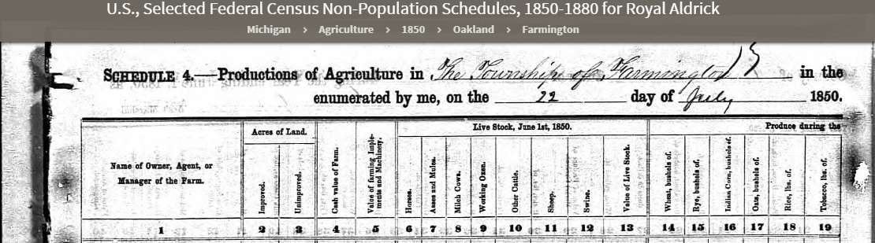
Example: Royal Aldrich House, Farmington, 1842
Improved Land: 112, Unimproved Land: 108, value $2500, value of farming equipment and machinery - $100 homes – 2, milk cows- 2, other cattle -2, sheep – 154, swine – 5, value of live stock $260, bushels of wheat – 440, bushels of indian corn – 350, bushels of oats - 25

Slide 68
Example: Royal Aldrich House, Farmington, 1842
Who Were These People?
Ruth Moehlman’s book provides two pages about the history of the Royal Aldrich house, providing us with good background information on the people who settled there. Although Esek Aldrich purchased the 320 acres at Eleven Mile and Orchard Lake Roads in 1823/24, he never settled there. His son Royal was the first to settle the land and build a house with his second wife Betsy. Like many of the pioneers who settled Farmington, the Aldriches were from Ontario, New York.
When Royal died in 1856, Betsy soon remarried Myron Tolman, though the marriage was short-lived. The two had a son. After Tolman left, it appears that Betsy was unable to care for her young sons and they went to live with relatives. Betsy stayed on the farm, and after her death in 1867 her oldest two sons by Royal Aldrich, Alvin (Almeron) and Bruce, took over the farm. Eventually Alvin married, and he bought Bruce out of his piece of the property.

Slide 69
Example: Royal Aldrich House, Farmington, 1842
Who Were These People?
The 1877 History of Farmington Township book throws a wrench in my theory that Esek Aldrich was Royal Aldrich’s father. Abraham Aldrich came to Farmington Township in 1825 with his sons Royal and Jesse. Perhaps Esee/Esek Aldrich was Jesse?
Other materials, particularly the book Farmington: 1824 – 1908 Brief Histories & Biographies, show that Royal and Jesse Aldrich didn’t settle in Farmington until 1834. Perhaps Esek is Abraham Aldrich’s brother? A census search on Esek Aldrich shows an individual in Farmington, Ontario, New York starting with the 1820 census. He continues to live there, never moving to Michigan.
Looking up Royal Aldrich, he was 35 in 1850, which explains why he wouldn’t have gotten the land grant.

Slide 70
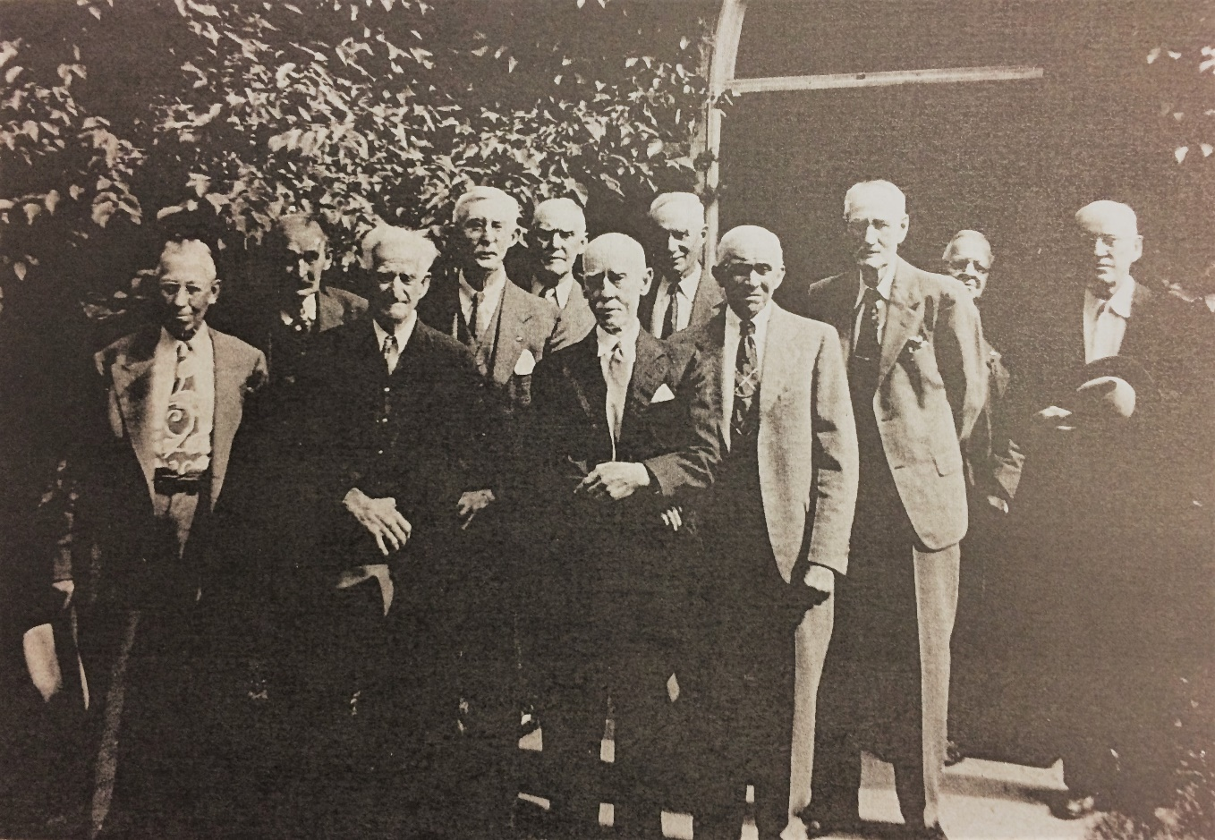
Example: Royal Aldrich House, Farmington, 1842
Who Were These People? Continued…
Just two years after Alvin Aldrich bought out Bruce Aldrich, the house, buildings and 80 acres of the property was sold to German immigrants Frederick and Fredericka Bade. The Banes had originally settled in Clarenceville. Their son, Fred H. Bade, was born in the Eber Durham house.
Fred H. Bade farmed the property on 11 mile as previous inhabitants had done since 1842. The younger Fred Bade and his wife owned the property until 1950, when the land was subdivided.*
Old Timers Club- Fred Bade is at the far left.

Slide 71
Questions?

